Slide 1
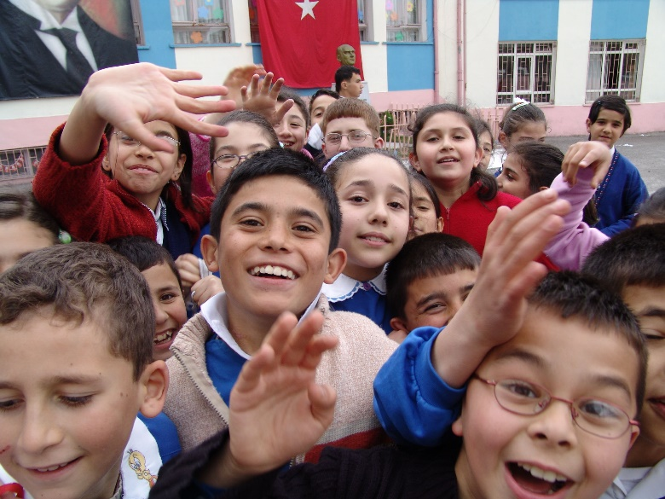
Bully Proof your School
Webinar by Ziptales.com

Slide 2
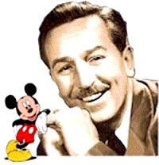
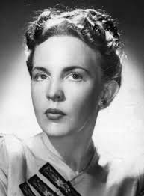
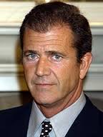
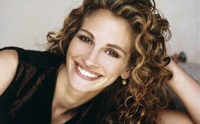
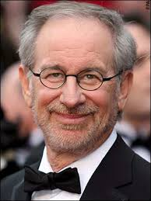
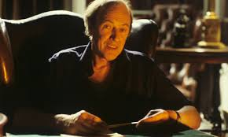
The Significance of Bullying
What do the following people have in common?
Woody Allen
Roald Dahl
Walt Disney
Mel Gibson
Clive James
Ruth Park
Julia Roberts
Steven Spielberg
Whitney Houston

Slide 3

That’s right - they were all bullied at school.
One in five children - world wide - are bullied on a regular basis.

Slide 4
This seminar covers the following:
What is bullying?
How common is bullying?
Why do bullies bully?
Who are the victims?
What are the effects of bullying?
Does your school have a problem?
Possible remedies to bullying
Recruiting the bystanders
A whole school anti-bullying policy
What about cyberbullying?

Slide 5
What is bullying?
Physical bullying
- punching, kicking, pushing, etc

Slide 6
What is bullying?
Verbal bullying
- name calling, teasing, racist
or sexist remarks

Slide 7
What is bullying?
Emotional bullying
- rumours, exclusion, mockery, etc

Slide 8
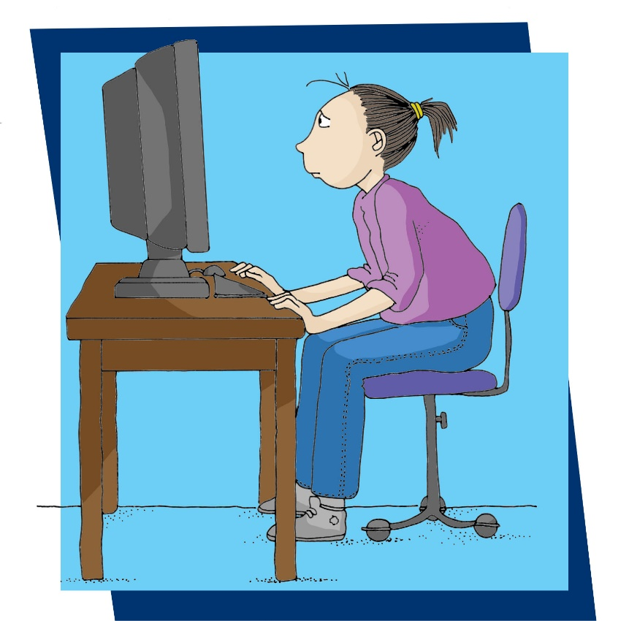
What is bullying?
Cyber bullying
- using social media sites,
emails or texting

Slide 9
Bullying is not
quarrelling.
It is deliberate hurt
It is persistent, and
It involves a power imbalance
between the person bullying and
the person bullied
“Bullying is repeated oppression, psychological or physical, of a less powerful person by a more powerful person or group of persons.”
(Dr Ken Rigby)

Slide 10
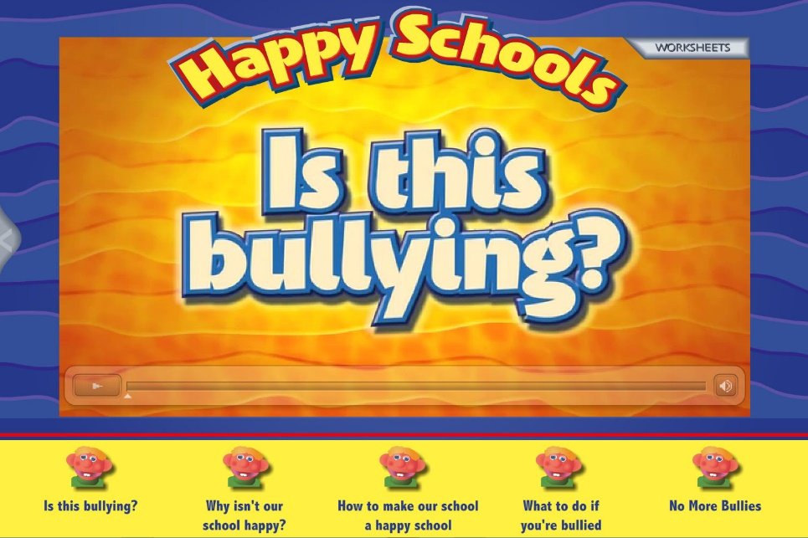
Activities
For lower primary students, the Happy Schools suite (Ziptales, Developing Library F-2).

Slide 11
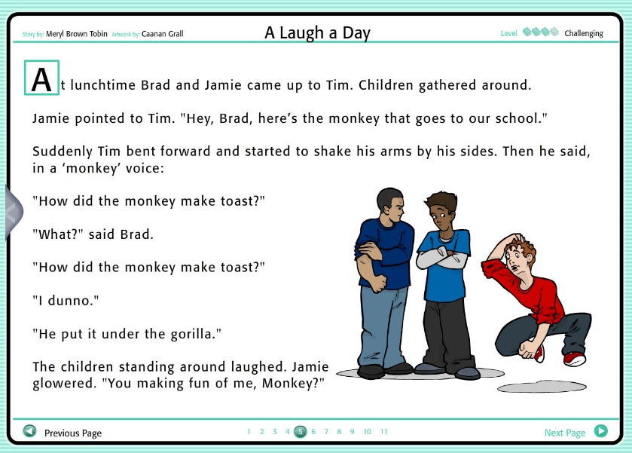
Activities
Stories on Ziptales with bullying themes:
Yrs 1 - 2: The Billy Goats Gruff, The Three Little Pigs and Snow White (Developing Library F-2).
Yrs 3 & 4: Danny’s New Glasses, A Laugh a Day, Jamie’s Secret and The New Girl (People stories).
Yrs 5 – 6: The Case of the Fancy Dress Fiend, The Case of the Battered Bully, The Case of the Crazy Codes. (Extending Library 3-6).

Slide 12
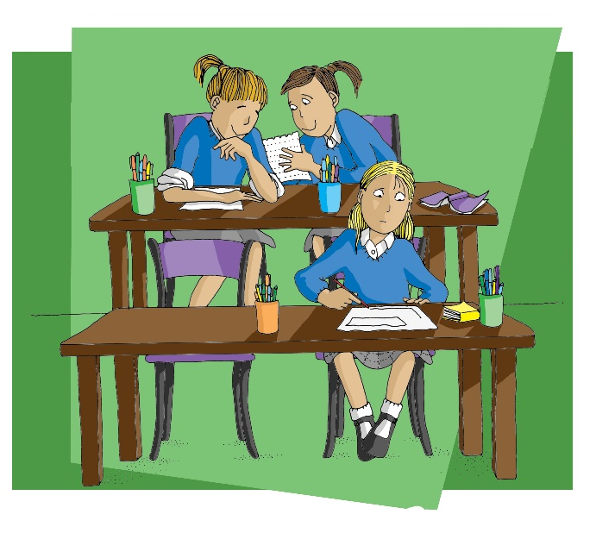
How common is bullying?
27% of children between Years 4 and 7 report being bullied regularly (1 in 4).
The peak is at Year 5 (32%).
In most cases (87%) other children are witnesses to what is happening.
(Source: www.bullyingnoway.gov.au)
One in seven children have a regular experience of bullying
Consistent rate between 10 and 15% of all children being subject to bullying at least once a week.
(Source: Rigby, Stop the Bullying, ACER)

Slide 13
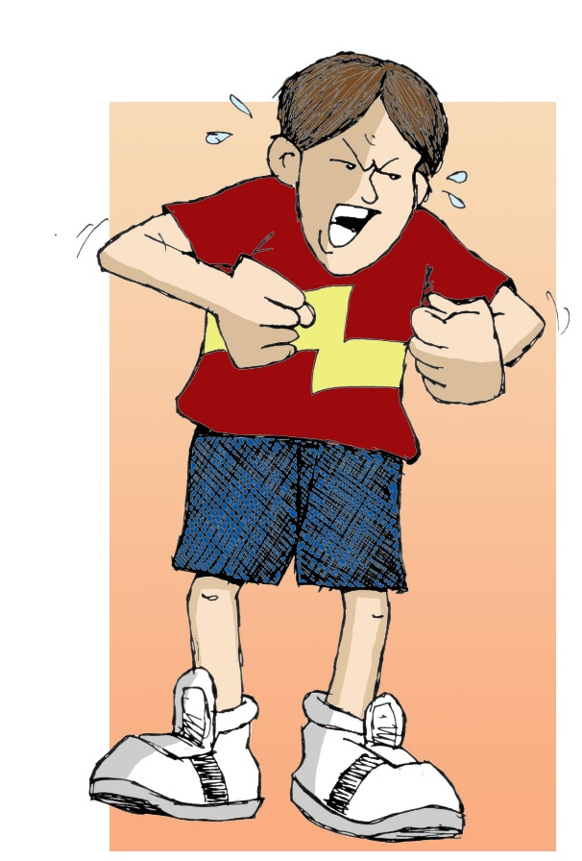
Why do bullies bully?
Damaged individuals? A secret feeling of weakness, or envy, or anger?
The psychology of the typical bully:
Narcissistic - they think everything revolves round their own needs
Impulsive - they act without thinking
Lacking in empathy - they don’t feel bad about hurting others
Aggressive and angry - wanting to lash out
(See Anne Vize, Research on Bullying, with this webinar)

Slide 14
Who are the children bullied?
What are the victims
of bullying like?
They may be different from their peers
They may be anxious and insecure
They may have low self esteem and be lacking in confidence

Slide 15
What are the effects of bullying?
It is here that we come to the sad part.
The list is a long one.
Physical problems
From cuts and bruises, through to stomach or headaches and rashes, loss of appetite, comfort eating, self harm

Slide 16
What are the effects of bullying?
Psychological problems
Being withdrawn and moody, irritable, aggressive, not wanting to go to school, difficulty sleeping, worrying obsessively, loss of motivation, low self esteem, panic attacks, relationship problems, depression - even suicidal thoughts

Slide 17
What are the effects of bullying?
Problems with study
Impaired concentration, decreased performance, and in some cases missing school either by truancy or fake illnesses

Slide 18

Bullies have a high incidence of antisocial behaviour (including criminal behaviour - 60% in one study), depression, aggression and other problems.
Activities
Peter’s Story (boy bullying)
Evita’s Story (girl bullying)
What is bullying?
NOTE: A link to download these will be sent after the webinar

Slide 19
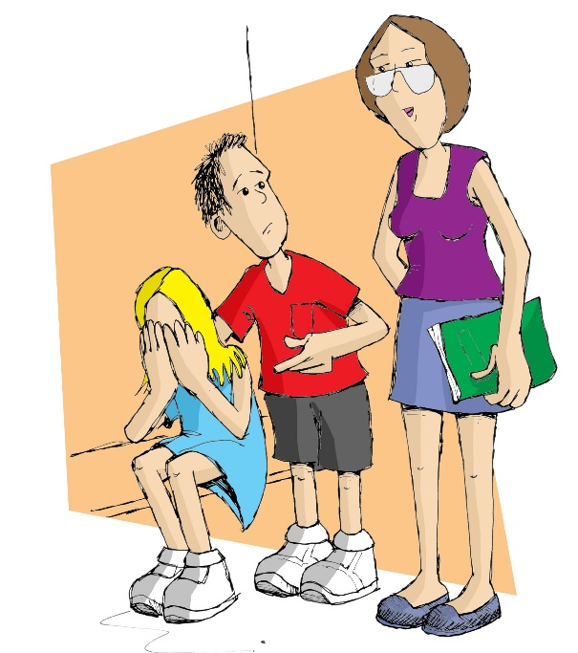
Does your school have a problem?
From Psychology Today:
The responses you get from your child's teacher include bland lip service such as:
• I didn't see it happening and I can't just take your child's word that it did.
• Kids will be kids, you know.
• This stuff just happens. It'll all blow over soon.
• Your child just needs to have a thicker skin.
• The child you are accusing of bullying is a [great] student … I just can't believe he would do such a thing. Are you sure your child isn't exaggerating?

Slide 20
Does your school have a problem?
Psychology Today (cont)
Parents whose children have experienced bullying … share this common experience of having their concerns downplayed by the very adults who are charged with keeping schoolchildren safe…
Bullying is missed by adults 96% of the time!
When classroom teachers tell concerned parents that they are not aware of bullying incidents taking place in their classroom, they are usually quite accurate.
Signe Whitson

Slide 21
Activities
Student survey
Where is it?
What would you do?
NOTE: A link to download these will be sent after the webinar

Slide 22
Possible remedies to bullying
Our research paper mentions the following methods:
The Restorative Justice Approach
The Friendly Schools and Families Approach
The No Blame Approach
The Method of Shared Concern
The Support Group Approach
The Peer Mediators Approach

Slide 23
The Method of Shared Concern
Developed by Dr Anatol Pikas - a ‘no blame’ approach.
Stage 1:
The teacher/counsellor gets the child who has been bullying (Z) in for a ‘chat’ - confronting him/her with the ‘problem’ that X is not happy. How can Z help change the situation for X?
Stage 2:
How has Z handled the challenge - is X feeling better?
Stage 3:
All the children - Z, X and Z’s support group.

Slide 24
The Support Group Approach
Barbara Maines and George Robinson - also a non-punitive approach.
Step 1 Fact finding - X is interviewed by the teacher/counsellor to find out what has been happening and who is involved.
Step 2 Support group discussions - X, Z, Z’s allies and some bystanders. No one is labelled or blamed. But X is not happy. How can we help X?
Step 3 Review - a week later, there is a check to see if things have improved.

Slide 25
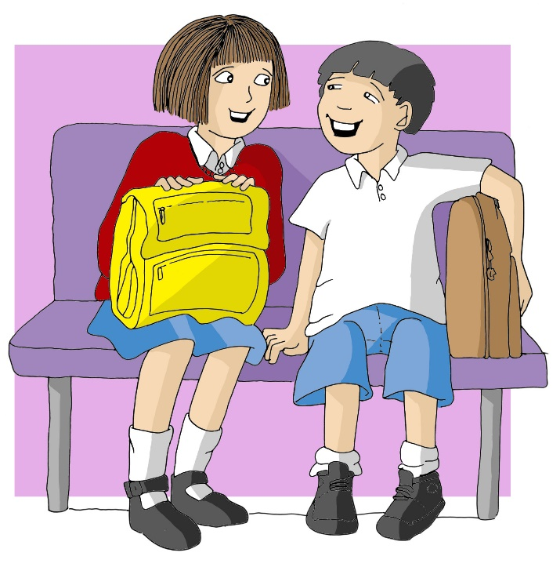
Mediation
NB: If there is a radical imbalance in the power relationship, and the victim is liable to be intimidated by the bully, this technique may not be a good idea.
Each party (Z and X) is able to speak without interruption. Then Z repeats what X has said. Then X repeats what Z has said. No comments or judgements are made or allowed. The two parties then talk about feelings - how X felt - and Z repeats this - how Z felt - and X repeats this. Finally, the discussion moves on to possible solutions. At the end, both agree on what will happen.

Slide 26
Activities
Managing Students’ Responses to Bullying
Research into Bullying
An expert opinion - a short 6 minute video by Dr Simone Heeney
NOTE: A link to download these will be sent after the webinar

Slide 27
Recruiting the bystanders
Why don’t the other children intervene and stop the bullying? They won’t act if:
They feel it’s none of their business
They feel it’s someone else’s job
(the teachers)
They think they might make matters worse
They feel nothing for the victim
They don’t know what to do
They are scared of the bully.

Slide 28
However, they will act if:
They feel responsible in some way
They feel empathy for the victim
They are convinced their action is the right one
They have a specifically designed task which they have practised.

Slide 29
Various responses are possible:
Heroic responses –
“I’ll stick up for him and tell the bully to get lost!”
Compassionate responses –
“I’ll tell her afterwards not to worry and that she’s a lovely person.”
Realistic responses –
“I’ll go and get a teacher.”

Slide 30
Activities
The Littlest Monster
Good Friends
The Heavy Coat
NOTE: A link to download these will be sent after the webinar

Slide 31
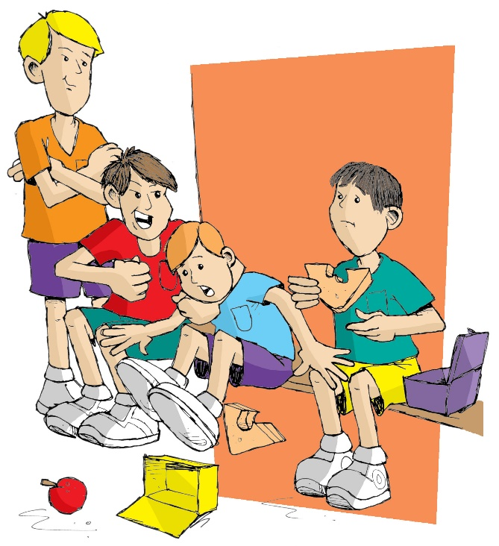
A whole school
anti-bullying policy
All the research affirms that schools need an antibullying policy.
See the Teacher Resources section of Happy Schools (Ziptales). Use the password ‘staff23’. One of the print outs is A Whole School Policy.

Slide 32

What about cyberbullying?
It involves
Use of Facebook, Instagram and other social network sites to harass
Use of chat rooms to leave nasty messages
Text messaging to ‘troll’* others
Email to abuse others
Misuse of games such as Minecraft, where it is possible to destroy others’ work
and so on.
*Troll: a person who sows discord on the Internet by starting arguments or upsetting people, by posting inflammatory messages … with the deliberate intent of provoking readers into an emotional response.

Slide 33
Cyberbullying:
It can reach a large audience
It can happen 24/7
Bullies can be anonymous
The offensive material can stay up after the bullying is over
It’s very difficult to stop.
UK research suggests that up to 70% of children and teens have been victims of online bullying. Up to 5% have engaged in self harm as a result. Some 20% deal with cyberbullying every day!
(Source: www.nobullying.com)

Slide 34
Suggestions:
Talk carefully about the issue
Ask children for examples of cyberbullying
Talk about the negative impacts of online bullying
Draw up a list of online etiquette for everyone to follow
We recommend the Method of Shared Concern - bringing into the open such behaviour, identifying it as a problem, and asking children to find solutions.

Slide 35
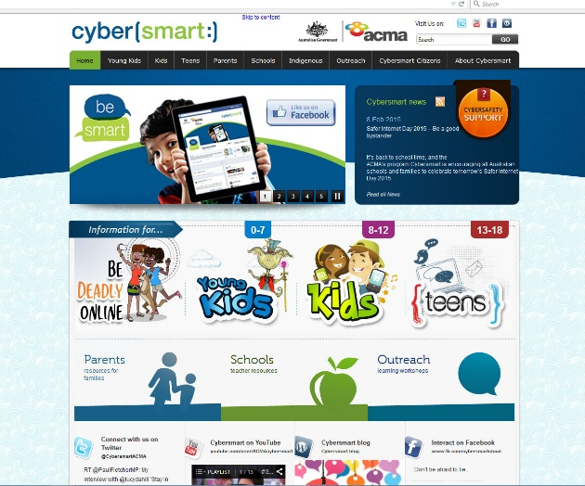
Websites such as Cybersmart have lots of ideas, such as:
Strategies your school can put in place now
Ensure every student, particularly those at risk, has a staff member they feel connected to, activities they feel a part of and that they feel valued as a member of the school community.
Encourage all students to be active bystanders by safely speaking up and telling teachers and other adults if they see or hear of bullying.
Book a Cybersmart Hero activity for upper primary students. The activity provides a live, online cyberbullying scenario which helps students to develop strategies to become effective bystanders.

Slide 36
Websites such as Cybersmart have lots of ideas, such as:
Strategies your school can put in place now
Book an Outreach Professional Development workshop for teachers and Internet Safety Awareness Presentations for students and parents. These are free to all schools.
Implement a cybersafety curriculum using the Cybersmart lesson plans.
View Tagged, an award winning locally made short film about cyberbullying and the impact on friendships. It comes with lesson plans and character reflections.

Slide 37
Websites such as Cybersmart have lots of ideas, such as:
Strategies your school can put in place now
Refer any student with social, academic or mental health difficulties to students support services.
(Source: www.cybersmart.gov.au)
Other resources are listed at https://education.gov.au/cybersafety-schools.

Slide 38
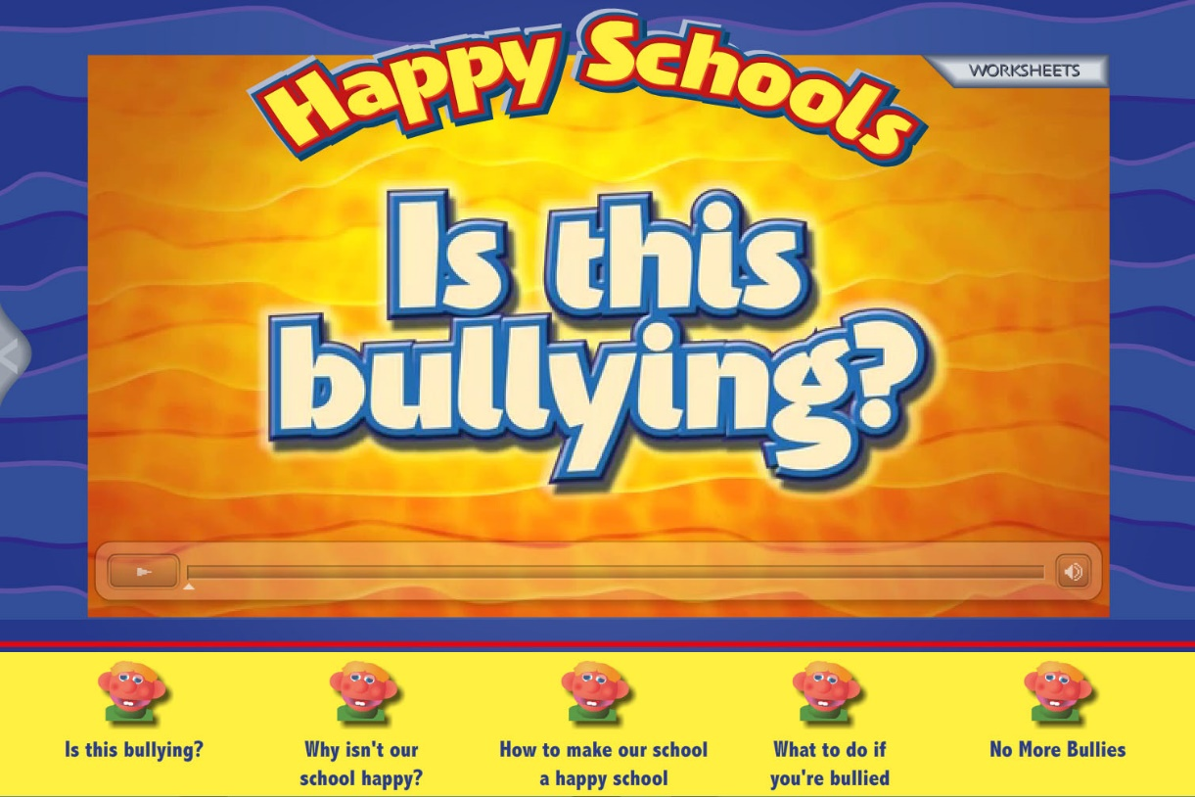
Remember that Ziptales has a resource called “Happy Schools” (Developing Literacy Library).

Slide 39
The stories which relate to bullying are the subject of a special printable extra sheet.
Downloadable resources:
Peter’s Story (boy bullying)
Evita’s Story (girl bullying)
What is bullying?
Student survey
Where is it?
What would you do?
Managing Students’ Responses to Bullying
Research into Bullying
An expert opinion
The Littlest Monster
Good Friends
The Heavy Coat
NOTE: A link to download these will be sent after the webinar

Slide 40
To access Ziptales “Happy Schools” and other resources, please go to www.ziptales.com and grab a FREE trial today!

