Slide 1
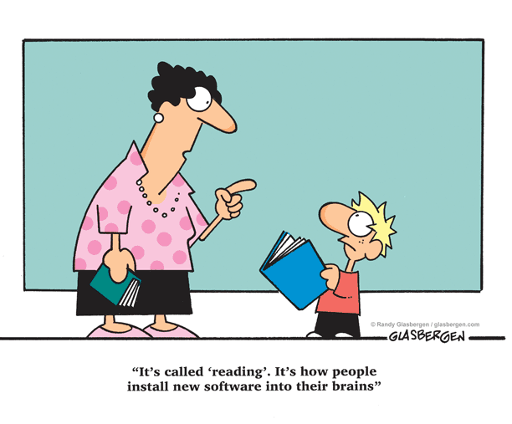
Fun with Phonics:
Using literature based activities to build phonological awareness
Webinar by Ziptales.com

Slide 2
Fun with Phonics:
Using literature based activities to build phonological awareness
Webinar by Ziptales.co.uk

Slide 3
Phonological awareness is the core component in learning to decode written text.
It involves three crucial skills:
  identifying syllabification – separating words into sound chunks called syllables
  recognising onset and rime – connecting the beginning sounds of words and syllables (onset) to the follow on sounds (rime)
  developing phonemic awareness – identifying the relationship between the letters of the alphabet and the sounds they make: the phonemes.

Slide 4
Curriculum References
Australian Curriculum Achievement Standards:
Prep/Foundation, students:
  identify the letters of the English alphabet and use the sounds represented by most letters.
  listen for rhyme, letter patterns and sounds in words.
Year 1 students:
  use knowledge of sounds and letters…to make meaning
  listen for and reproduce letter patterns and letter clusters.
Year 2 students:
  monitor meaning and self-correct using …phonic knowledge.
  listen for and manipulate sound combinations and rhythmic sound patterns.

Slide 5
Curriculum References
New Zealand Curriculum:
  use sources of information (meaning, structure, visual and grapho-phonic information) and prior knowledge to make sense of a range of texts;
  associate sounds with letter clusters as well as with individual letters

Slide 6
Why use a literature-based approach?
Literature-based instruction:
  promotes an enjoyment of reading
  builds vocabulary
  develops an awareness of the conventions of written text
  increases understanding of text structures and features
  encourages awareness of contextual cues
  links word segmentation to a variety of classroom learning experiences

Slide 7
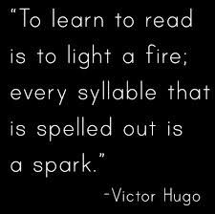
Skill 1: Identifying Syllabification
Learning to segment words by identifying syllables:
  speeds up the decoding process
  builds awareness and recognition of phonics
  promotes an awareness of syllable boundaries
  assists with spelling strategies

Slide 8
Syllabification Activities:
The Name Game
Read or view a focus text that has a character’s name in the title (e.g. one of the Ziptales Wendy stories in Storytime). Ask children to clap that character’s name - Wen-dy - identifying the number of syllable in the name (2).
Individual students then clap their own names (either first name only or both first name and surname) counting the number of syllables. (Record the range of these numbers!) Go to an open space (e.g. a basketball court) and line students up in a ‘starting’ area.
Hold up or call out a number generated from the previous activity and whoever has that many syllables in their name run to the finish line, bounce a ball as they say their name (in syllables) and then run back to the start.

Slide 9
Syllabification Activities:
Make a Syllable Group
Share a story that mentions days of the week (e.g. Ziptales Easy Reader Bob the Frog). Students clap or use instruments to count the number of syllables in each day of the week identifying the odd one out (Sat-ur-day).
Use the students’ birthdays to identify the number of syllables in the months of the year. Go to an open space (e.g. an oval, the gym) and call out one of the weekdays or months. Students are to make groups with the same number of people as the day/month. Each member has to then say a syllable of the word aloud.
(Note: Any remaining students join together and think of a day or month with the same number of syllables as the people in their group.)

Slide 10
Syllabification Activities:
Title Tap
Locate a hard copy of a fairytale or nursery rhyme anthology or use the home pages for the Ziptales Storytime or Timeless Tales.
Ask students to hold their hands flat underneath their chins and count the number of times their mouths tap their hands as they read the title of each story or rhyme (e.g. The – Three – Li – ttle – Pigs). Count the number of syllables in each title identifying the one with the most syllables and the one with the least number of syllables and read these rhymes/stories to the class.
fall
ing

Slide 11
Syllabification Activities:
Syllable Split
Use the rhythmic pattern from popular nursery rhymes to clap the syllables as the rhyme is being orally recited. Students then write the words with more than one syllable onto paper and cut each word into individual syllables. For example: Jack and Jill
wa | ter
pa | per
vin | e | gar
Extension Activity: The words with two syllables could be used to play a game of Memory.

Slide 12
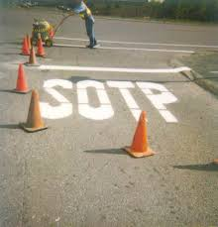
Skill 2: Recognising Onset and Rime
Most words and syllables are made up of sounds created from onset and rime or a combination of both.

Slide 13
Onset: the initial phonological unit of any consonant sound placed before a vowel in a syllable or word.
Rime: the letters that follow the onset, usually a combined vowel and consonant pattern, so in the word spoon – sp is the onset and –oon is the rime.
Learning about onset and rime helps children to:
  recognise and identify the common ‘chunks’ within words
  generate word families
  decode new words when reading
  improve their spelling

Slide 14
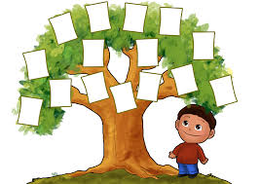
Onset and Rime Activities:
Word Family Tree
Use rhyming words from phonics based texts (e.g. Ziptales Easy Readers), poems or nursery rhymes to create a Word Family Tree. Read the story first, locate two or more rhyming words with the same letter pattern at the end of the word.
Then ask students to brainstorm words to add to the tree.
For example, words from the ‘op’ family using shop and stop from the Easy Reader Set 1 story I Wish – hop, top, chop, flop, drop, mop etc

Slide 15

Onset and Rime Activities:
Octofamilies
Share a focus text with an octopus as a main character (e.g. Ziptales Puppet Play The Octopus). Use a template of an octopus to create word families for focus rimes generated from relevant words in the story (e.g. sh/ip) writing the words on the legs of the octopus.
If possible write
ship, lip, hip, grip, chip, trip, clip & slip
on the legs of the octopus!!

Slide 16
Onset and Rime Activities:
Rhymes with Rimes
Select a focus word from a popular nursery rhyme e.g. ‘snow’ from Mary Had a Little Lamb.
Prepare flashcards with other words that either rhyme with the focus word (e.g. blow, grow, go, no) or have the same spelling pattern as the focus word (e.g. flow, now, cow).
Students use objects (e.g. a happy/sad face on either side of a paper plate) or actions (e.g. thumbs up, thumbs down) to indicate the words that do belong to the same word family as the focus word (i.e. blow, grow) and those that don’t belong (i.e. go, no, now, cow).

Slide 17
Onset and Rime Activities:
Rime Racing
Use the rhyme pattern from the Snow White repeated phrase ‘Mirror, mirror on the wall, who is the fairest one of all?’ (Ziptales Timeless Tales) to springboard the creation of a word family for ‘all’ – wall, fall, tall etc using magnetic letters or laminated letter cards.
Take other words from the story and break students into pairs or small groups giving them one word at a time to create their own word family (e.g. snow, white, queen, king).
Allocate a certain amount of time (e.g. 1 or 2 minutes) for them to generate as many words as possible.

Slide 18
Onset and Rime Activities:
Blend Bingo
Use words from stories with common blends (e.g. Ziptales Set 2 Easy Readers) to create bingo cards. Children can make their own bingo cards by selecting words that have a blend as an onset. The number of words can vary depending on the ability level of the group.
Blend Bingo
play | slide | flap | climb
blow | crab | fruit | spoon
slug | slip | drum | crazy
dream | sky | ground | brown

Slide 19
Onset and Rime Activities:
Shoebox Shuffle
Use shoeboxes to sort words into the same word families generated from a phonics based text (e.g. Ziptales Easy Reader e.g. Is it Fun?) Record relevant words onto flashcards (e.g. sit, pin, rip, lip, wig, pig etc). The students then take turns to sort the words into the appropriate box. Labels can be changed depending on the focus rime.
Once words are sorted, students can challenge themselves to write down other words that could go into each shoebox. Keep the boxes in a prominent place so words from other learning activities can be added. At the end of the week, count the number of cards in each box to see which one had the most.
-in family
-it family
-ip family
-ig family

Slide 20
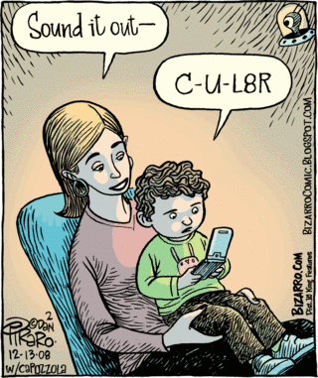
Skill 3: Building Phonemic Awareness
Phonemes: the sounds within a word. They are not necessarily counted by the number of letters in a word for example the word ‘bee’ only has 2 phonemes ‘b’ and ‘ee’.
Graphemes: written versions of the sounds. They can be formed from 1 letter (e.g. p, b); 2 letters (e.g. sh, th); 3 letters (e.g. tch) or 4 letters (e.g. ough).
Children with a well-developed phonemic awareness will be able to:
  recognise and identify rhymes
  blend and segment phonemes
  identify missing phonemes
  replace phonemes with other phonemes
  listen for and orally repeat phonemes
  connect graphemes with phonemes

Slide 21
Phonemic Awareness Activities:
Letter of the Day:
Use focus texts to springboard a discussion about the different sounds that the letters of the alphabet make. For example, in the Ziptales Storytime story Wendy and the Genie, the letter ‘g’ makes a ‘j’ sound - also known as soft ‘g’. Read the story then reread it asking students to keep an eye out for words with the letter ‘g’ that make a hard ‘g’ sound and a soft ‘g’ sound. Begin a Letter of the Day focus chart and add to it during other classroom activities.
Letter of the Day: g
Hard g big again great gave | Soft g genie huge magic giant

Slide 22
Phonemic Awareness Activities:
Sound of the Day:
Have a Sound of the Day focus. For example, use the Ziptales Timeless Tale Pinocchio to locate words that show the different letter patterns used to make a hard ‘c’ sound and record them on focus chart:
Sound of the Day: hard ‘c’
c | k | ch | ck
carpenter come coal coin | lifelike workshop looking drink | Pinocchio school | back locked tricks

Slide 23
Phonemic Awareness Activities:
Sound Sums
Locate compound words in focus texts to introduce students to the concept of breaking one word into two separate words e.g. the Ziptales Storytime story Wendy and the Pirate has the compound words ‘waterfall’ and ‘everyone’. Create a maths style sum to break up the words:
Discuss how you could break single words into separate sounds like a maths sum also:
water+fall= waterfall every+one= everyone
W+e+n+d+y = Wendy (5 sounds)
p+ir+a+te = pirate (4 sounds)

Slide 24
Phonemic Awareness Activities:
Counting Sounds
Count the sounds in words using concrete materials to separate each sound in the word e.g. counters on a frame.
The word ‘l-i-tt-le’ from The Three Little Pigs (Storytime)
As an extension, students could replace the counters with the individual sounds.
l | i | tt | le

Slide 25
Phonemic Awareness Activities:
Same Sound Snap
Read or view a nursery rhyme. Record the rhyming words and discuss how different letter patterns are used to make the same sound e.g. Old Mother Hubbard from Ziptales Rhyme Time: there/bare, fruit/flute, shoes/news, hose/clothes.
Create a snap game with laminated cards for students to play by matching words with the same end sound.

Slide 26
Phonemic Awareness Activities:
Simon Says
Use the familiar game Simon Says… to practise adding and removing sounds from words. For example, words from the Ziptales Set 2 story Have You Ever? - Simon Says say ‘snail’ without the ‘s’ sound (nail); ‘ball’ without the ‘b’ sound (all); ‘seen’ without the ‘n’ sound (see); ‘for’ but add a ‘t’ at the end (fort); ‘up’ but add a ‘c’ at the beginning (cup).
Extension Activities:
  Ask students to add or remove blends e.g. ‘stand’ without the ‘st’(and).
  Allow the use of nonsense words e.g. ‘spoon’ without the ‘n’ (spoo!).
  Encourage students to create their own Simon Says instructions for their classmates.

Slide 27
Phonemic Awareness Activities:
Simon Says
Use the familiar game Simon Says… to practise adding and removing sounds from words.
For example, words from the Ziptales Set 2 story Have You Ever? - Simon Says say ‘snail’ without the ‘s’ sound (nail); ‘ball’ without the ‘b’ sound (all); ‘seen’ without the ‘n’ sound (see); ‘for’ but add a ‘t’ at the end (fort); ‘up’ but add a ‘c’ at the beginning (cup).

Slide 28
Lost and Found
Whilst reading or viewing, record relevant words that could be used for sound replacement. For example, the word ‘bed’ from the Ziptales Easy Reader Let’s Get Wet:
For example if a child replaces the ‘b’ sound in ‘bed’ for an ‘s’ sound making ‘sed’, you can explain that although ‘sed’ sounds like a word we know, it is actually spelt ‘said’ with the ‘ai’ making a. short ‘e’ sound. You could create a chart ‘Special Sounds’ chart for words like this.
Extension Activity: This activity could be made more difficult by taking away middle and end sounds to get students used to letter/sound replacement e.g. the word ‘boat’ from the poem The Rainbow in Ziptales Rhyme Time:
My word is ‘bed’
But I lost the ‘b’ sound.
So I put in an ‘r’
And guess what word I found? Red
My word is ‘boat’
But I lost the ‘oa’ sound.
So I put in ‘ea’
And guess what word I found? beat

Slide 29
Phonemic Awareness Activities:
Same Sound Sentences
Locate examples of simple alliteration in texts e.g. the nursery rhyme Sing a Song of Sixpence; the Ziptales Easy Reader Set 3 story Charlie the Chatterbox. Students experiment writing sentences, poetry or tongue twisters using a specific beginning sound or blend to experiment with alliteration.
Extension: Identify the use of assonance in a variety of texts e.g. the nursery rhyme - Row, Row, Row Your Boat; the Dr Seuss book Hop on Pop – ‘Mr. Brown is out of town’. - the Ziptales Rhyme Time poem The Wind – ‘when the trees bow down their heads’. Students create simple texts that demonstrate the repetition of a focus sound.

Slide 30
Phonemic Awareness Activities:
Sound Sort
Read a focus text paying attention to words that share the same sound e.g. long ‘e’ sound. Record the words and at the end of the story, sort them into common sound groups e.g. the chart below uses words generated from The Three Little Pigs (Ziptales Storytime).
‘ee’
three, bee
tree
‘ey’
chimney, monkey
Long ‘e’ sound
‘e’
me, he, she
because
‘y’
happily, puppy
‘ea’
easy, leave, really, eat

Slide 31
Conclusion
Fostering an enjoyment of reading whilst establishing the building blocks of decoding text can instill long-lasting effects on a young learner.
Using a literature-based approach not only enriches the learning experience for students, but also establishes an ideal platform for developing phonological awareness in your students.

Slide 32
Questions and Answers…

Slide 33
To access Ziptales suite of Phonic based texts as mentioned, please go to www.ziptales.com and grab a FREE trial today!

Slide 34
To access Ziptales suite of Phonic based texts as mentioned, please go to www.ziptales.co.uk and grab a FREE trial today!

