Slide 1
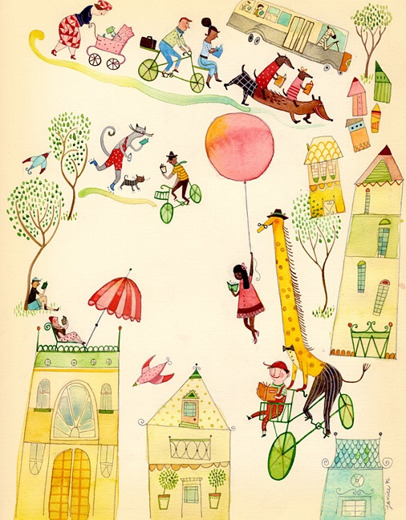
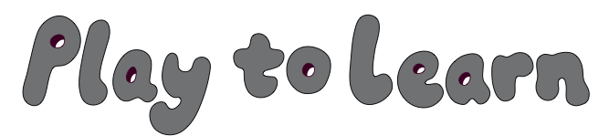
Building Literacy in the Early Years

Slide 2
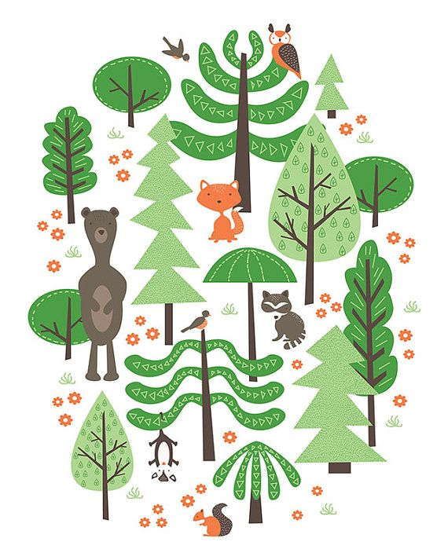
In this webinar we will explore:
Different types of play
Pretend play development
Pretend play and links to language and learning
Play based curriculum – findings from local research
Defining types of play

Slide 3
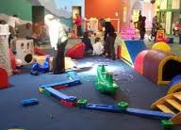
Gross Motor Play
Large muscle movement play - eg running, climbing, rolling
Physical activity & active play are closely linked to gross motor play
Improved balance
Increased strength
Better postural control
Increased self-esteem

Slide 4
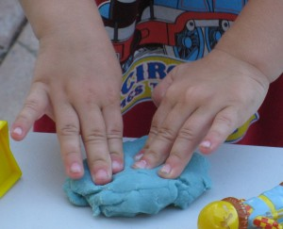
Fine Motor Play
Small muscle movements of the hands – eg threading, drawing, play dough
Required daily, practised daily
Increased hand and finger strength
Fine motor skill development
Increased self-esteem
Handwriting preparation

Slide 5
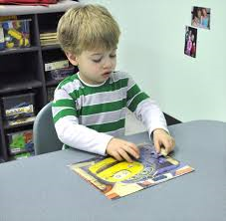
Visual-Perceptual Play
Visual tasks, perception skills - eg puzzles, shape matching games, cards
Recognition of shapes
Recognition of letters (pre-literacy skills)
Recognition of colours
Memory improvement
Sense of accomplishment

Slide 6

Auditory Play
Hearing and listening skills – eg ‘I spy’, listening games
Concentration
Attention
Phonological awareness
Hearing ‘mother tongue’
-semantics, pragmatics, phonology,
syntax, morphology

Slide 7
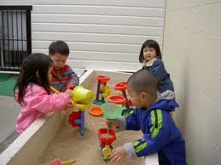
Sensory Motor Play
Combination of fine and gross motor play, with an added sensory element
For example, swinging on swings, playing in mud, water or sand
Increasing co-ordination
Increased balance
Body awareness
Increased self-esteem

Slide 8
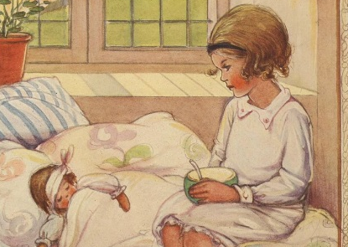
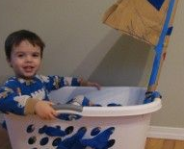
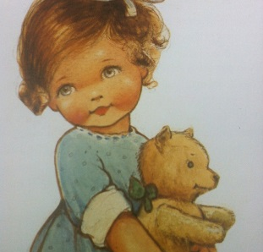
Pretend Play
Imposing meaning on imagined things or objects – as if they were real
Using an object and pretending it is something else eg using a box as a bed
Attributing properties to objects eg “My doll is sick!”
Referring to absent or imaginary objects eg “Let’s go to the market.”

Slide 9
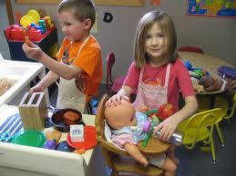
In pretend play, children may play with toys as well as unstructured
objects like boxes, cloth and natural materials
Benefits:
Increased language use
Increased social competence
Problem solving skills
Self-regulation
Increased understanding of narrative

Slide 10
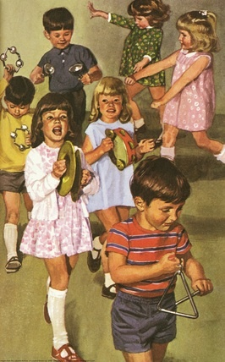
Development of Play
Play scripts
Logically sequencing play actions
Using objects as something else
Social interaction
Role play
Doll/Teddy play

Slide 11
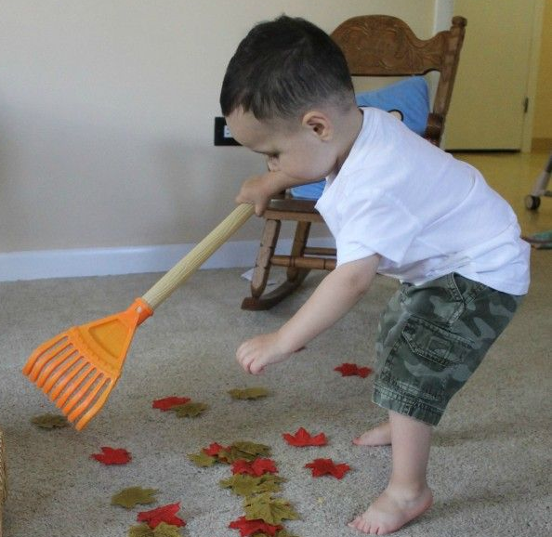
Play Scripts
Play scripts begin with children re-enacting what they know
Re-creating stories about the child’s life
These play activities help to build a sense of who they are
For example: sweeping the floor, washing the dishes, fixing the car
Complex play scripts use characters from
stories, movies and books intertwined with
the child’s own ideas
Developing play scripts will copy direct storylines
as seen in movies and books

Slide 12
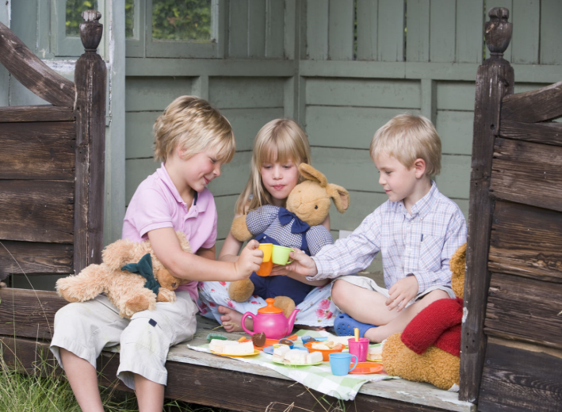
As play becomes more complex, children will
add problems to the play
Play will go on longer
It may carry over a number of days/weeks
Often additional characters will be added,
to negotiate with and further develop the script

Slide 13

Sequences of Play Actions
Play needs a logical sequence
Play needs flow
Play is often repetitive and reoccurs throughout scenes
- eg having many cups of tea at a tea party
Logical sequencing occurs when two actions are linked together and ‘make sense’
- eg feeding a baby and putting her to bed
Early development of play narratives

Slide 14
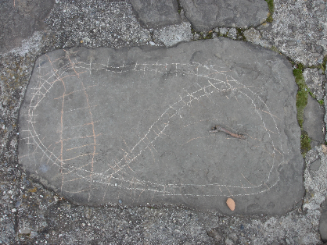
Using objects as something else
Using symbolic objects is strongly related (in the
research) to language acquisition
Children logically connect objects eg socks and shoes
When using objects to represent something else, children will pick something
that looks similar eg a box for a bed
As skills develop, children further vary the objects they use eg shoe as a phone

Slide 15
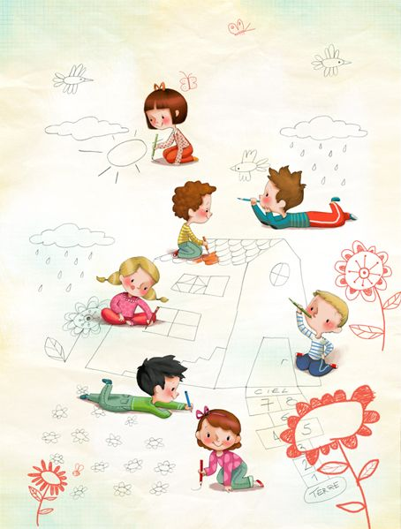
Social Interaction
Pretend play can be solitary or social
Social play is more demanding
Co-operation and negotiation skills become important
Children need to learn to ‘read’ the play situation
Social discourses become apparent

Slide 16
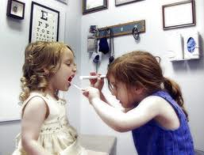
Role Play
Role play starts with imitation
It is a complex skill to stay in the same character
for the duration of the play
It requires children to think about how someone else behaves
Props may be needed, actions may differ and play scenes will change

Slide 17

Doll/Teddy Play
Children impose a character onto their toy
How Teddy feels and talks is separate from the child
This play allows Teddy to do things the child
hasn’t done yet
Important for understanding other points of view

Slide 18
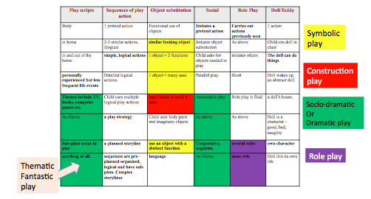
A Play Matrix

Slide 19
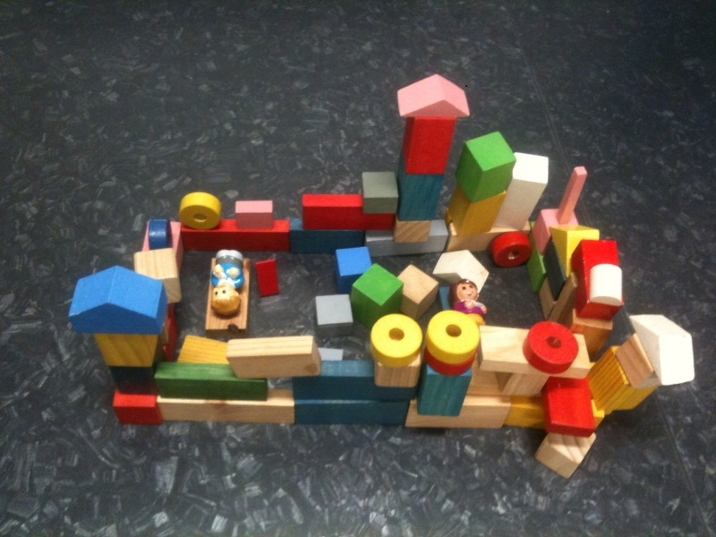

Slide 20

Play and Literacy
Language is the basis of literacy
Curriculum focus on listening, reading,
writing, viewing, speaking and creating
Pretend play and literate behaviour are linked:
Narrative Competence
Organisation of thinking (logical sequencing)

Slide 21
Play and Literacy – The Process
Children tell stories about themselves
Children tell fictional stories
Children create problem-solving narratives
Students’ narrative abilities develop
Students tell whole stories
Students master the grammar of stories

Slide 22

Benefits of play for later schooling
Reading social situations
Negotiation skills
Thinking through concepts
Understanding roles
Using language to communicate ideas

Slide 23
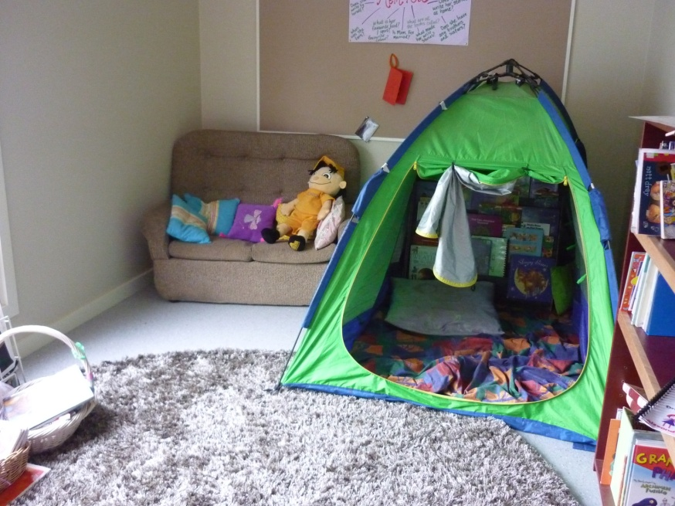
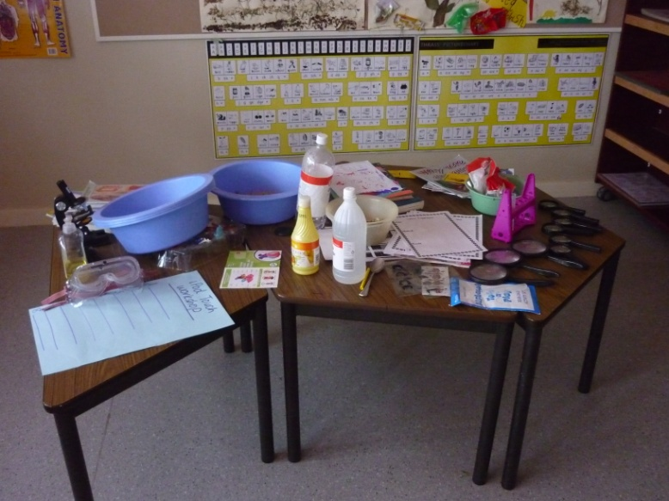
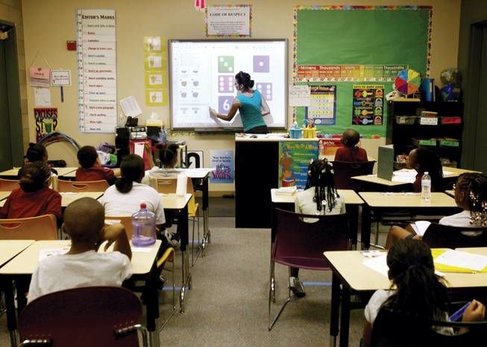
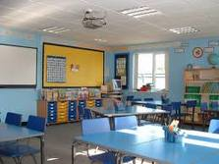
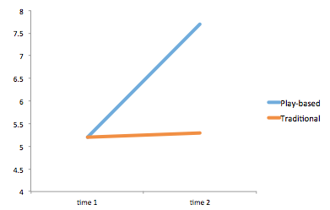
Field Research in Play Outcomes
Play-based curriculum
Traditional Curriculum

Slide 24
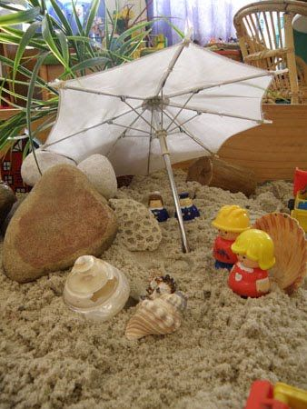
Signs that play is needed
Poor language
Unorganised
Low level of story comprehension
Difficulty writing stories
Provide minimal answers to questions
Difficulty predicting what will happen in texts
Difficulty understanding meaning in texts

Slide 25
Thank you for attending this webinar.
For more, goto www.ziptales.com (Australia and NZ)
Or
www.ziptales.co.uk (UK and Europe)

