Slide 1
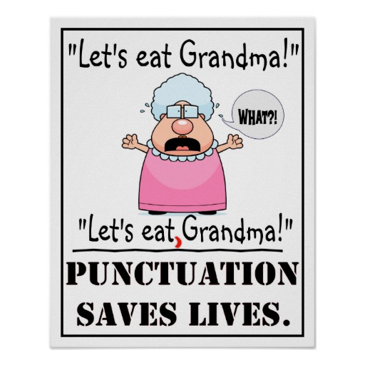
PUNCTUATION WITHOUT PAIN
A WAY TO TEACH PUNCTUATION
USING GAMES AS WELL AS INSTRUCTION YEARS 3-6
Webinar by Ziptales.com

Slide 2
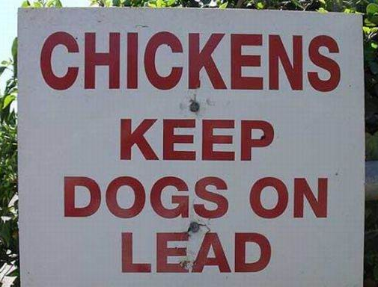
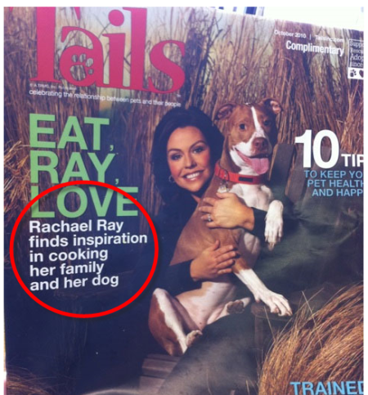
WHY PUNCTUATE?
I like cooking, my grandmother and my dog.
I like cooking my grandmother and my dog.
You don’t think people could be that foolish?

Slide 3

What are the following punctuation marks:
dinkus
crotchet
paraph
asterism
fleuron
caret
tilde (or twiddle)
dingbat ?
The answers are on the last slide of this presentation.

Slide 4


DO WE HAVE TO TEACH IT?
Know that word contractions are a feature of informal language and that apostrophes of contraction are used to signal missing letters. (Australian Curriculum, Year 3)
Recognise how quotation marks are used in texts to signal dialogue, titles and quoted (direct) speech. (Australian Curriculum, Year 4)
Understand how the grammatical category of possessives is signalled through apostrophes and how to use apostrophes with common and proper nouns (Australian Curriculum, Year 6)
Understand the uses of commas to separate clauses. (Australian Curriculum, Year 6)
Uses a range of text conventions, including most grammatical conventions, appropriately and with increasing accuracy. (New Zealand Curriculum, Level 3, Language features)

Slide 5
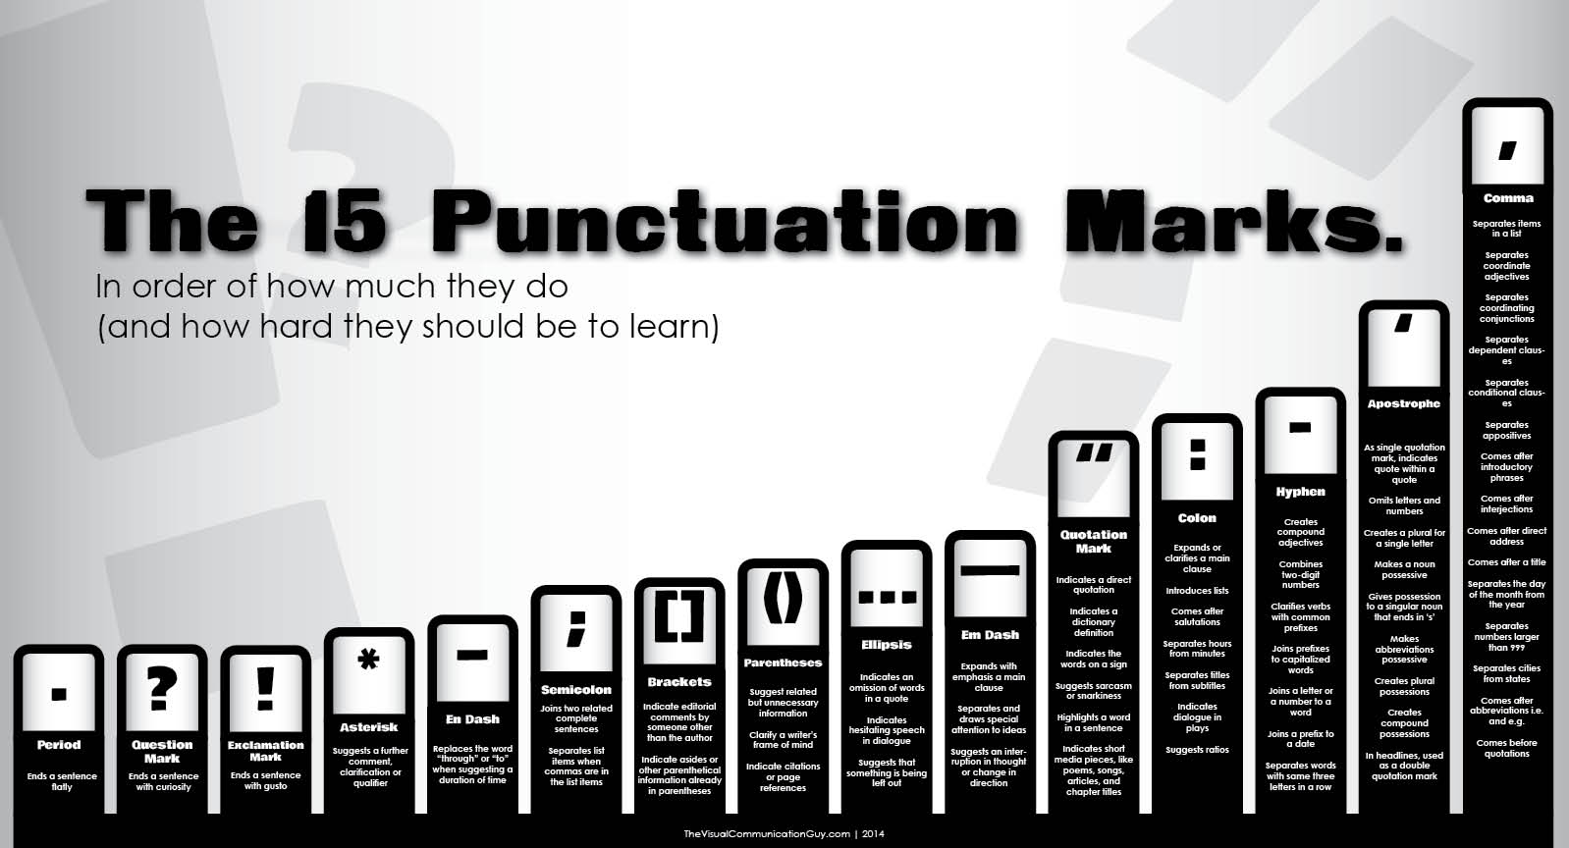
But which punctuation?
  Junior primary:
  Full stop, capital letter, question mark and comma.
  Middle primary school:
  Apostrophe, exclamation mark and quotation marks.
  Senior primary:
  Parentheses/brackets, colons, semicolons, hyphens, ellipsis and the en/em rule.
  For en/em rules, see instructions in separate Games document.

Slide 6
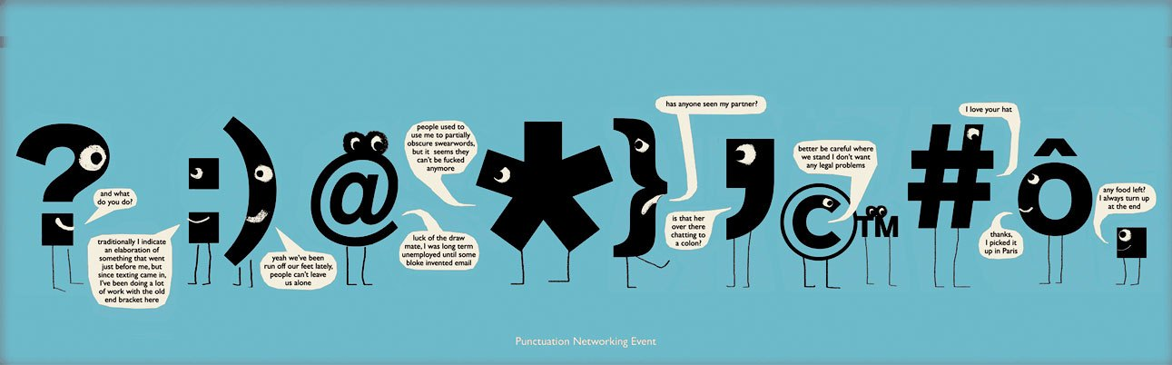
Why do we call it punctuation?
“Punctuation” was based on which root word? The Greek for
punch
point
pun
pull
?

Slide 7
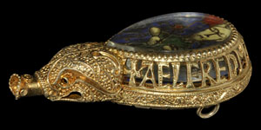
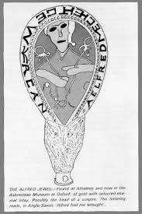
A SHORT HISTORY OF PUNCTUATION
(1) THE UNREGULATED WILDERNESS OF
THE ANCIENTS
In the early days of the English language, there
was no punctuation.
AELREDMECHEHTGEWYRCAN
It’s in Old English. But … there are no spaces, no punctuation marks, and every letter is a capital. With spaces, we read:
AELFRED MEC HEHT GEWYRCAN
Alfred has ordered me to make [this].
An English inscription (c878AD):
The famous Alfred Jewel.

Slide 8
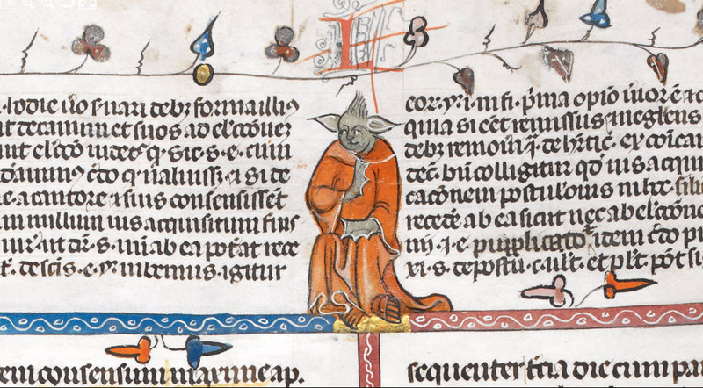
(2) THE FIRST REFORM:
SEPARATION OF WORDS
In the beginning, reading and writing was for the privileged few. There was little need to ‘make things easy’.
Paper was precious. Every part of the page was filled with words and pictures. Texts were very hard to read.
So a ‘reform’ was introduced - spaces between words.
Medieval Monsters

Slide 9
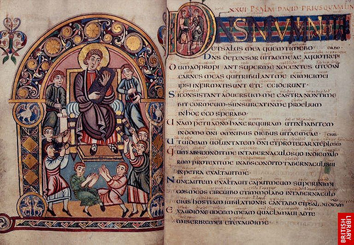
Here’s what old texts with spaces looked like.
A simple idea, but essential.
Vespasian Psalter

Slide 10
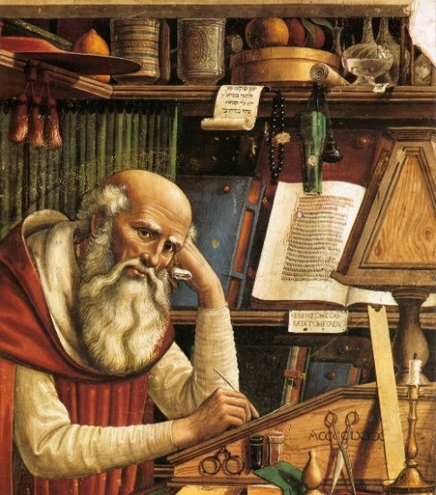
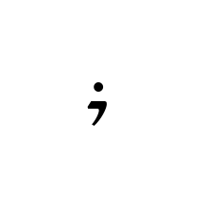
(3) THE SECOND REFORM: PERIODS AND PAUSES
In the Middle Ages, scribes were making the job easier by adding in ‘points’ (punctuation). They were:
The punctus versus (‘turned’ point) - we now call this a full stop (or period)
The punctus elevatus (‘rising’ point) - we now call this a comma
The punctus interrogativus (interrogation or question point) - we now call this a question mark
The punctus exclamativus (exclamation point) - we now call this an exclamation mark
Here is the punctus versus, or ‘full stop’, (c12 century):

Slide 11
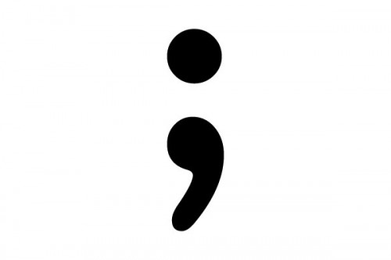
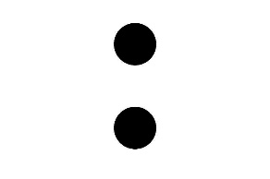

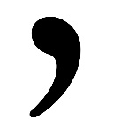
With the coming of the printing press (1450 onwards), these ‘points’ settled into the forms we now know.
At one time, scholars tried to impose a musical notation schema on the different ‘points’…
One beat Two commas Two semicolons Two colons
1 measure 2 4 8
But this was impractical.

Slide 12

THE FULL STOP
The full stop constitutes 45% of all punctuation.
Randolph Quirk, A Comprehensive Grammar of the English Language (1985)
The Americans call them a ‘period’ - from the Greek periodus (‘period of time’). We call them ‘full stops’ after the British printer’s term.

Slide 13
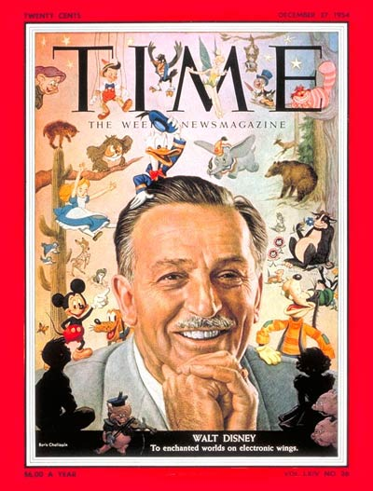
THE RULES:
Only one:
You must always use a full stop to mark the end of a sentence.
Walt Disney was born in 1901 and died in 1966. He won 22 Academy Awards. His corporation, with assets of 75 billion, is one of the most successful in the world.

Slide 14
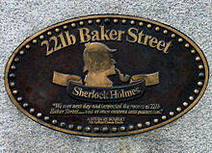
For a long time, it was considered essential to mark abbreviations, as in
Mr. S. Holmes
221b, Baker St.,
London, N.W.1,
United Kingdom
But … by the end of the
twentieth century:
Mr S Holmes
221b Baker St
London NW1
United Kingdom
The key principle was clarity. Did the name and address make sense without the fussy full stops?
Modern usage also disapproves the overly complex use of stops - in acronyms (ASIO, FIFA) and abbreviations (Mr, Dr).
Professor David Crystal, Making a Point: the Pernickety Story of English Punctuation (St Martin’s Press, 2015), Britain’s foremost expert, and author of the Cambridge Encyclopedia of the English Language

Slide 15

Activities to teach or revise full stops
(1) STOP me now (EASY): two volunteer children are chosen to come out the front. A starts talking, slowly. Whenever he comes to the end of a sentence, B holds up the full stop sign. If B misses one, the person who corrects becomes B. See instructions
(2) Spot the dot (EASY): unpunctuated text must be completed. See instructions
(3) Scrambled sentences (CHALLENGING): a game in which words have to be put together and full stops added. See instructions
(4) Skill Builders - there is a special lesson on full stops (in Skill Builders), with worksheets.
(5) Specialised English Lessons (SEL) - the following units are devoted to punctuation: What is punctuation? Why punctuate? Making it read better; Refining editing skills.

Slide 16
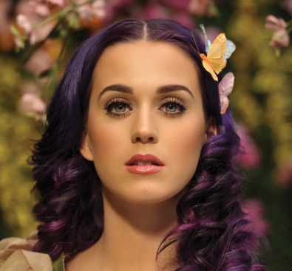
CAPITAL LETTERS
Capital letters are normally bundled in with the other ‘points’, because without them texts are confusing:
katheryn elizabeth "katy" hudson (born october 25, 1984), known professionally as katy perry, is an american singer, songwriter, and actress. after singing in church during her childhood, she pursued a career in gospel music as a teenager. perry signed with red hill records and released her debut studio album katy hudson in 2001, which was commercially unsuccessful. she moved to los angeles the following year to venture into secular music after red hill ceased operations. after being dropped by the island def jam music group and columbia records, perry signed a recording contract with capitol records in april 2007… perry has received many awards, including four guinness world records, and been included in the forbes list of "top-earning women in music" (2011–15). throughout her career, she has sold 11 million albums and 81 million singles worldwide. (wikipedia, with apologies)
C
The capitals signal important people or items.

Slide 17
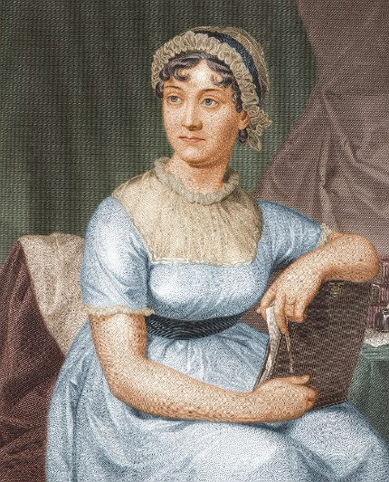
In times gone by, the practice was different.
For instance, Robinson Crusoe (1719):
I consulted several Things in my Situation which I found would be proper for me, first Health, and Fresh Water … Shelter from the Heat of the Sun …Security from ravenous Creatures, whether Men or Beasts…
And even Jane Austen (1818):
Mrs. Clay’s affections had overpowered her Interest, & she had sacrificed for the Young Man’s sake, the possibility of scheming longer for Sir Walter; she has Abilities however as well as Affections… (Persuasion, first handwritten draft)
But by the mid 1800s we had arrived at our current conventions.

Slide 18
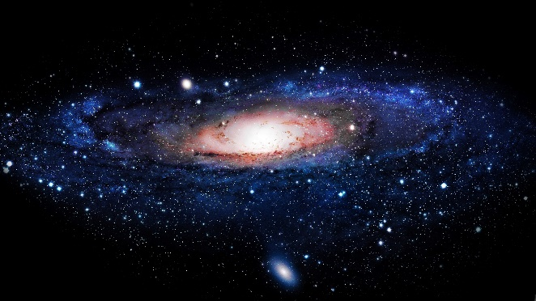
THE RULES:
(1) A sentence must always begin with a capital letter.
We see the Milky Way as a band of stars stretching across the heavens. The sun, all the stars we see in the sky, and 100,000 million others, make up a vast group of stars called the galaxy. The galaxy formed some 7,500 million years ago. It is 100,000 light years across.

Slide 19
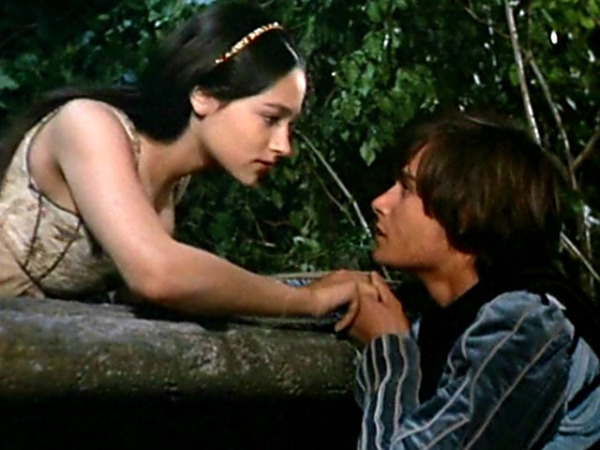
(2) All proper nouns must have a capital letter.
Romeo and Juliet was a tragedy written by William Shakespeare early in his career about two young star-crossed lovers whose deaths ultimately reconcile their feuding families. It was among Shakespeare's most popular plays during his lifetime and, along with Hamlet, is one of his most frequently performed plays. … Romeo and Juliet has been adapted numerous times for stage, film, musical and opera venues. In the 20th and into the 21st century, the play has been adapted in versions as diverse as George Cukor's 1935 film Romeo and Juliet, Franco Zeffirelli's 1968 version Romeo and Juliet, and Baz Luhrmann's 1996 MTV-inspired Romeo + Juliet. (Wikipedia)

Slide 20
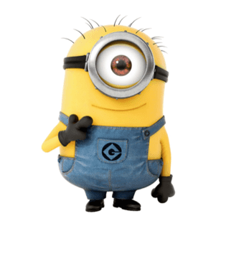
(3) The pronoun I must always have a capital letter.
I came.
I saw.
I conquered.
I hate brussel sprouts, but I also hate boiled cabbage and most of all I hate soggy lettuce.

Slide 21
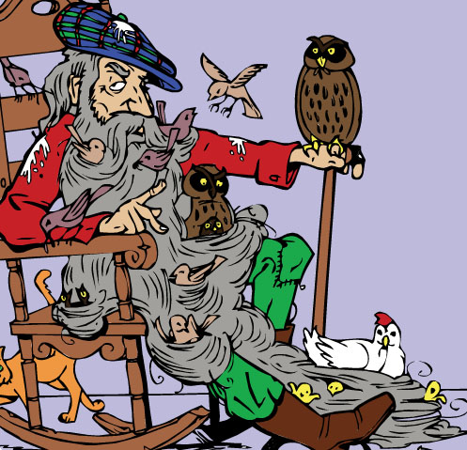
(4) Lines in poetry should all begin with a capital letter.
There was an old man with a beard
Who said “It is just as I feared,
Two owls and a hen,
Four larks and a wren,
Have all built their nest in my beard.”
(Edward Lear)

Slide 22
Activities to teach or revise capital letters:
Add a cap (EASY): this game involves scrambled cards with a variety of words, including common and proper nouns. See instructions
(2) Spot the proper noun (EASY): this requires a set of cards on which both common and proper nouns appear. See instructions
(3) Skill Builders - there is a special lesson on Capital letters in the Skill Builders suite.

Slide 23

COMMAS
The word comes from the Greek komma.
A comma is to mark a short pause. This is the medieval punctus elevatus - the ‘point’ that indicates a rising intonation.
It is essential.
Commas represent 46% of all punctuation marks.
Randolph Quirk, A Comprehensive Grammar of the English Language (1985)

Slide 24
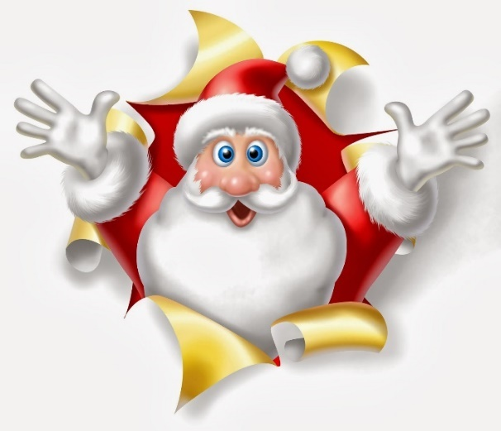
THE RULES:
(1) A comma is used to show a pause.
Take a deep breath, and try again.
(2) A comma is used to mark off an introductory phrase.
Once upon a time, there were twelve beautiful princesses.
(3) A comma is used to separate clauses in a sentence.
Everybody's favourite clause is the Santa Clause, which needs no further definition.

Slide 25
(4) A comma is used to separate items in a list.
When you go to the supermarket please bring me back eggs, milk, honey, bread, spaghetti and the newspaper.
NB The ‘Oxford’ or ‘serial comma’ breaks this rule. But it is quite controversial and I would not suggest teaching it to children.
See information in separate Games document
(5) A comma is used before or after direct speech.
The teacher called out, “Where have you been?”
Any short pause means a comma.

Slide 26
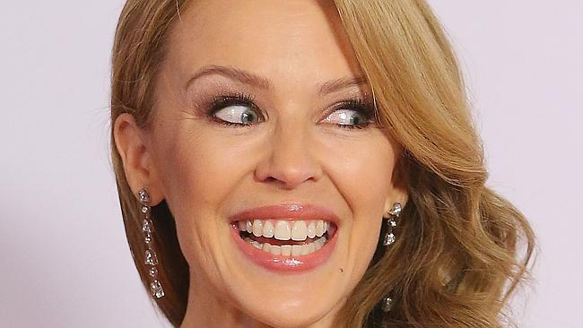
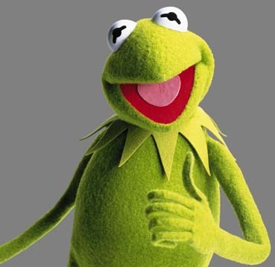
Activities
(1) Crazy Commas (EASY): children work in groups. They take a set of ambiguous sentences and explain what is wrong with the ‘inappropriate’ version eg
I love my parents, Kylie Minogue and Kermit the Frog.
I love my parents Kylie Minogue and Kermit the Frog.
See instructions

Slide 27
Activities
2. Lists to go (EASY): brainstorm lists on the board - be imaginative. Then students must select and write out their own lists, with commas added in. See instructions
3. Talking talk (CHALLENGING): this involves creating (1) a set of quotes and (2) the typical intro and end clauses that embed them in sentences (eg I said, “Come here.”). See instructions
4. Builders - there is a special lesson on commas (in Skill Builders), with worksheets.

Slide 28
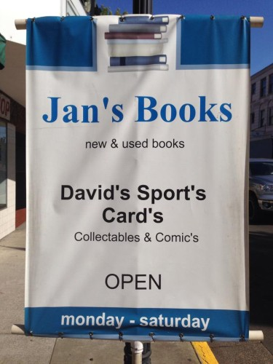
APOSTROPHES
The word comes from the Greek, apostrophos (‘turning away’).
They cause a lot of trouble!
There is a group in the UK called the Apostrophe Protection Society, whose mission is to stamp out illicit uses of the mark.

Slide 29
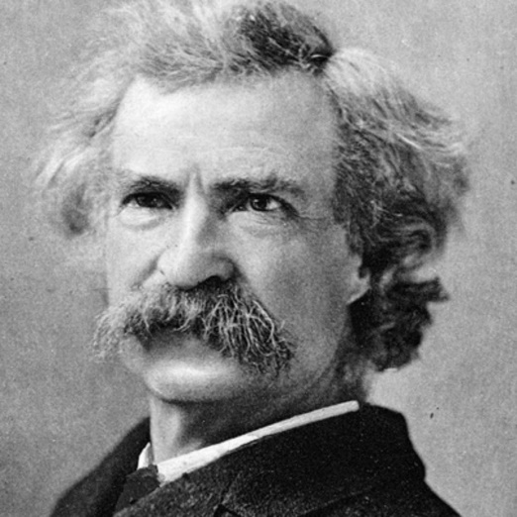
THE RULES:
An apostrophe is used to show a contraction.
Denial ain’t just a river in Egypt. (Mark Twain)
This usage dates from 1559. It is normally one letter that is missing, but as long as the sense is clear, it can be more.
(2) An apostrophe is used to show possession.
The school’s rules are necessary and just.
This usage goes back also to the 1500s, as in
Did Romeo’s hand shed Tybalt’s blood?
Only nouns have possessive apostrophes (eg the little girl’s doll, or Freddie’s book).

Slide 30
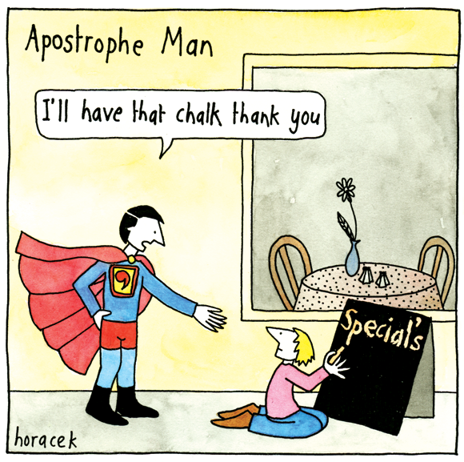
The so-called ‘greengrocer’s apostrophe’, as in the sign Tea’s, is unnecessary.
A wag has dubbed this tendency ‘apostrophitis’.
It’s remarkably common on signs and even on the internet.

Slide 31
Activities
Which one? (EASY): children look at correct and incorrect examples. Two teams, which have five seconds to spot the incorrect usage, before ceding to the other team. See instructions
Outrageous apostrophes (EASY): this requires a bank of ‘silly’ uses. It is meant to be fun but also to promote understanding of ‘right’ and ‘wrong’. See instructions
Contraction matchup (MEDIUM): this requires a group of words with contractions (eg “isn’t” and the full form, ie “is not”). See instructions
Skill Builders - there is a special lesson on apostrophes (in Skill Builders), with worksheets.

Slide 32
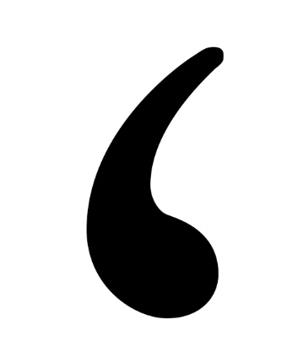
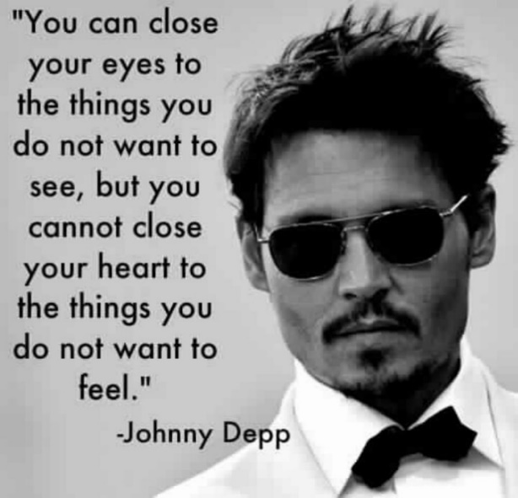
QUOTATION MARKS
These date from the 1500s. They took some time to develop, with the original form being a diple symbol (>). By the 1700s, printers had taken another punctuation mark (the comma) and reused them above the line. We call them still by the printer’s term, ‘inverted commas’.
This was the scheme: inverted commas marked the beginning of the speech, and uninverted commas marked the end.
NB The Johnny Depp example shows ‘vertical’ quotes (or inverted commas). I use ‘curly’ (or ‘smart’) quotes. Both are fine (but you must be consistent).

Slide 33
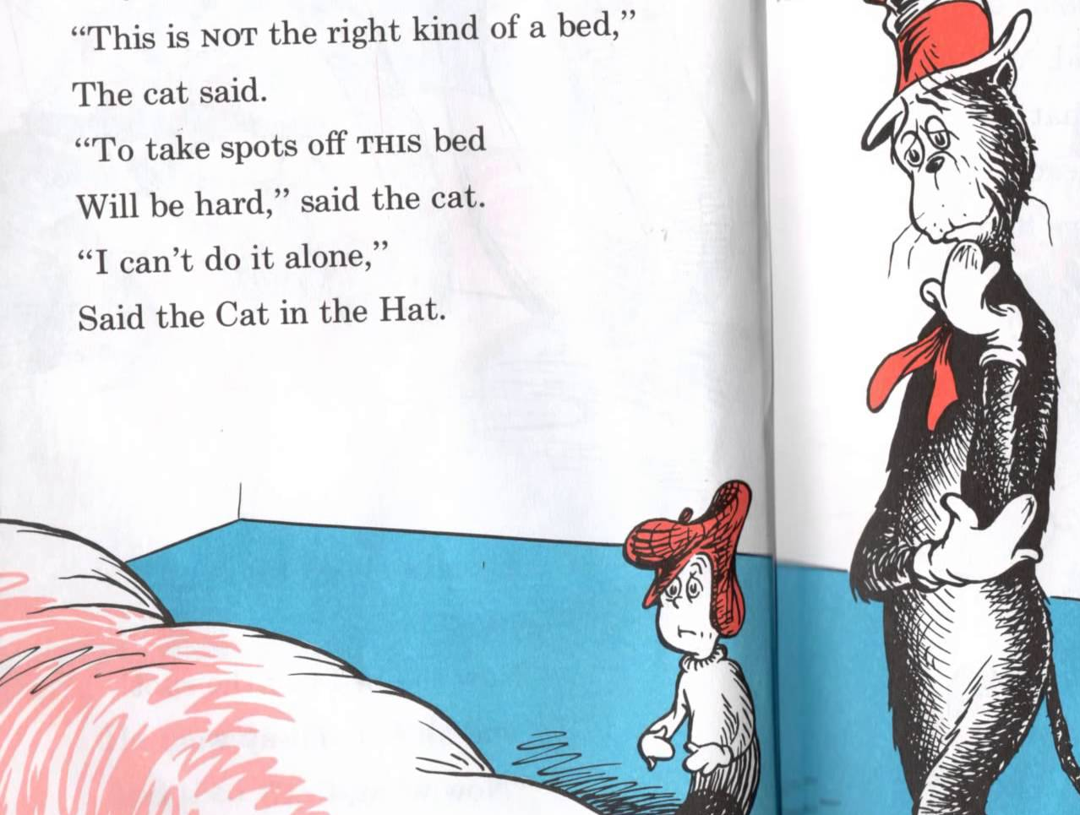
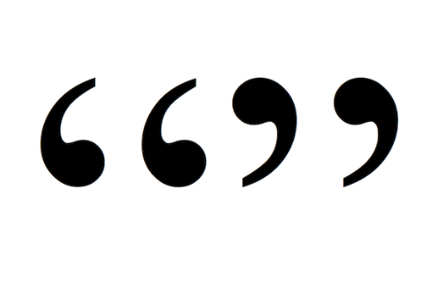
Should it be a single mark or a double?
Doubles are best for small children - and singles for people above middle to upper primary school.
This however is a matter of taste.
In practice, Americans prefer doubles, while the English prefer singles.
Dr Seuss, The Cat in the Hat

Slide 34
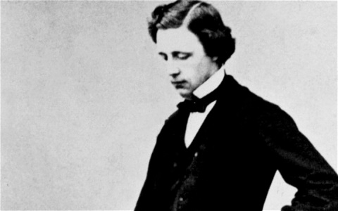
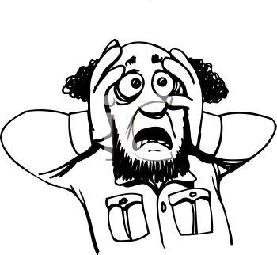
THE RULES:
(1) Quotation marks are used for any piece of direct speech.
“You are old, Father William,” the young man said,
“And your hair has become very white;
And yet you incessantly stand on your head -
Do you think, at your age, it is right?”
(Lewis Carroll)
(2) Where a quotation is inside a sentence, it is separated from the rest of the sentence by a comma.
He yelled out, “Help!”
NB Other punctuation marks are required to be inside the quote, as in
I called out, ‘Don’t look now!’
I recommend the Skill Builder lesson on Quotation Marks to make teaching this easier.

Slide 35
Activities
(1) A tale of two quotes (EASY): this activity requires children to look at and compare indirect and direct speech (eg He said to come here vs “Come here,” he said.) See instructions
(2) Famous Quotes (EASY): this is a fun one, in which children compete to amuse one another with famous and even silly quotes. See instructions
(3) Quotes and commas (CHALLENGING): this requires revision of the rules about quotes inside sentences (eg She said, “Come here!”). See instructions
(4) Skill Builders - there is a special lesson on quotation marks (in Skill Builders), with worksheets.

Slide 36
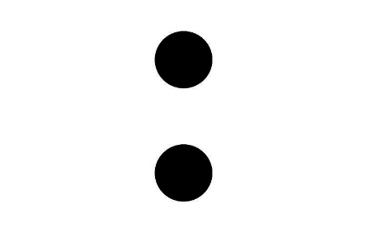
COLONS AND SEMI COLONS
The word colon comes from the Greek kolon - meaning limb or ‘bit’ (of a sentence).
Are they too sophisticated for children?
In most cases a comma, full stop or conjunction will do the same job.

Slide 37

THE RULES:
A semicolon connects two or more independent clauses inside a sentence that are connected in their sense but don’t justify a new sentence in their own right.
There were pears and apples, clustered high in blooming pyramids; there were bunches of grapes; there were piles of hazel nuts, mossy and brown; there were Norfolk apples, squat and worthy … beseeching to be carried home and eaten after dinner. (Charles Dickens, A Christmas Carol)
(2) A colon is used to show that what follows sums up or explains further what has come before.
She was delighted to have his proposal: it was the third time she had been asked, and she loved him dearly.

Slide 38
Activities
Colon or not colon (EASY): children work with unpunctuated text which needs colons or semicolons. They can work in pairs or small groups. See instructions
What options? (MEDIUM): semicolons can be replaced by other marks or by recombining and using conjunctions. See instructions
Simple or complex (CHALLENGING): this is a complex one, looking at the sentence options and requires solid revision of sentence etiquette. See instructions

Slide 39

General Punctuation Activities
1 Punctuation by numbers (MEDIUM): teacher finds a passage with all major marks, takes them out and then has cards displayed. Children work out ‘how many’ of each. See instructions
2 What else could it mean? (CHALLENGING): a passage is given with an obvious meaning. How else could it be punctuated to give a different meaning? See instructions

Slide 40
What are the following punctuation marks?
dinkus *** (used to mark a new block or section in a text)
crotchet [ ] (square brackets)
paraph or pilcrow ¶ (marks a new paragraph, once visible, now hidden)
asterism ⁂ (a section break marker)
fleuron §(a section break marker)
caret ⁁ (an insert marker)
tilde (or ‘twiddle’) ~ (a sign of approximation)
dingbats ❄ ❤ ➽ ✂ ✊ ❎ etc (decorative signs)

Slide 41

Questions and Answers…

Slide 42
If you are not a subscriber yet, register for a 30 day free trial of Ziptales at www.ziptales.com

