Slide 1
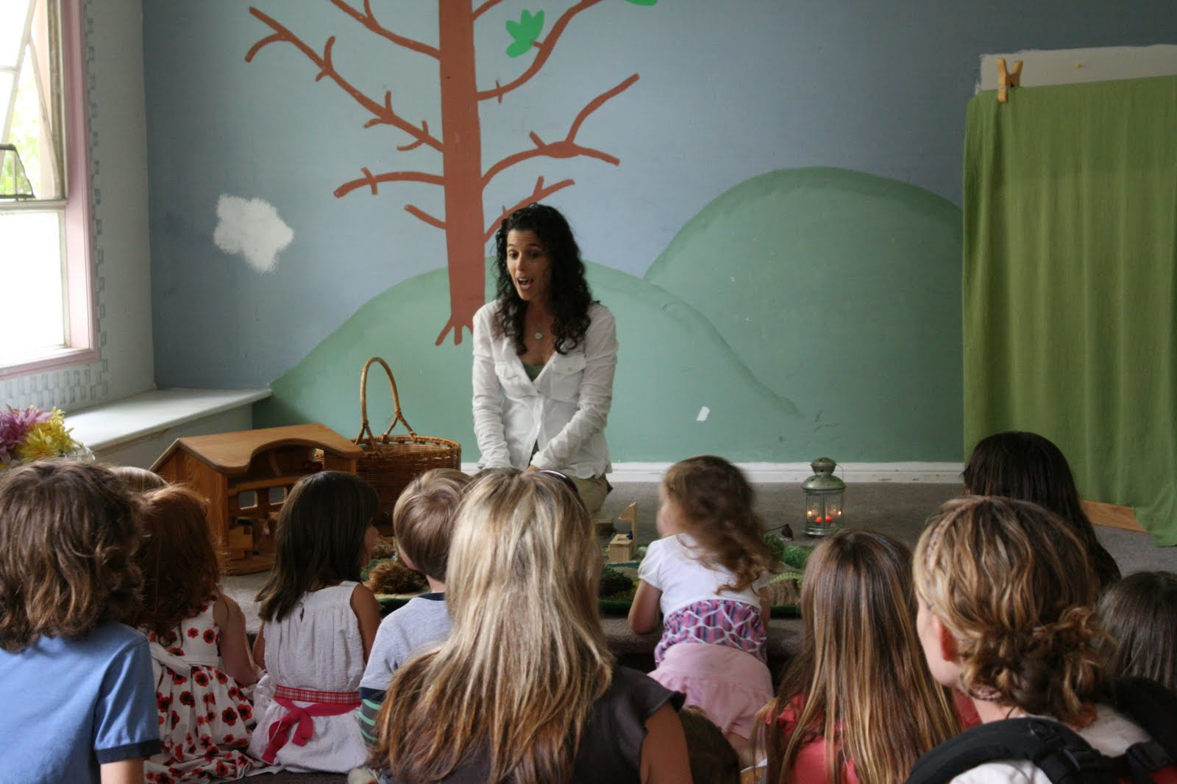
Literacy Lessons from Tell Tales
By Karen McLean
Webinar by Ziptales.com

Slide 2
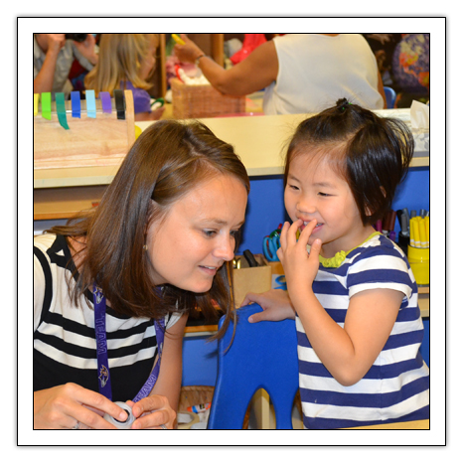
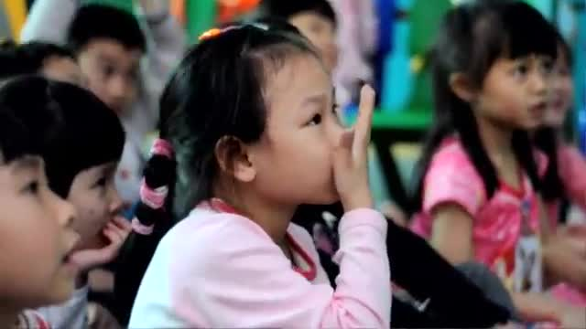
Overview
Why storytelling?
  Theories of learning
What is Tell Tales?
  Oral language and literacy learning
  Play and literacy learning
  Structure
Key strategies
  Repetition
  Text connections
  Creative responses
Choosing stories
Interweaving language, literature
and literacy
Acknowledgements

Slide 3
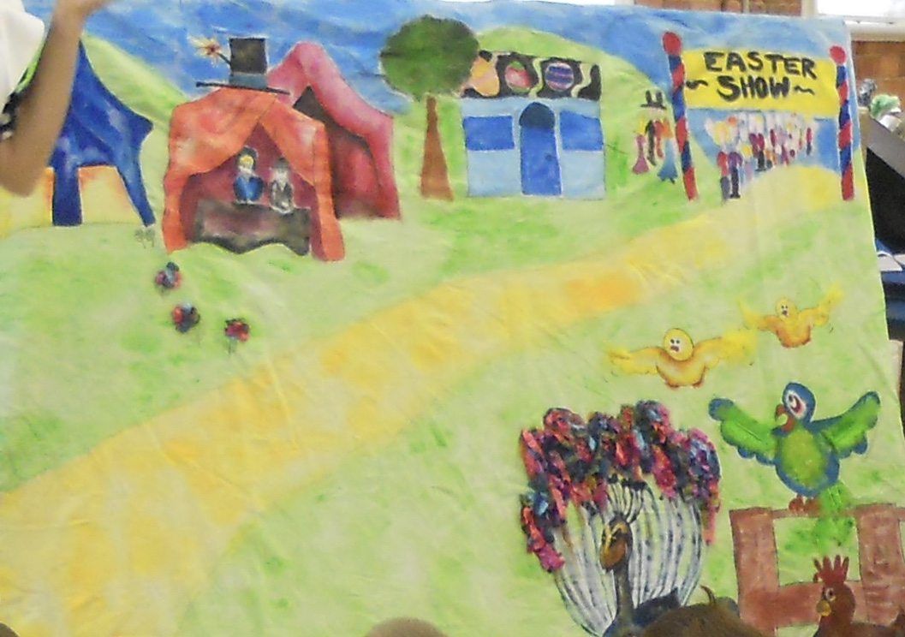
“If you want your children to be intelligent, read them fairy tales. If you want them to be more intelligent, read them more fairy tales.”
(Albert Einstein)
Creativity and imagination do matter and indeed may be more critical than ever in preparing children to be active citizens in a changing world.
Margulis, E. (January 1958). Fairy Tales and More Fairy Tales. New Mexico Library Bulletin.
Retrieved from https://blogs.loc.gov/folklife/2013/12/einsteins-folklore/

Slide 4
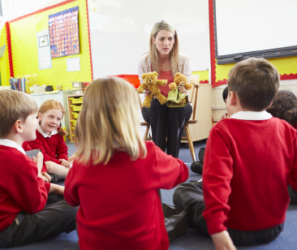
Why storytelling?
develops language and understanding of narrative
contributes to a sense of self
provides opportunities to engage and emphasise with other perspectives
encourages problem solving skills
builds and strengthens classroom relationships
exercises alternative ways of knowing

Slide 5
Storytelling & oral language
Oral language provides the foundations for early literacy learning.
Halliday (2004) describes language as fundamental for learning, communicating and thinking
Learn language
Learn through language
Learn about language

Slide 6
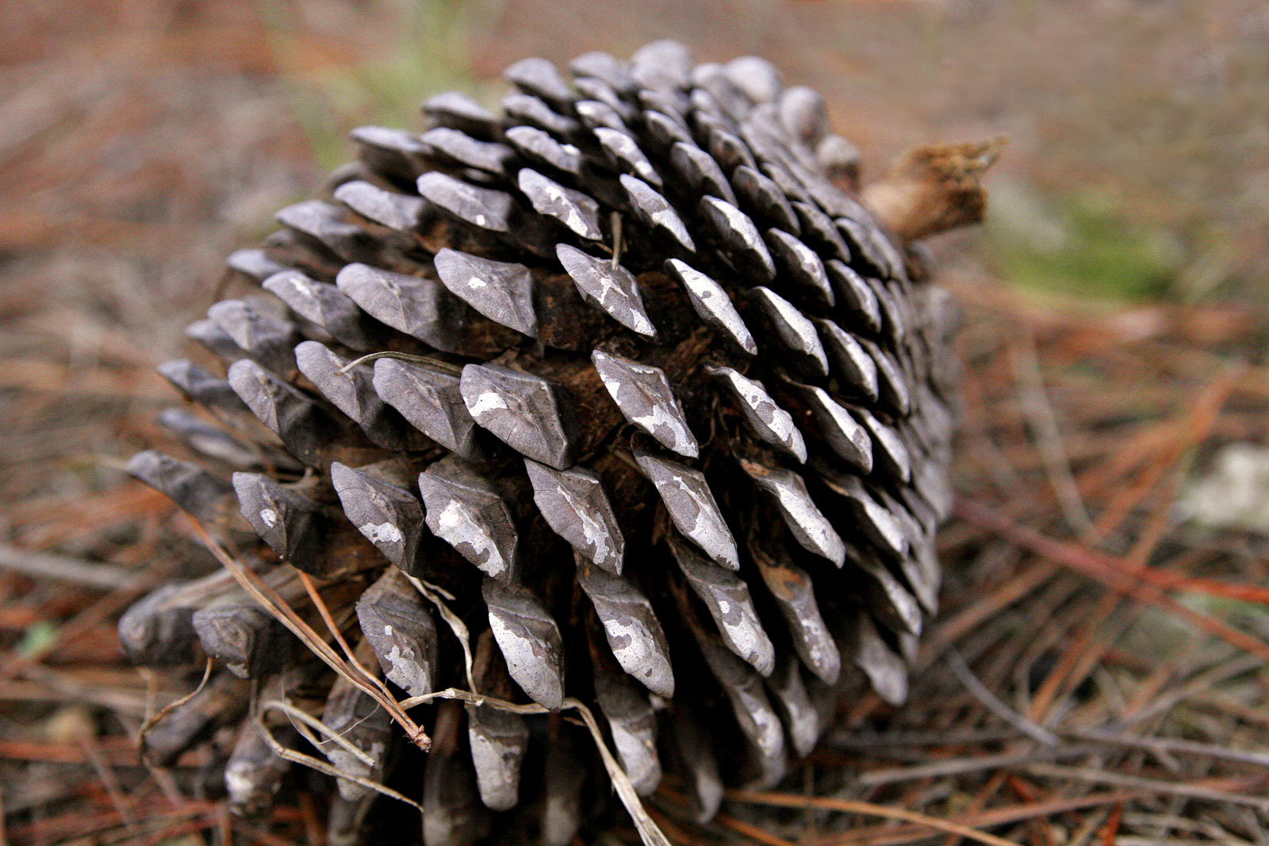
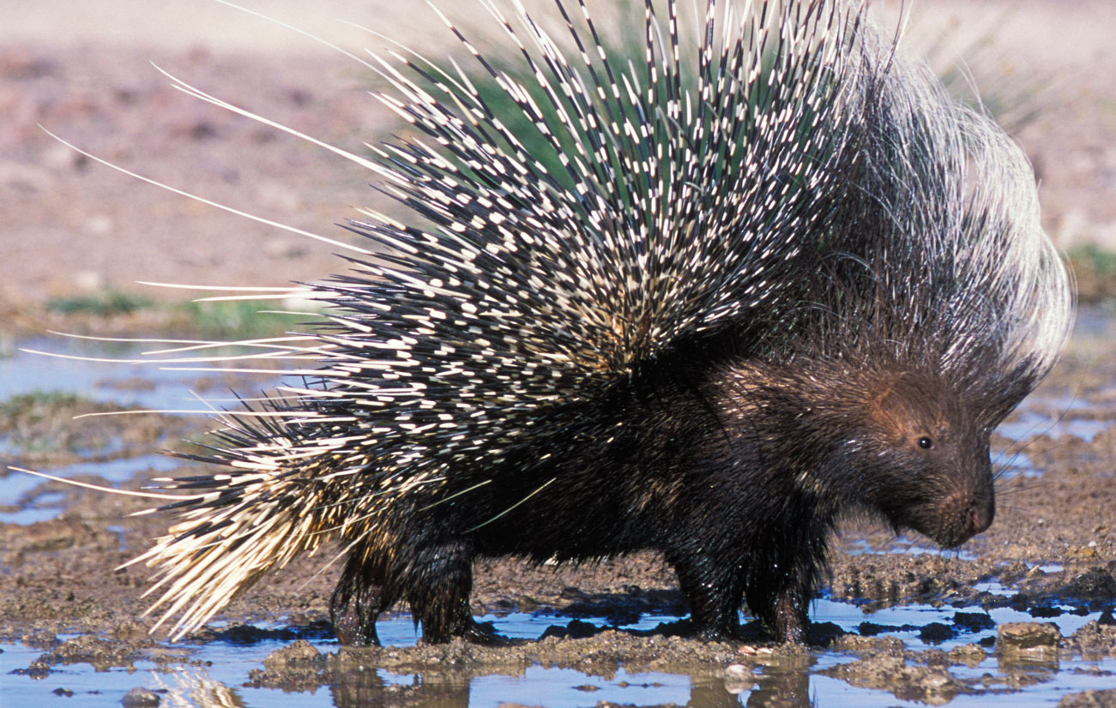
Some personal examples:
1 “Look mum a porcupine”.
“That’s not a porcupine, it’s a pinecone”.
2 “Do you think the Gulf of Mexico looks like that golf course?”

Slide 7
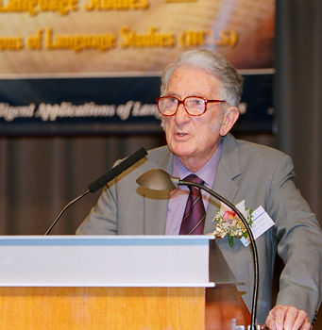
Halliday (2004) describes language as fundamental for learning, communicating and thinking and highlights three aspects of learning language that are important for oral language development.
Children learn language in speech rich communities and most children will effortlessly acquire language through being immersed in speech rich communities.
Children learn through language through their interactions with others, at first through directing their language to an adult and later by internalising it to become thinking.
Children learn about language when they learn how language works.

Slide 8
Being able to hear language, perceive differences (porcupine and pinecone) in meaning and articulate and approximate language (as in the Gulf of Mexico) is essential for learning to read and write.
We know that oral language provides the foundation for writing because it is the beginning of using symbol for meaning. However as modes of communication these two systems are different.
Oral language relies on context. For example here and now when a child points to an apple and says “Look at this one”.
Written language is removed from this context. It is decontextualised and the writer has to provide additional information for meaning to occur. For example, “Look, here is a red apple.”

Slide 9

Telling Tales
Telling stories provides a way for children to organise their experiences
Children as young as three can tell stories
Story telling as a vehicle for literacy learning and nurturing creativity and imagination

Slide 10
Teacher responses to the idea of storytelling:
“I can’t do that.”
“I’m not a storyteller.”
“That’s too hard - I’m not any good at drama.”

Slide 11
Bransford, Brown and Hocking (2000) How People Learn, storytelling is described as a “powerful way to organise lived and listened to experiences”.
The research shows that children young as three can tell stories in ways that act as stepping stones for more complex stories and the development of language reading skills.
“Brain Rules" by John Medina (2014): “if you wanted to create an education environment that was directly opposed to what the brain was good at doing, you probably would design something like a classroom”.

Slide 12
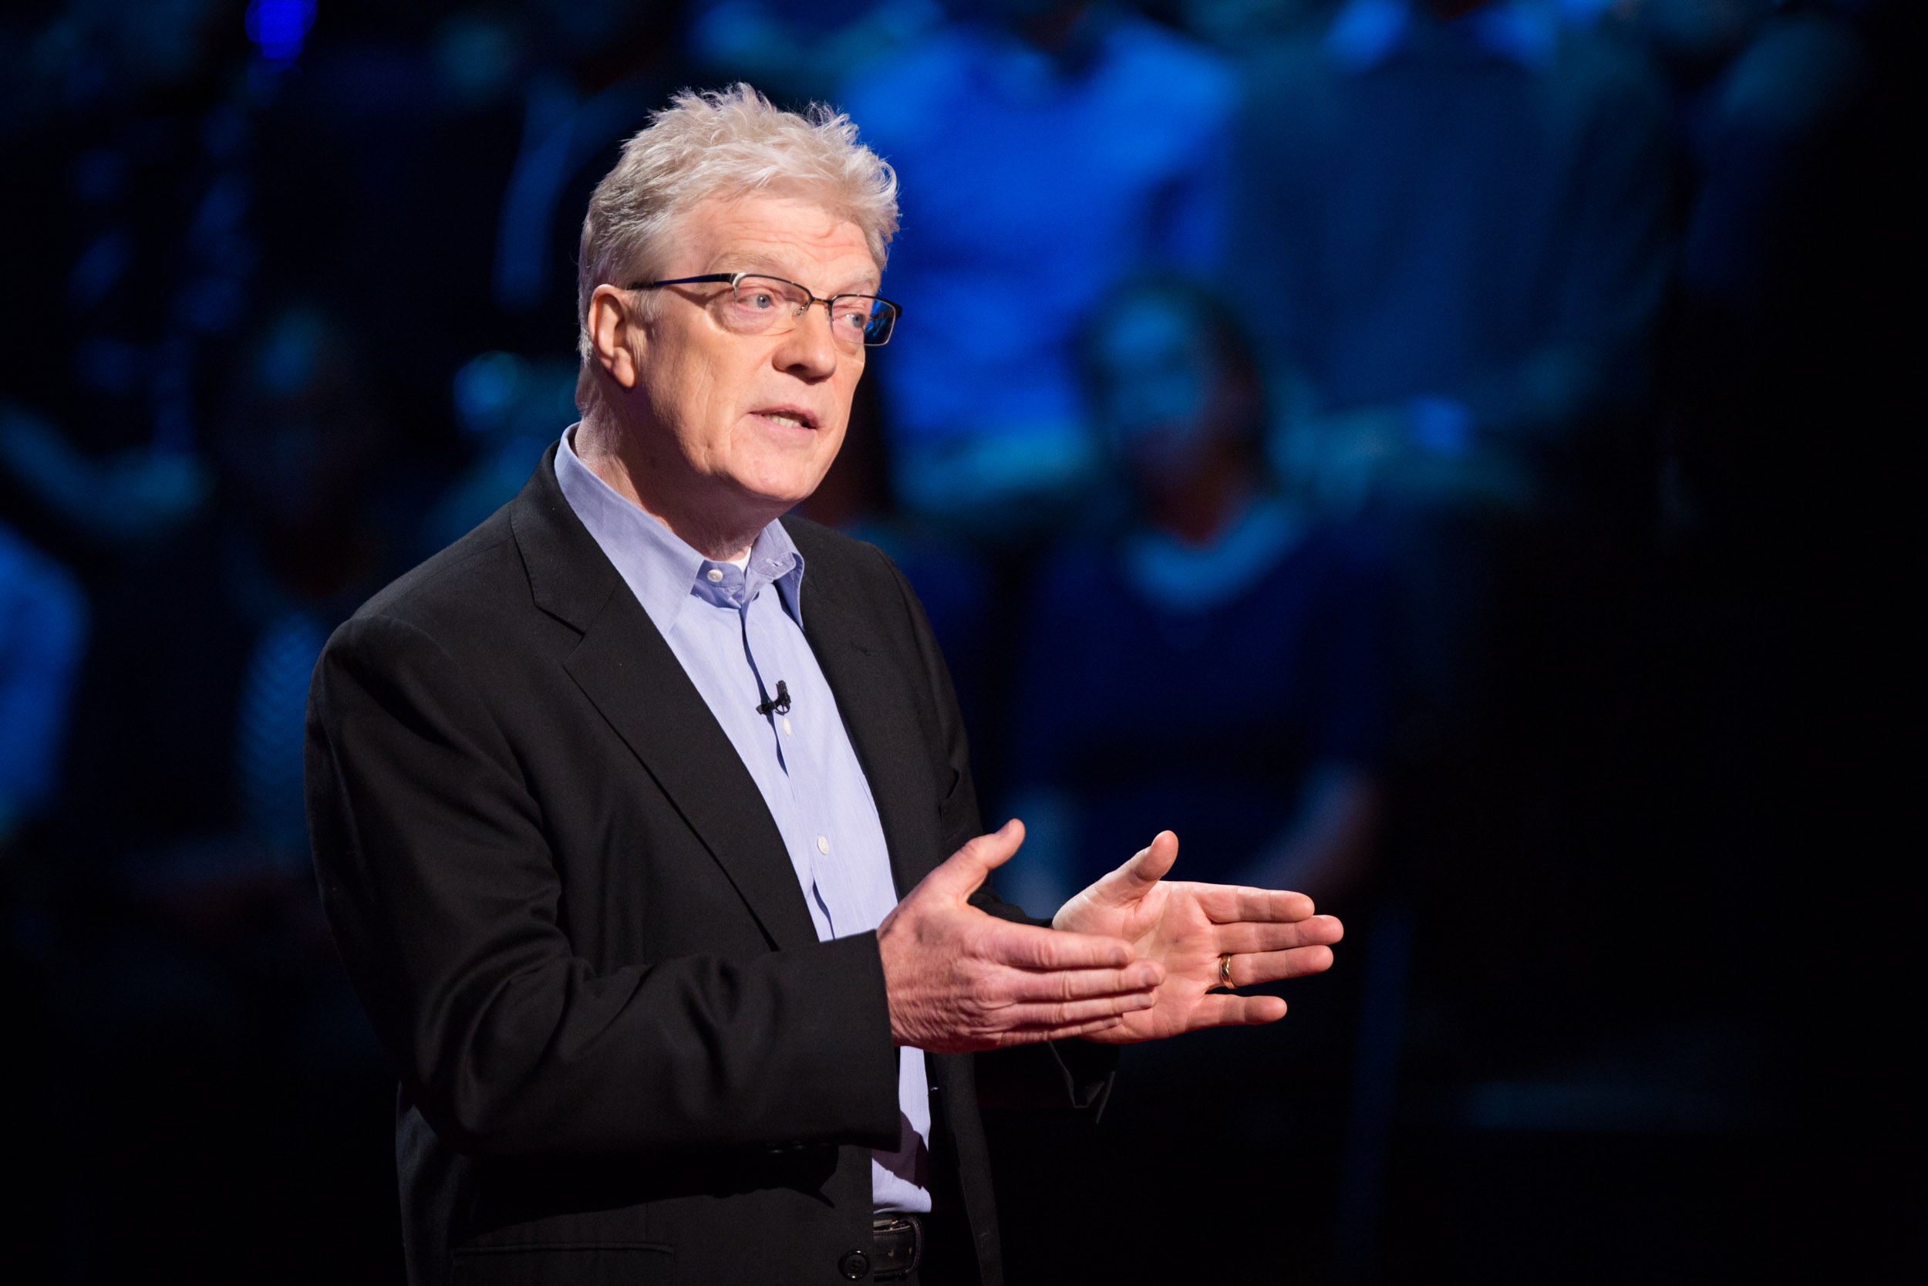
Sir Ken Robinson’s TED Talk.
In his talk he puts forward a strong case for nurturing creativity in education and celebrating imagination. This TED talk had over 39,000,000 views.
My work with Tell Tales in the early years of education has convinced me that the use of storytelling as a vehicle for literacy learning can nurture creativity and imagination in ways that are more in tune with the research on how children learn.

Slide 13
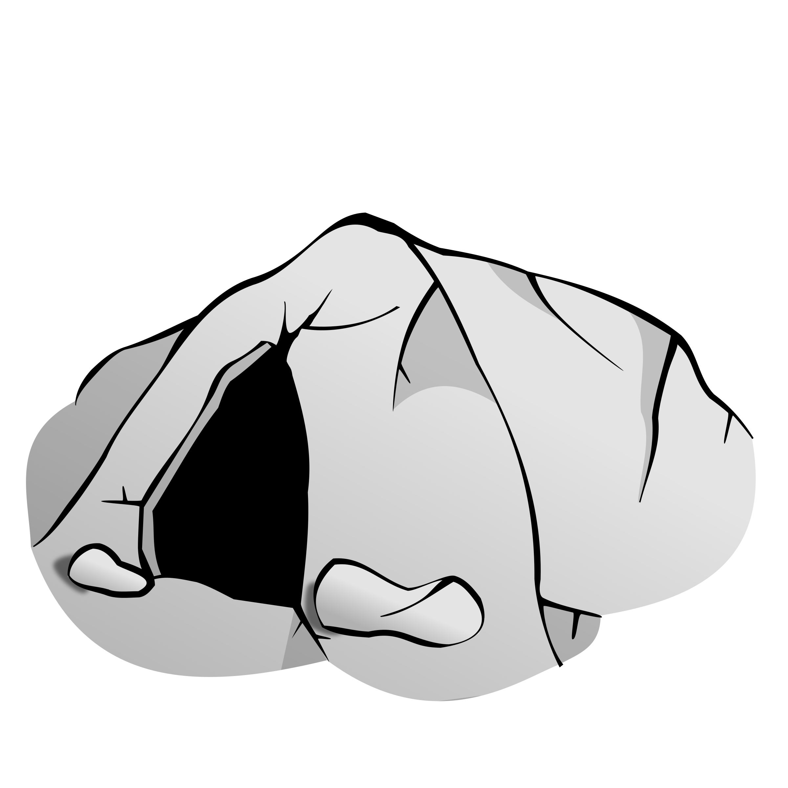
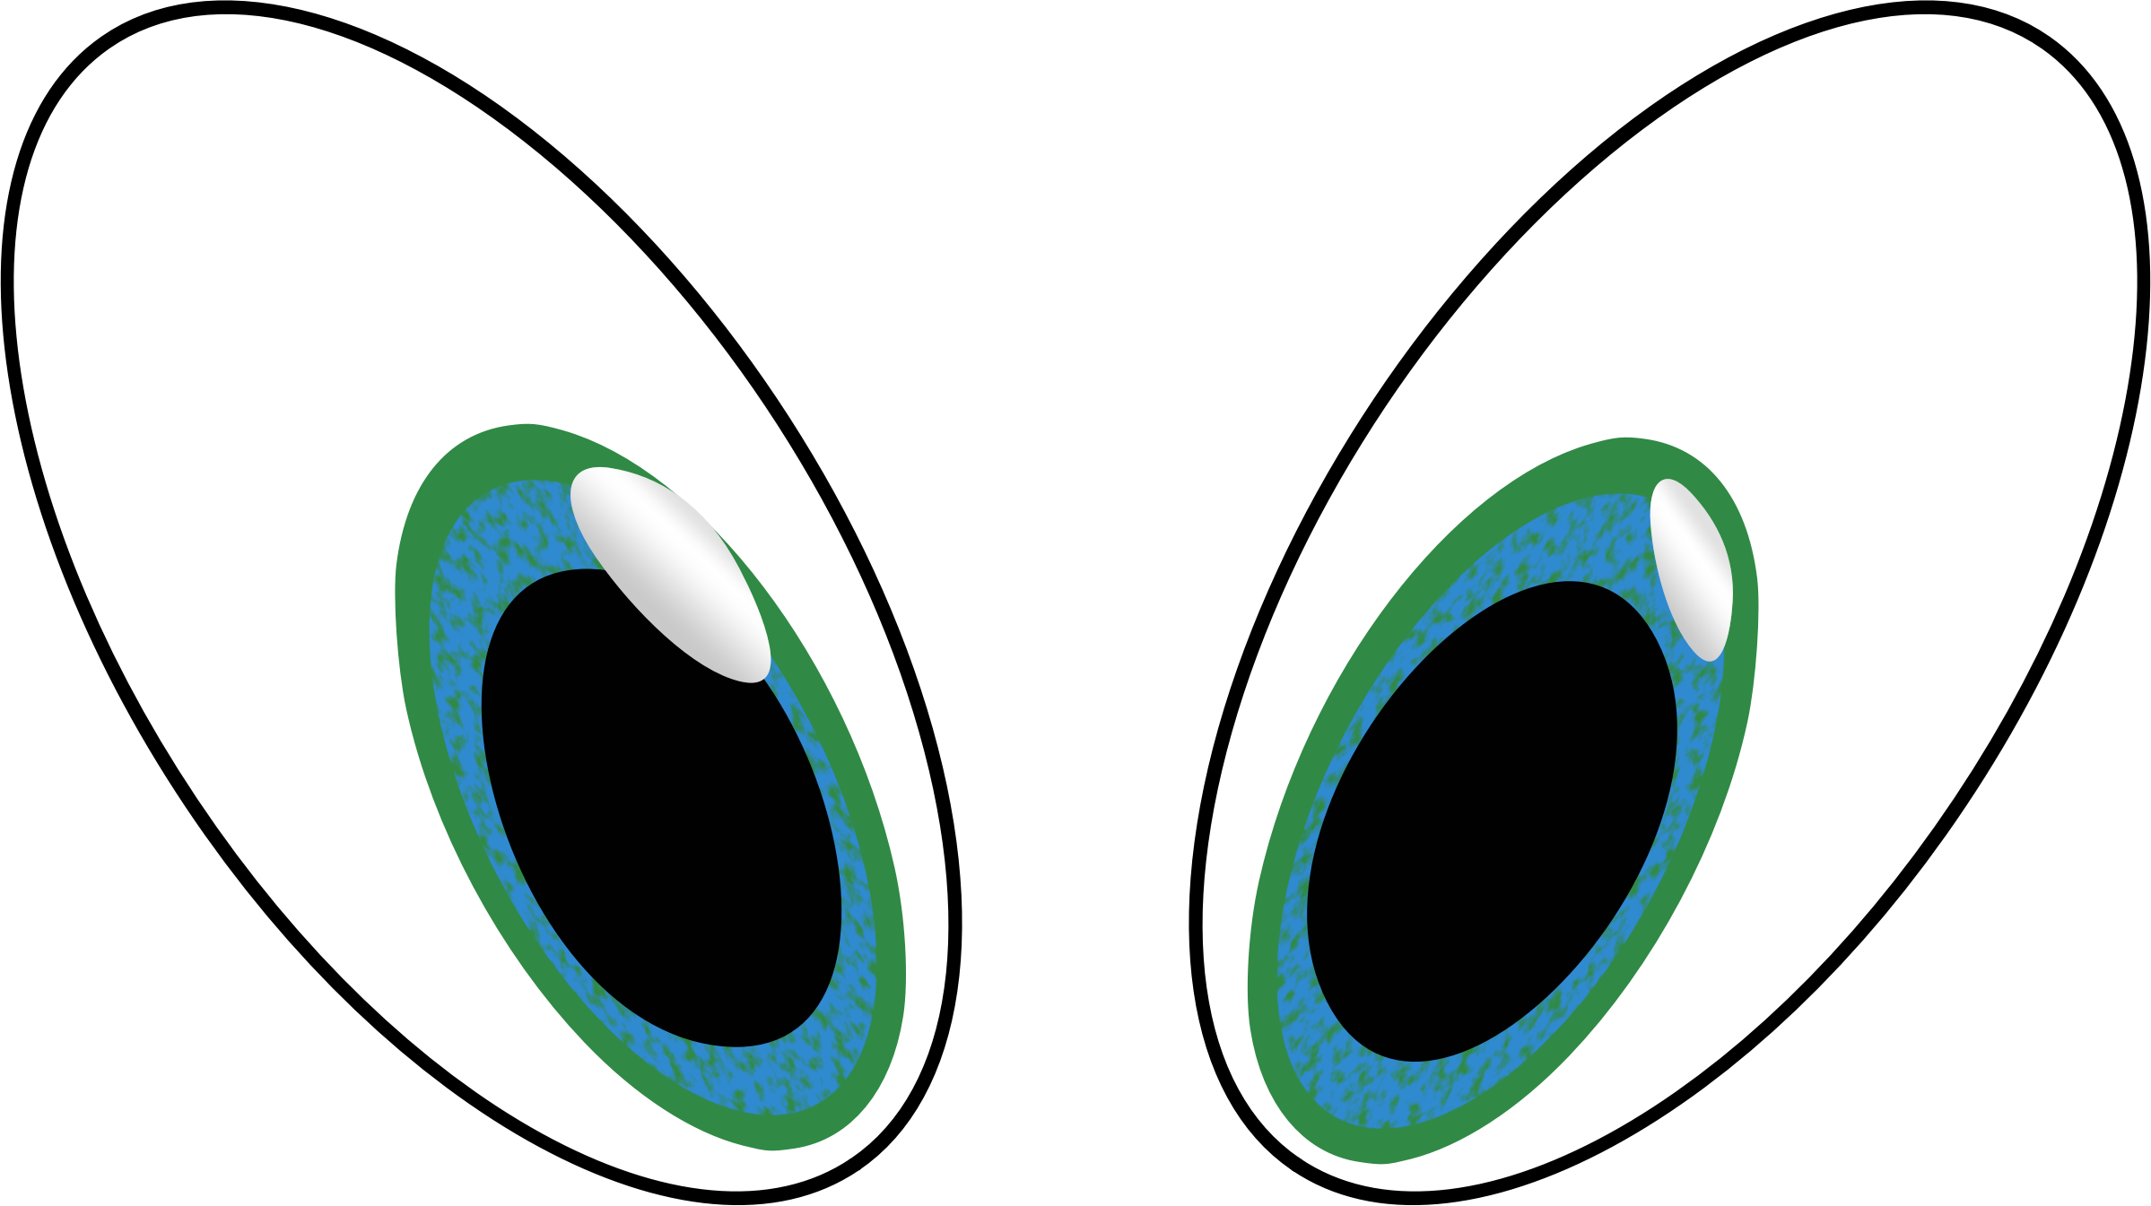

Finding your inner storyteller
Growl, growl, growl
Growl Bear from, Winer, Y. (2005). Stories for telling. Castle Hill, NSW: Pademelon Press
Clip art images retrieved from https://openclipart.org/

Slide 14
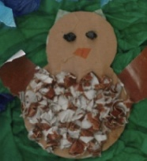
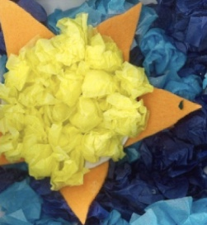
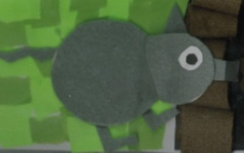
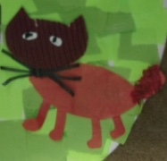
Finding your inner storyteller
?
Growl, growl, growl
Growl Bear from, Winer, Y. (2005). Stories for telling. Castle Hill, NSW: Pademelon Press
Clip art images retrieved from https://openclipart.org/

Slide 15

Finding your inner storyteller
?
Growl, growl, growl
Growl Bear from, Winer, Y. (2005). Stories for telling. Castle Hill, NSW: Pademelon Press
Clip art images retrieved from https://openclipart.org/

Slide 16
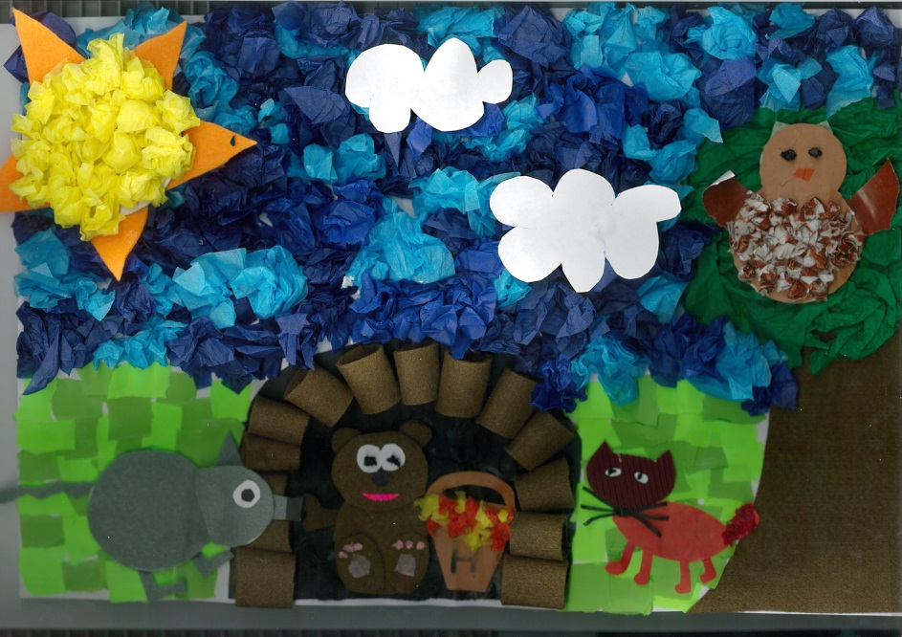
What is Tell Tales?
  Storytelling program with an explicit focus on
      Oral language and literacy learning
      Contemporary play pedagogies
Teacher tells the story
Teacher and children tell the story
Children tell the story

Slide 17
Oral language
  Encouraging talk
    Props, joint construction of text, creative response activities
  Sociocultural environments for literacy learning
  Gradual release of responsibility

Slide 18
  Play
  Storytelling provides an authentic context for enhancing children's ability to use language components of
      Syntax
        “Growl Bear lived in a dark, dark cave.”
        “Growl Bear lived in a dim, black cave”
      Semantics
        Growl Bear. Grizzly Bear, Scary Bear, Grumpy Bear
      Phonology
      We’re going on a bear hunt
      Growl, Grumpy, Grizzle
Teacher tells the story
Teacher and children tell the story
Children tell the story

Slide 19
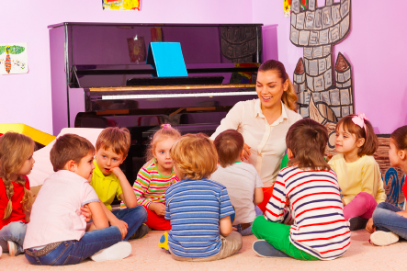
A typical tell tales program
  Session 1 Teacher tells a story
    Talking about the story using questioning frameworks (comprehension)
      Literal, inferential, evaluative/critical
    Children respond to the story –
    Sequencing experiences
    Sharing ideas, experiences and learning
  Session 2 Teacher and children retell the story
    Talking about the characters in the story
    (building vocabulary)
    Creating props for retelling
    Sharing ideas, experiences and learning

Slide 20
  Session 3 Children and teacher retell the story using props created by the children
    Talking about and extending on concepts in the story (enriching understanding)
      i.e. hibernate
    Innovating on the text (Growl Bear – Sleepy Bear)
    Creating props for text innovations
    Making comparisons– original and innovation (similarities and differences)
    Sharing ideas, experiences and learning
  Session 4 Children retell the story and/or text innovation to an audience using props created by the children
    Children share their learning through creative response
      Dramatization of key concepts, pictorial representation, podcast report…

Slide 21
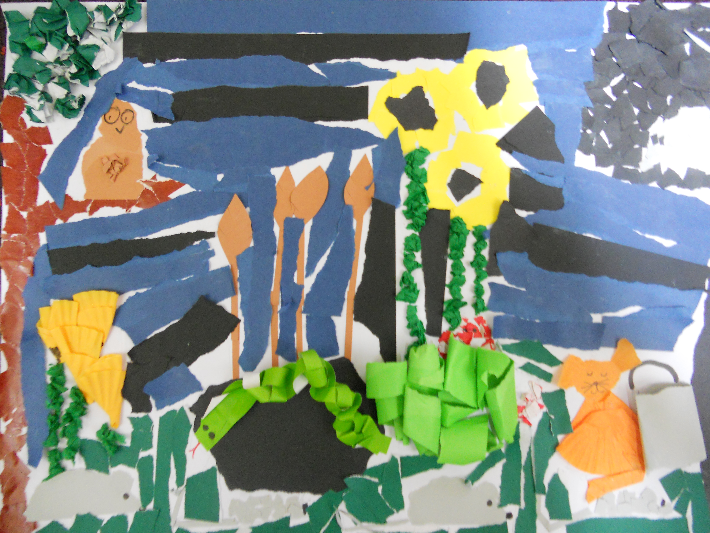
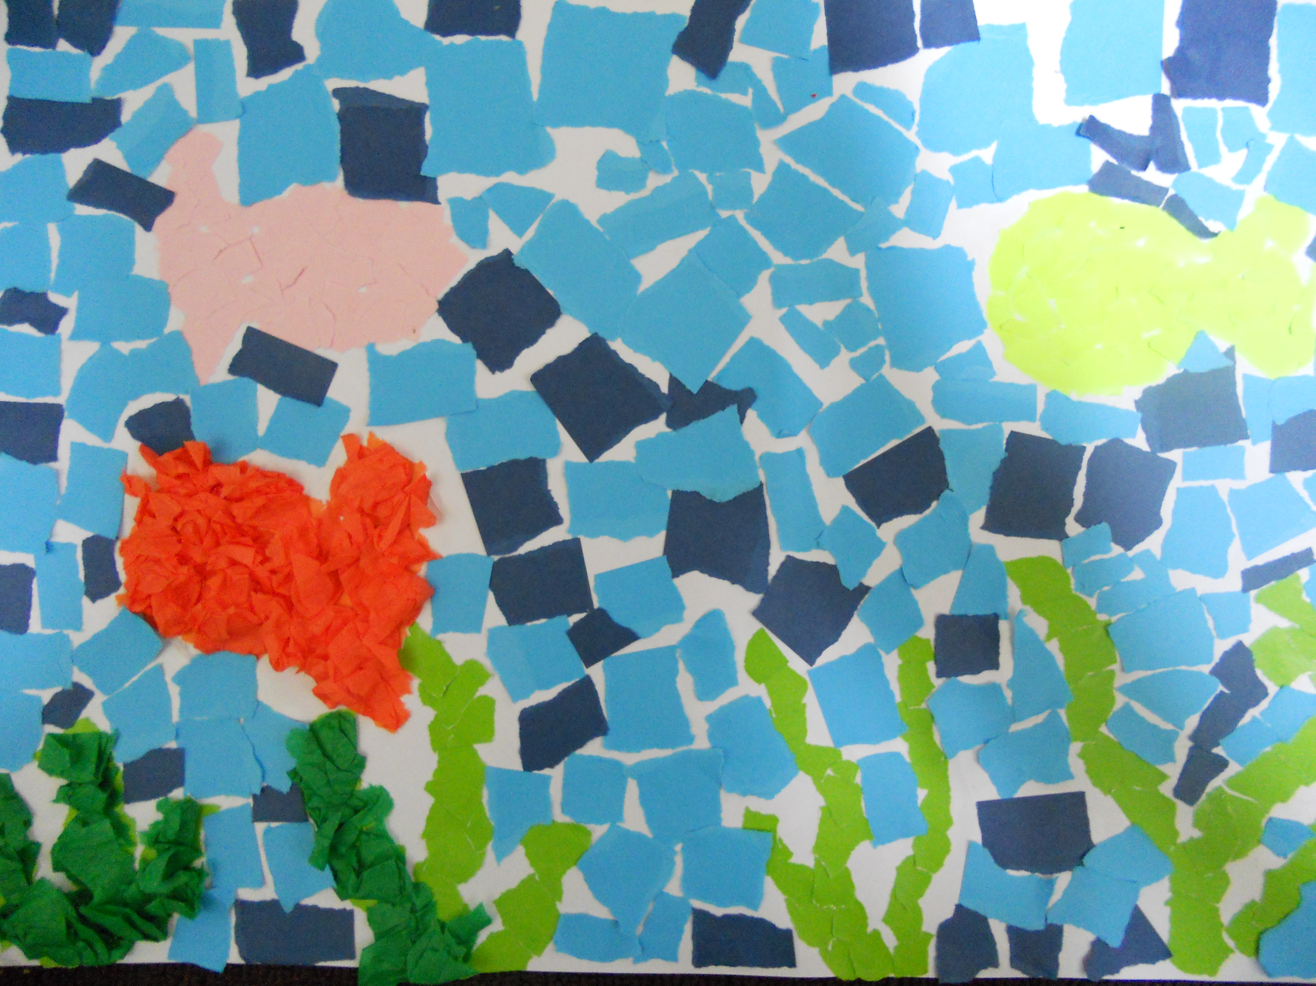
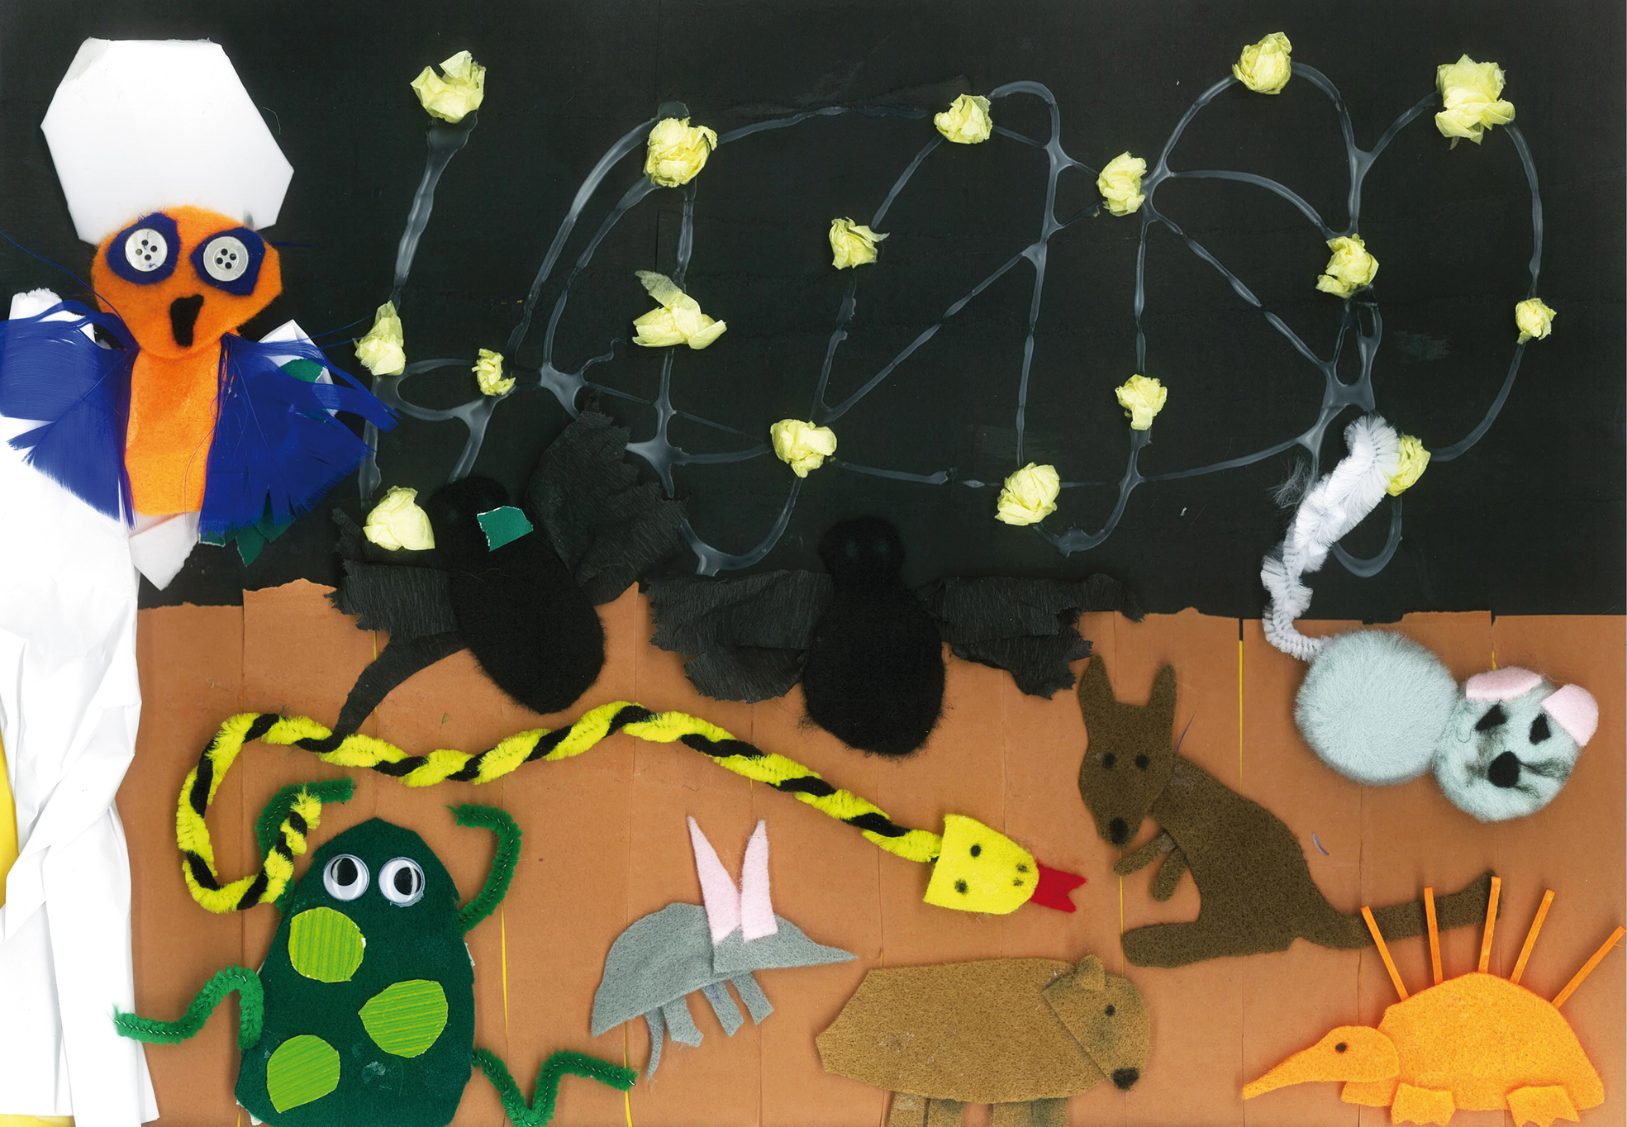
Example of Creative response using collage
Using only the materials provided create a collage to represent an event in the story
Use the following techniques to make your collage
  Tearing
  Fringing
  Handprints
  Scrunching
  Twisting
  Weaving
  Curling
  Folding
  Painting

Slide 22
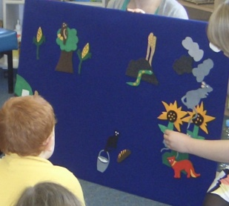
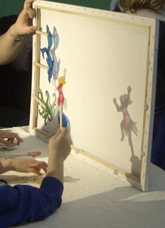
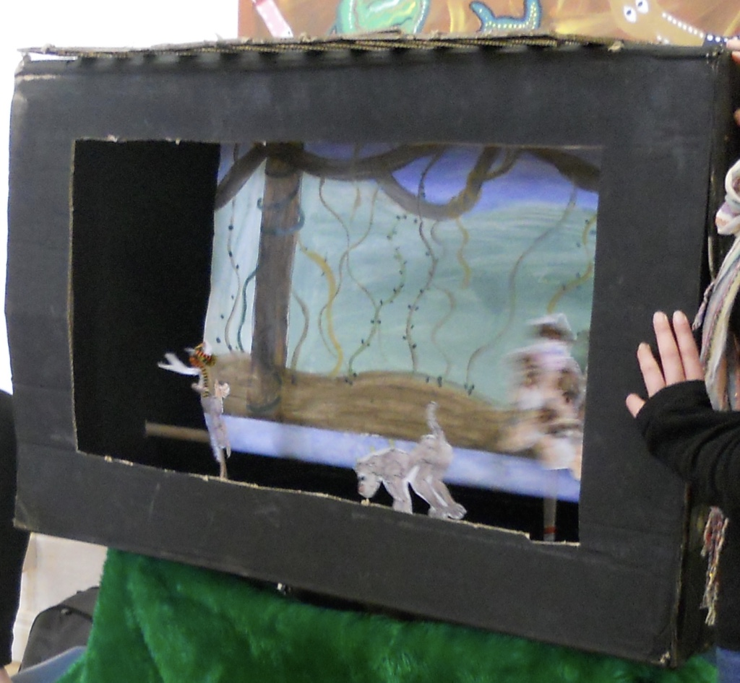
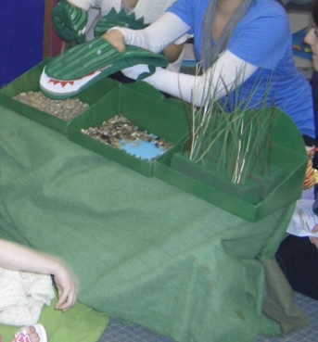
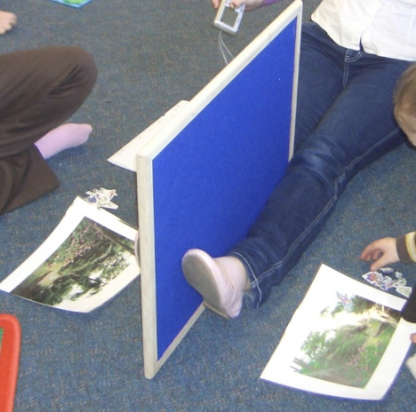
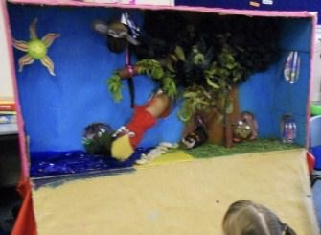
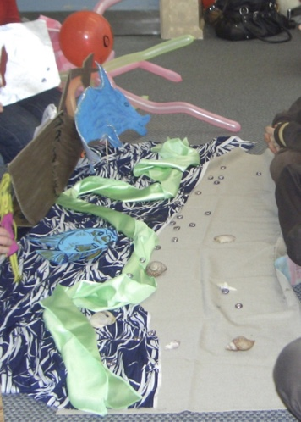
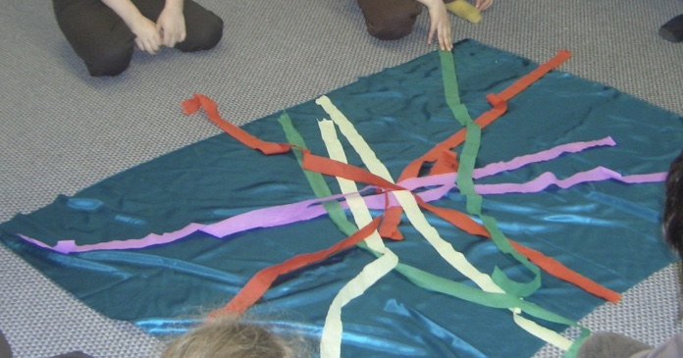
Engaging with the story
Felt board
Television
Shadow puppets
Puppets
Barrier games
3 dimensional mural
Sock puppets
Steamers for movement

Slide 23
Play silks: Some play ideas
Superhero or wizard cape
Doll sling
Magic carpet
Meadow of grass for toy animals
Princess dress or skirt
Fairy wings
Covers for sleeping toys
A veil
Pirate scarf
Belt for a sword
Toga
Puppet show backdrop
Scarf for magic tricks
Lake, river, waterfall or sea
Fort, tent or canopy
Tea party table cloth
Swirl it around in time to music
Wet washing
Peek a boo games
Wrapping paper for pretend presents
Teddy bear parachute
Bandage or arm sling
Toy picnic rug
A puddle
Wet washing
For more idea visit www.silkplayground-play-ideas.blogspot.com | Images retrieved from clipart, 2011

Slide 24
Key strategies
  Repetition and retelling
    Sock puppets, paper mache puppets, shadow puppets, felt boards, story sack, costumes
  Text connections
    Text to self
    “When the animals were waiting to see if Growl Bear would come out of his cave it made me think about when I play hide and seek with my little sister and she waits for me to come out of my hiding place.”
    Text to text
    “That story reminds me of the my favourite chant. The one where the children are going on a bear hunt”
    Text to world
    “Growl bear was in the cave eating honey but in Canada grizzly bears go into the cave in winter to hibernate.”

Slide 25
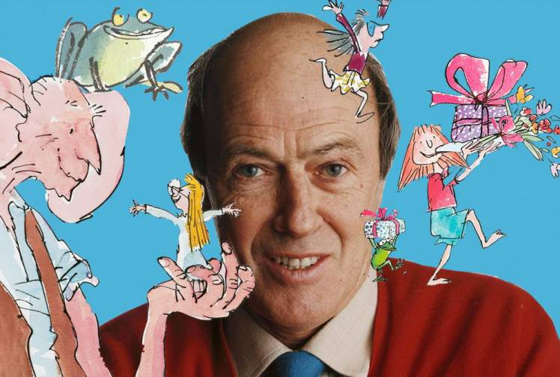
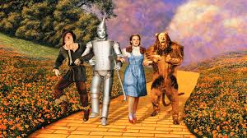
Key strategies
  Sequencing
    E.g: storymaps felt boards, dioramas depicting each event in the story, ipad apps for creating scenes from the story, animations, cartoon software, concertina books, digital photography, drama…
  Creative responses
    E.g.: Movement, drama, collage work, painting, silk scarves, construction, play dough & modelling clay …

Slide 26
Choosing a story
Commercial books and compilations of stories for telling are available
Choose a story you enjoy yourself
Repeated parts, clear structure
Action and/or series of events

Slide 27
Growl Bear | Australian Curriculum Foundation Descriptor
Explore the use of descriptive words in the oral text such as Growl – discuss synonyms | Language Expressing and developing ideas Explore the different contribution of words and images to meaning in stories and informative texts
Share ideas and feelings about the characters in Growl Bear, and use these ideas to create a growl bear puppet/mask for use in retelling | Literature Responding to literature Share feelings and thoughts about the events and characters in texts
Children respond to the initial storytelling expressing ideas about presentation. During share time children podcast their responses to the storytelling | Literacy Texts in context Listen to and respond orally to texts and to the communication of others in informal and structured classroom situations
Children retell the story to an audience using their own props | Literacy Texts in context Deliver short oral presentations to peers
Children will be engaged in various story mapping activities such as sing felt boars to sequence and retell events from the text | Literature Examining literature Identify some features of texts including events and characters and retell events from a text

Slide 28
Growl Bear | Australian Curriculum Foundation Descriptor
Identifying spoken words in the oral text such as ‘growl’ and share rhyming words and /or create word lists including other two letter blends such as ‘grizzle’‘grumpy’ | Language Phonics and word knowledge Recognise and generate rhyming words, alliteration patterns, syllables and sounds (phonemes) in spoken words
Building vocabulary through speaking and listening – New vocabulary –hibernation; exploring synonyms – growl, grump; making text connections | Language Expressing and developing ideas Understand the use of vocabulary in familiar contexts related to everyday experiences, personal interests and topics taught at school
Responding to initial storytelling using the initial, inferential and evaluative questioning framework. | Literacy Interpreting, analysing, evaluating Use comprehension strategies to understand and discuss texts listened to, viewed or read independently
Joint construction of a text innovation of Growl Bear for performance to an audience. | Literacy Creating texts Create short texts to explore, record and report ideas and events using familiar words and beginning writing knowledge
Retell the story of Growl Bear using performance including props (i.e. puppets and /or music and movement) | Literature Examining literature Retell familiar literary texts through performance, use of illustrations and images

Slide 29
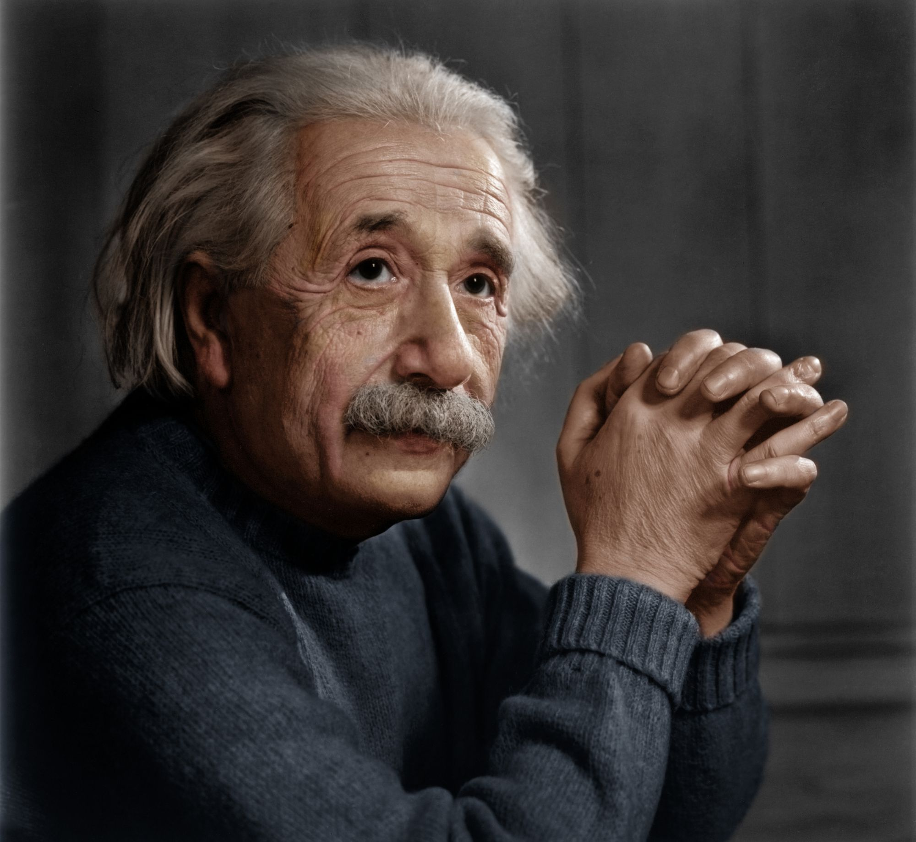
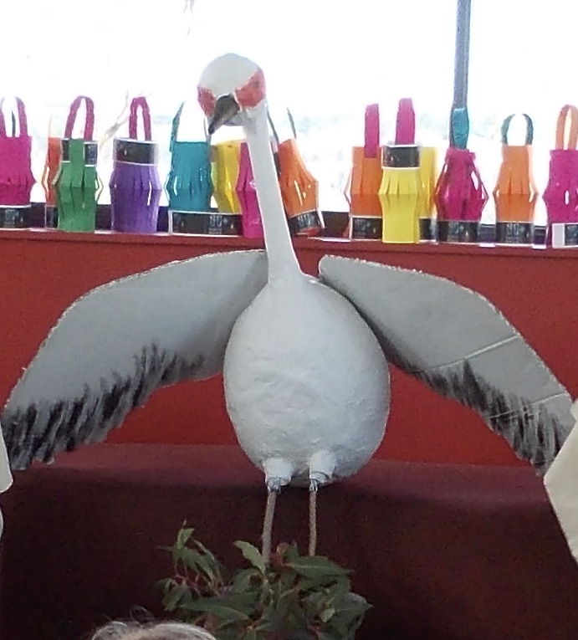
Imagination
Imagination is more important than knowledge. For knowledge is limited to all we know and understand, while imagination embraces the entire world, and all there ever will be to know and understand. – Albert Einstein
Creativity is intelligence having fun
- Albert Einstein

Slide 30
Acknowledgements
the Smith Family in regional Victoria for their support of the Tell Tales program
the local storytellers’ group for volunteering their time each year to share the storytelling craft with pre-service teacher education students
schools who been involved in the Tell Tales program
the wonderful children and families for their support of Tell Tales year after year
the pre-service teacher education students who always exceed my expectations in the delivery of this program through their wonderful and creative work

Slide 31
References
ACARA (2016) The Australian Curriculum. Retrieved from http://www.australiancurriculum.edu.au/
Batt, T. (2006) The story sack: Storytelling and story making with young children. Auckland, NZ: Play Centre Publications.
Batt, T. (2004). Dance upon a time: Movement stories for feet and tongue. Auckland, NZ: Play Centre Publications.
Bransford, J.D. Brown, A.L. & Cocking, R.R (Eds.). (2000). How people learn. Washington: National Academic Press.
Fellowes, J., & Oakley G. (2010) Language, Literacy and Early Childhood Education. Melbourne, Victoria: Oxford University Press.
Hill, S. (2012). Developing early literacy: Assessment and teaching (2nd ed.). Melbourne: Eleanor Curtain Publishing.
McLeod,, S., & McCormack. J. (2015). Introduction to speech, language and literacy. Melbourne, VIC: Oxford University Press.
Medina, J. (2014). Brain rules. Melb, VIC: Scribe.
Winer, Y. (2005). Stories for telling. Castle Hill, NSW: Pademelon Press.

Slide 32
If you are not a subscriber yet, register for a 30 day free trial of Ziptales at www.ziptales.com

