Slide 1
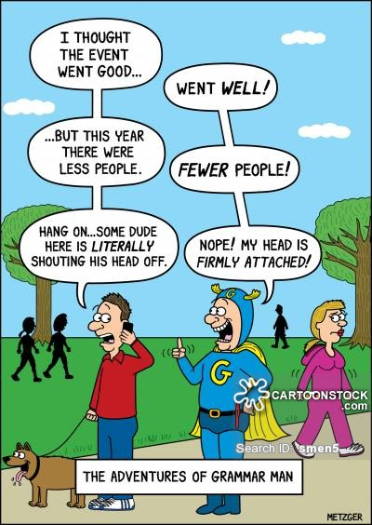
USING GAMES TO TEACH GRAMMAR
Webinar by Ziptales.com

Slide 2

Which is right?
My friend and I went to see the movie.
My friend and me went to see the movie.
“They said in that American movie: She danced real good. Is that right?”
What is wrong with “She danced real good.”?

Slide 3
The curriculum documents:
Year 4 AUS:
Understand that the meaning of sentences can be enriched through the use of noun groups/phrases and verb groups/phrases and prepositional phrases (4)
Understand the difference between main and subordinate clauses and that a complex sentence involves at least one subordinate clause (5)
Uses a range of text conventions, including most grammatical conventions, appropriately and with increasing accuracy. (NZ Level 3)

Slide 4
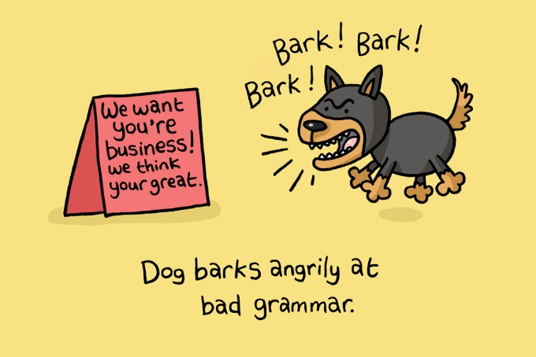
So it is important to have a working knowledge of grammar.
This webinar has the brief: how to make grammar enjoyable.
Overview of the grammar debate
What aspects of grammar are critical to student writing?
How to establish a basic knowledge of the Parts of Speech
How to teach nouns
How to teach pronouns
How to teach verbs - and what to teach
How to teach adjectives
How to teach adverbs
Trouble shooting common mistakes

Slide 5
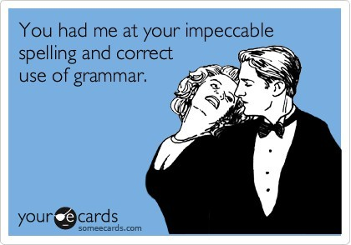
Grammar is a minefield in terms of the theory. You will have heard of “Transformational grammar”, “Functional grammar”, and any number of other varieties.
In practice the standard syllabus depends on the notion that there is a “standard English” or a “commonly accepted” way of speaking and writing.
Reread and edit student's own and others’ work using agreed criteria for text structures and language features (6).
This can be called “prescriptive” grammar - meaning that we understand that there are “agreed criteria”.

Slide 6

A child writes…
“I seen ‘im and I ain’t sure what he done.”
What does a teacher say?
A. That’s lovely. Good work!
OR
B. Why don’t we change I seen to I saw and I ain’t to I’m not sure and What he did.

Slide 7
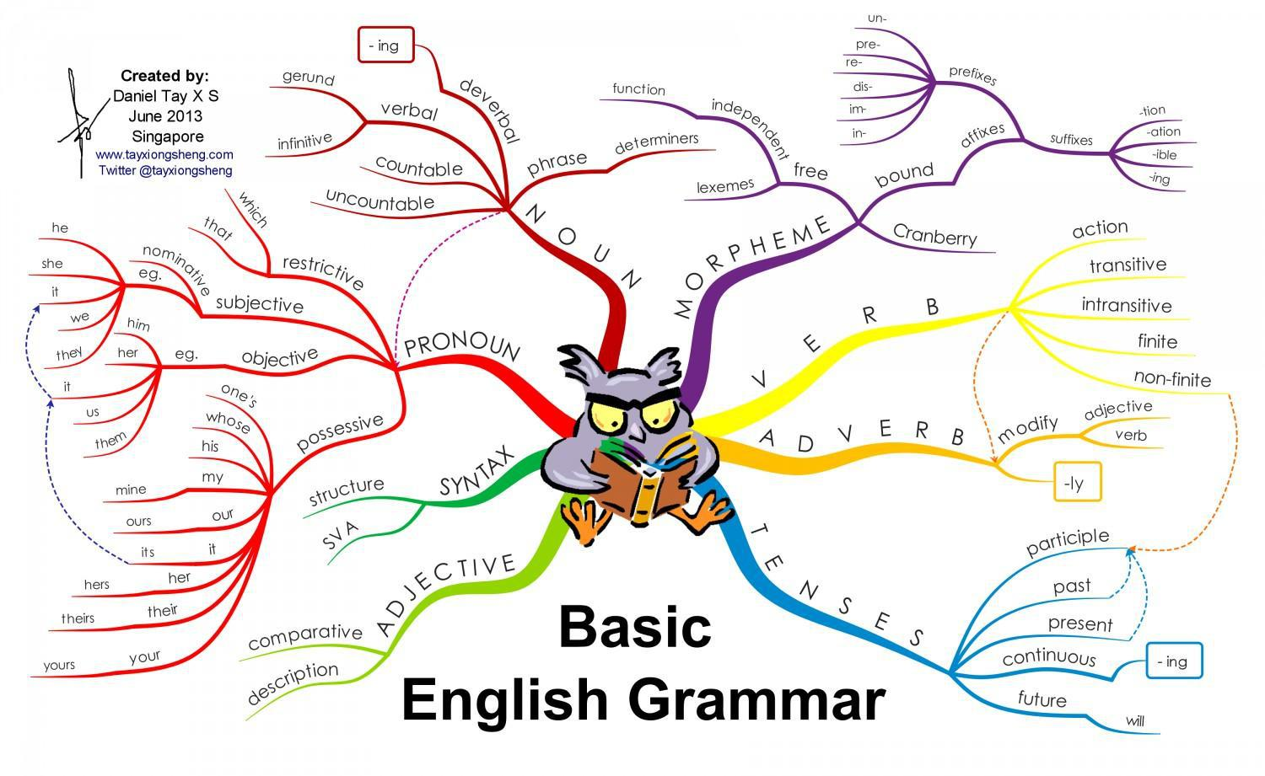
What are the basics?
Nouns
Pronouns
Verbs
Adjectives
Adverbs
Let’s keep it to the
basic concepts.

Slide 8

How to explain the parts of speech?
Let’s take a simple sentence like this:
  A indefinite article
  little descriptive adjective
  girl common noun
  played verb - past tense
  happily adverb (qualifying the verb)
  in preposition
  her possessive pronoun
  garden. common noun
Here we have the basics in eight words.

Slide 9
The essential idea is simple
    girl noun - who was it?
    played verb - what was she doing?
    A indefinite article - she is not someone you’d know
    (The would tell you that she was someone already referred to)
So
  A girl played. A complete sentence
What sort of girl was she?
  A little girl - the adjective describes her
  A little girl played.
Where did she play?
in her garden
preposition (the place) possessive pronoun (it was her place) garden (noun)
And how did she play? Can we add something more to a sense of her state of mind?
A little girl played happily in her garden.

Slide 10
This shows all the major classes of words - the “parts of speech” - in action.
A first game? It’s called “Mix and Match”.
You take the eight words, and brainstorm as many options as you can for each word.
Article | adjective | common noun | verb | adverb | preposition | pronoun | noun
A | little | girl | played | happily | in | her | garden.
The | big | boy | jumped | noisily | around | his | bedroom.
The | silly | dog | barked | incessantly | outside | its | kennel.
An | angry | bird | perched | precariously | atop | a | tree.
etc

Slide 11
A variation on this exercise, which we might call “Mix and Match Advanced”, has the essential elements varied more creatively. These could be done on the board, again with everyone participating and suggesting options. So it might be
Maisy danced in her room.
(proper noun)
Or
A little girl called Maisy sang loudly in the treehouse.
(noun phrase)
Maisy, a nice little girl I know glumly did her homework.

Slide 12
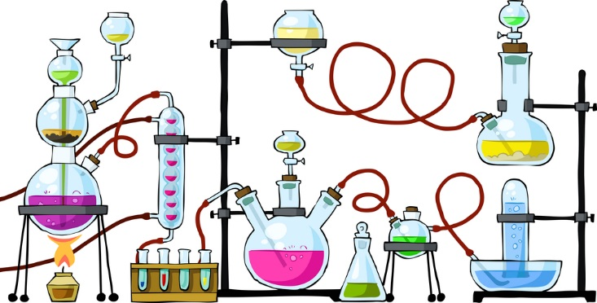
Let’s remember that the many sections of the “parts of speech” of English can be confusing.
Let’s remember that the many sections of the “parts of speech” of English can be confusing.

Slide 13
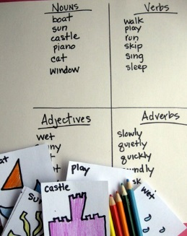
Activities
Go Fishing (EASY): students generate a set of words under the headings “Nouns”, “Verbs”, “Adjectives” and “Adverbs”. When finished they play “GO FISH”. (See detailed instructions in separate handout.)
Speech Bag (EASY): students help in the creation of eight labelled bags, for the major parts of speech (nouns, pronouns, verbs, adverbs, adjectives, adverbs, prepositions, articles). Each of these is filled with word cards. The cards are pulled out, and students make sentences of out them. (See detailed instructions.)
Grammar Scrabble (EASY): students generate sentences, then put the words onto cards and pool them. A separate group takes the cards, and two players make up sentences out of them. The winner is the one who creates four sensible sentences first. (See detailed instructions.)

Slide 14
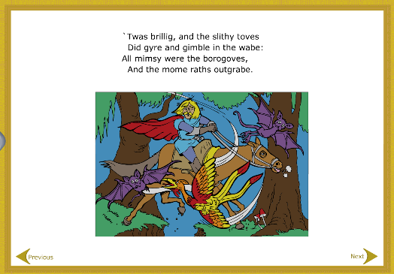
The Jabberwocky Game (MEDIUM): This is a game based on Lewis Carroll’s famous poem Jabberwocky. It involves isolating the 28 new words he created for the poem, analysing them one by one, and then creating other variants for each. A game that unites meta-analysis and creativity, and which will open up the pleasures of language. (See detailed instructions.)
Scrambled Sentences (CHALLENGING): In groups, children create sentences of up to 14 words, eg That is one small step for a man, one giant leap for mankind. These sentences are then broken down onto cards, shuffled and handed to another group to be reconstructed and labelled. (See detailed instructions.)

Slide 15
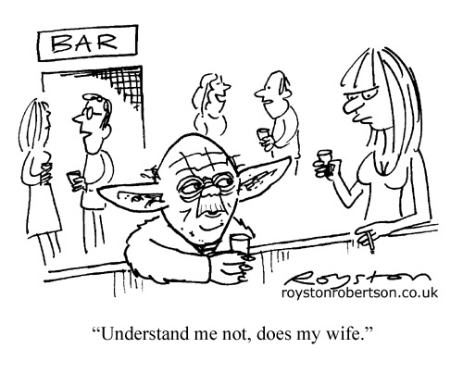
Cartoons for Classifying (CHALLENGING): This game uses cartoons as the source material, and analyses the parts of speech in the cartoon. This exercise requires a little private research, but is a very agreeable, and memorable activity. (See detailed instructions.)
Skill Builders - there are special lessons on Ziptales for each of the following: nouns, pronouns, verbs, adverbs, adjectives, prepositions and sentences. These lessons are ideal “boot camp” material. You can just sit back and work through the basics before beginning a staged series of games.
Specialised English Lessons (SEL) - the following units are devoted to the key parts of speech: What are nouns for? What are verbs for? What are relating verbs? What are adverbs for? What are personal pronouns? What is a Simple Sentence? Expanding Simple Sentences (Years 3-4); What are noun phrases? How to use verbs; What time is it? Adding descriptors; How to join sentences. (Years 5-6)

Slide 16
How to explain nouns?
The big four here are
  common nouns
  proper nouns
  abstract nouns
  collective nouns
Most children will be completely up to speed on common nouns.
  common nouns
  chair, hat, bicycle, teacher, television, moon
The only issue that may come up as an area of difficulty is plural endings. By this I mean, is it “mosquitos” or “mosquitoes”, “fairys” or “fairies” - and why? Are there rules? May I recommend the general lesson on Nouns in Skill Builders, and the lessons Predictable plurals and Weird plurals in the Spelling suite (Skill Builders) - which spell out these rules in great detail.

Slide 17



However…
proper nouns
William Shakespeare, Miss Marple, the Eiffel Tower, Sydney, I
The trick is that capital! Here is a simple parallel.
This is the notion of a man and woman.
But
Here we are talking unique entities - Ben is unique - Emily is unique. Their names are their labels. In recognition of this, in English, we use a capital.
The same logic applies to non-human unique entities (Sydney, Eiffel Tower, etc).
Ben Noble
Emily Madison

Slide 18
abstract nouns
love, intelligence, fear, ideas, misgivings, despair
These are fun words and quite easy to handle - occasional plurals (love, loves) but no capitals! The main challenge: they are “invisible” (not “concrete” nouns such as person or hat) but they are still nouns.

Slide 19


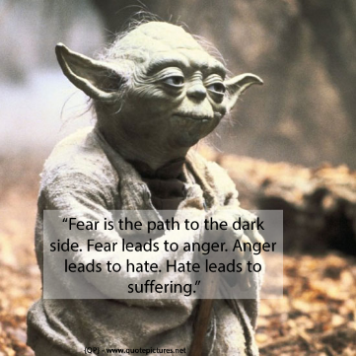
Activities
Who am I? (EASY): students in groups of 4 (A, B, C, D, E) create a list of common nouns eg tiger, harp, happiness. Next: “Who am I?”. The student who can guess the mystery word wins. (See detailed instructions.)
Name the noun (EASY): this group game focusses on the difference between common and proper nouns. (See detailed instructions.)
Abstract Pictionary (EASY): students in a special drawing group create cards to illustrate abstract nouns (eg fear, surprise, beauty, pain). These are displayed and the rest of the class must guess the word. (See detailed instructions.)
Invisible nouns (MEDIUM): exercise to focus on abstract nouns. Find a poster (such as to the right) and talk about emotions and other invisible qualities. (See detailed instructions.)

Slide 20
Activities
Collective catch up (ADVANCED): this game requires research. Students must find out all the collective nouns eg slaughter of crows, pod of whales, etc and then put them on sheets or cards. A control group must then guess at the class of noun involved while the originators sit back and watch (and perhaps give hints). (See instructions.)
Skill Builders - there is a special lesson for nouns (in Skill Builders), with worksheets. This is useful for revising the basics.
Specialised English Lessons (SEL) - the following units are devoted to nouns: What are nouns for? What is a Simple Sentence? Expanding Simple Sentences (Years 3-4); What are noun phrases? How to join sentences. (Years 5-6)

Slide 21
How to explain pronouns?
I would stick to the first two. They are where most of the errors occur.
PERSONAL PRONOUNS
 |  | Subject pronouns |  |  |  |  |  | Object pronouns | Possessive pronouns
Singular | First person | I | ate | it | First person | She | sees | me | my
 | Second person | you | ate | it | Second person | She | sees | you | your
 | Third person | he, she, it | ate | it | Third person | She | sees | him, her, it | his, her, its
Plural | First person | we | ate | it | First person | She | sees | us | our
 | Second person | you | ate | it | Second person | She | sees | you | your
 | Third person | they | ate | it | Third person | She | sees | them | their

Slide 22

The notion of “person” can be best explained with a simple picture or drawing. Imagine an island. On it is just one person. Let’s call him Jack.
How many people are on the island? One. Jack. He is the “first” person.
If Jack sees a boat, and calls,
“Hello, I want to be rescued!”
he uses the pronoun “I” because it refers to him alone. I is the first person pronoun. It is his “name” for himself.
If another person swims to the island (you can draw this), the other person - in relation to Jack - is the second person.
“Hi, it’s good to see you!”
If a third person staggers up, that person is the third person.
“It’s good to see her too!”

Slide 23


IMPORTANT NOTE: The “subject” is the grammatical name for the doer of the verb. It always comes before the verb.
Let’s look at Emily and Ben again.
Emily is going to see Ben.
She is going to see him.
Emily is the doer. Who is going to see Ben? Emily. She (the subject of the verb) is going to see Ben. We don’t say: Her is going to see Ben.
The “object” is the person or thing to which the action is done. So
Emily is going to see him.
Ben is the object of Emily’s action. We wouldn’t say: Emily is going to see he.
The biggest problem is with the pronouns “I” and “me”.
What is wrong with this?
She and me are going on a picnic.
That’s right. Incorrect use of the object pronoun - when both people are the subject of the verb! (It has to be: She and I are going on a picnic.)

Slide 24
POSSESSIVE PRONOUNS
Singular | First person | my
 | Second person | your
 | Third person | his, hers, its
Plural | First person | ours
 | Second person | your
 | Third person | their
This is the same deal, but with “possession” as the focus. Who owns, possesses, a thing?
It is my book.
It is your book.
It is her book.
etc

Slide 25
Activities
Spot the Pronoun (EASY): The teacher provides a text, perhaps a short story or even a joke - with a known number of pronouns. The first person to highlight all of them wins. A variation on this is to have one person read the text, and children call out “pronoun” when they hear one.
What Matches? (EASY): Students revise the 24 basic pronouns. In groups, they put these on cards, then they add some nouns and verbs. These are shuffled and players have 30 seconds to put together a simple sentence.

Slide 26
Activities
Fill the Gaps (CHALLENGING): A pairs activity. In this exercise, students take a piece of writing they have written. They then rewrite the piece and remove all pronouns. The other person in the pair has to fill in the gaps.
Skill Builders - there is a special lesson for pronouns (in Skill Builders), with worksheets.
Specialised English Lessons (SEL) - the following units are devoted to pronouns: What are personal pronouns?

Slide 27
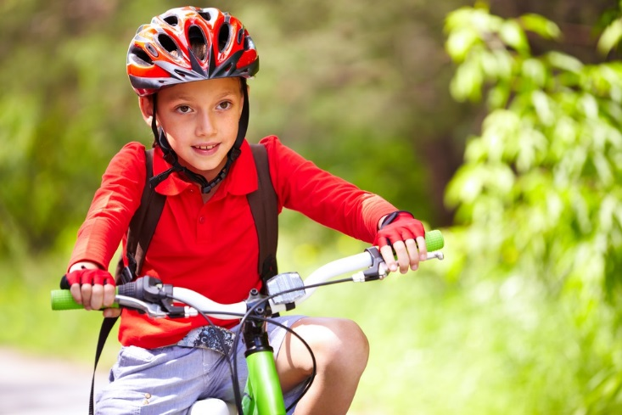
How to explain verbs?
Keep it as simple as possible.
Jamie rides his bike.
(Simple present - the no frills version)
Jamie is riding his bike.
(Present continuous - showing it’s going on right now)
Jamie rode his bike.
(Simple past tense - the action is over)
Jamie was riding his bike, when...
(Past continuous - showing that was happening when…)
Jamie will ride his bike.
(Future tense - the action hasn’t yet happened)
Jamie would like to ride his bike.
(Conditional tense - the action hasn’t yet happened, and may never happen)

Slide 28

The problem of tenses
The concept of tense (“time signature”) is easily explained.
Lucy jumped. Lucy jumps. Lucy will jump.
(Past) (Present) (Future)
Lucy has jumped. Lucy is jumping. Lucy will be jumping.
All good. But what about mixing them up?

Slide 29

RULE: Once a text is begun in one tense, it must continue in that same tense, unless clearly signposted (and for a very good reason).
Lucy came into the gymnasium. She took off her sweater. She warmed up. She did stretches. She went to the bar and lifted her leg. She climbed onto the rings and did her workout.
(8 verbs in the past tense - perfect!)
Not:
Lucy came into the gymnasium. She takes off her sweater. She warms up. She does stretches. She went to the bar and lifts her leg. She climbs onto the rings and does her workout.
(8 verbs - five in the present and 3 in the past - disaster!)

Slide 30
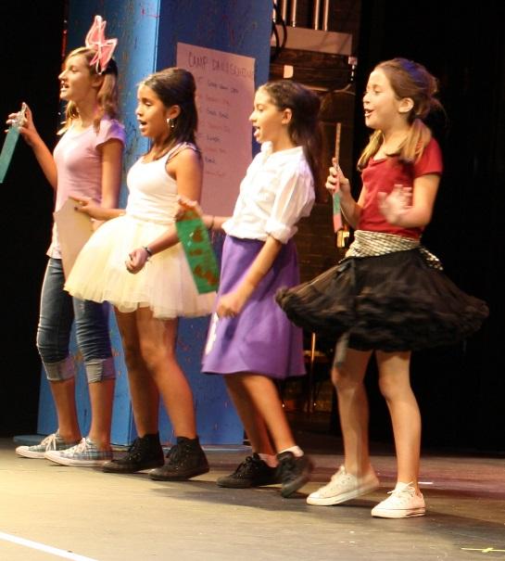
Activities
Manic Mime (EASY): children work in groups. They come up with a set of action words (eg bounce, cry, climb). They practise miming the verb. Then they do their actions and another group must work out which verb is being represented.
It’s Time (EASY): Whole class. Children write down three verbs on cards, each in a different tense. They are dealt out to the class. A monitor (or teacher) calls “Jodie, what do you have?” “ran”. What tense?

Slide 31
Activities
Tell a Story (CHALLENGING): this is a theatre sport activity with three teams (A, B, C). First player (A) “Johnny was walking through the forest when he _________ (B player supplies the word). He fell in a hole. (C) And in the hole he found a strange door. And so on.
Skill Builders - there is a special lesson for verbs (in Skill Builders), with worksheets.
Specialised English Lessons (SEL) - the following units are devoted to nouns: What are verbs for? What are relating verbs? What is a simple sentence? Expanding Simple Sentences (Years 3-4); How to use verbs What time is it? (Years 5-6)

Slide 32
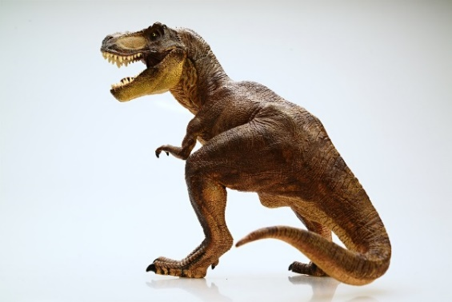


How to explain adjectives?
The beauty of adjectives is that they never vary.
The only serious catch is in the comparatives.
the big dinosaur the bigger dinosaur the biggest dinosaur
Another problem is that while most adjectives do this comparative/superlative operation using standard endings
  nice nicer nicest
  wet wetter wettest
  heavy heavier heaviest

Slide 33
A few very old ones are completely irregular. Here are some of the classics:
And finally, there are the compound adjective clusters where the adjective stays the same but a qualifier is added in front.
Adjective (the base word) | Comparative | Superlative
bad | worse | worst
far | further | furthest
good | better | best
ill | worse | worst
less | lesser | least
little | less | least
many | more | most
Adjective | Comparative | Superlative
boring | more boring | most boring
contagious | more contagious | most contagious
difficult | more difficult | most difficult
expensive | more expensive | most expensive
marvellous | more marvellous | most marvellous
popular | more popular | most popular
wonderful | more wonderful | most wonderful

Slide 34
Activities
Add an Adjective (EASY): Two teams create a sentence with missing adjectives. (See instructions.)
Synonym Scramble (EASY): Six groups build a series of variations on “master” adjectives (eg sad gives unhappy, miserable, etc). These are scrambled and selected. (See instructions.)
Antonym Attack (EASY): In pairs. One (A) generates adjectives; the other (B) must find antonyms. (See instructions.)
Skill Builders - there is a special lesson for adjectives (in Skill Builders), with worksheets. This is useful for revising the basics.
Specialised English Lessons (SEL) - the following units are devoted to adjectives: Adding descriptors (Years 5-6)

Slide 35

How to explain adverbs?
Lucy jumps.
noun verb
But how does Lucy jump?
Lucy jumps happily.
Lucy jumps quickly.
Lucy jumps excitedly.
These are “adverbs of manner” (the how factor).
There are “adverbs of time”:
  Lucy jumps now.
  Lucy jumps regularly.
  Lucy jumps rarely.
And “adverbs of place”:
Lucy jumps up.
  Lucy jumps away.
  Lucy jumps everywhere.
I would finish a unit of revision of adverbs with a quick look at comparatives - which actually look very like adjectives.
  Lucy is jumping quickly.
  Lucy is jumping more quickly.
  Lucy is jumping most quickly.

Slide 36

Activities
Charades (EASY): The object is to come up with adverbs (eg nervously) and then play charades. (See detailed instructions.)
Adverb Shuffle (MEDIUM): This involves making synonyms. Teams create a sentence with missing adjectives. (See detailed instructions.)
Picture This (MEDIUM): Four teams create a list of adverbs. A volunteer draws the adverb and the class have to guess what it is. (See detailed instructions.)
Skill Builders - there is a special lesson for adverbs (in Skill Builders), with worksheets.
Specialised English Lessons (SEL) - the following units are devoted to adverbs: What are adverbs for? (Years 3-4);

Slide 37

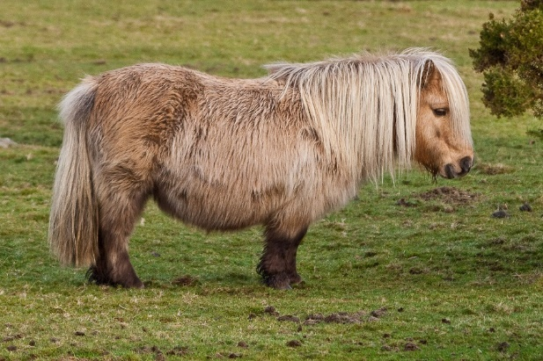
Trouble shooting common problems
I and me
Julie and I went to see the principal.
The principal saw Julie and I.
?
Misplaced (or “dangling”) modifiers
At eight years old, my father gave me a pony for Christmas.
After rotting in the cellar for months, my brother brought up some oranges.

Slide 38

The old classics - where quasi-homophones pose a trap
affect (verb) and effect (noun)
its (possessive adjective) and it’s (pronoun and verb)
lie (intransitive verb) versus lay (transitive verb)
lose (verb) and loose (adjective)
practise (verb) and practice (noun)
there (adverb), their (possessive adjective)
and they’re (pronoun and verb)
who (subject relative pronoun) and
whom (object relative pronoun)
your (possessive adjective) and you’re (pronoun and verb)
For a full discussion of these vexed issues, see the accompanying “Instructions” sheet.
And look out next for a webinar on the other difficult aspects of teaching English - punctuation and spelling problems.

Slide 39

Questions and Answers…

Slide 40
If you are not a subscriber yet, register for a 30 day free trial of Ziptales at www.ziptales.com

