Slide 1
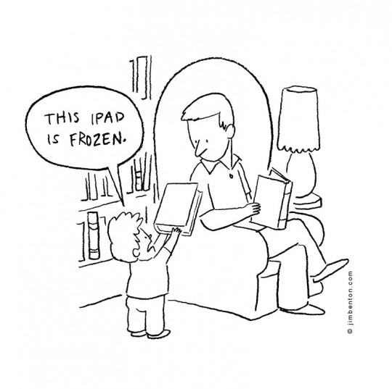
Selecting the Best Apps for Literacy Development
Webinar by Ziptales.com

Slide 2

The introduction of tablet technology has transformed the way we use computers.
There is a plethora of apps available today and locating those that provide high quality learning experiences can be time consuming and often fruitless.
This webinar focusses on:
Creating texts
Organising information
Communicating verbally
Building spelling knowledge

Slide 3


Linking tablet technology to the curriculum
The Australian Curriculum: Students use ICT when they interpret and create print, visual and multimodal texts. In particular, they use ICT to access, analyse, modify and create hybrid, digital and multimodal texts, using digital publishing. As students interpret and create digital texts, they develop their capability in ICT.
The New Zealand Curriculum: Students who are competent users of language, symbols and texts can interpret and use words, number, images, movement, metaphor, and technologies in a range of contexts…they confidently use ICT to access and provide information and to communicate with others.

Slide 4

Ideas are provided for all year levels and defined in two categories:
Developing Literacy
(Foundation, Years 1 & 2 in Australia; Level 1 in New Zealand)
Extending Literacy
(Years 3 - 6 in Australia; Levels 2 & 3 in New Zealand)

Slide 5
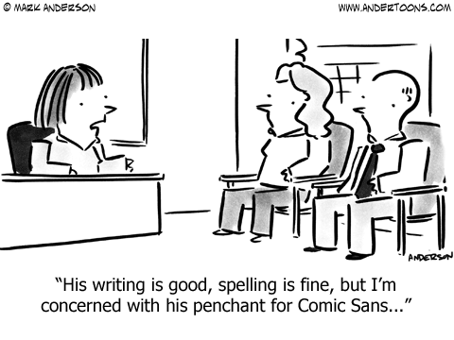
Apps for Creating Texts
Creating texts for a variety of purposes and audiences is a core component of any English curriculum.

Slide 6
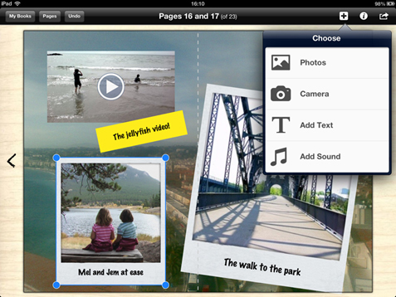
Apps for creating e-books
These apps are extremely appealing to students as they enable them to display their own creative flair when composing stories that can be shared with others and read over and over again.
Developing Literacy:
Book Creator (free or $7.99 for full version)
Voted best educational app at the 2015 BETT awards (British Educational Training and Technology), it enables students to create e-books by adding text, images, their own drawings, photos, videos, music and voice recordings. It also includes comic templates and stickers.

Slide 7
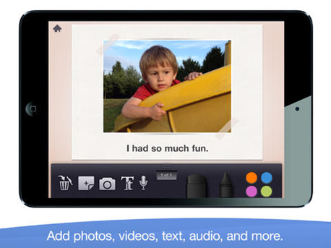
Story Creator (free)
Made for ages 6-8, this app is easy to use and allows young students to create their own simple stories using photos, text, drawings, videos and voice recordings.

Slide 8
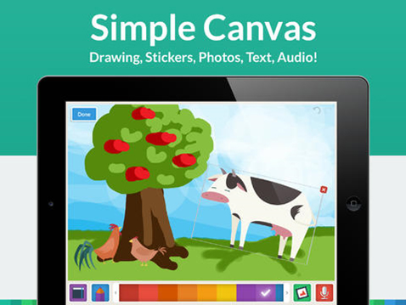
My Story Book Creator (School Edition - $5.99)
Also made for ages 6-8, this app enables students to create e-books using text, drawings, photos and voice recordings with the added bonus of hundreds of stickers for students to use to illustrate their stories.

Slide 9
Activities:
Design an e-book about a letter of the alphabet identifying words that begin with that letter. Use the Learn the ABC worksheets. Extend older students by using phonics instead of individual letters (such as those from the Easy Readers e.g. short vowel sounds).
View the Specialised English Lessons Writing module What’s in a Story? and Reading module Let’s Look at Narratives (Yrs 1 & 2) to guide students with creating e-books.
Create an e-book that retells a story from a different point of view of one of the characters e.g. Wendy and the Genie from the point of view of the genie (Storytime).

Slide 10
Activities:
Students read or view the Storytime story The Three Little Pigs, then use Worksheet #3 to inspire an e-book about a place that makes them feel safe OR Worksheet #4 to write a story that has a moral.
Compose an e-book that explains what happens after a story or poem has ended. Use the following worksheets to springboard this activity:
  Worksheet #3 for The Billy Goats Gruff and Worksheet #4 for Goldilocks (Storytime)
  Worksheet #2 for The Owl and the Pussycat (Rhyme Time).
Explore the Make and Do instructional texts, then ask students to create their own e-book that gives instructions about how to make something (such as a recipe) or how to play a particular game (such as snakes and ladders).

Slide 11
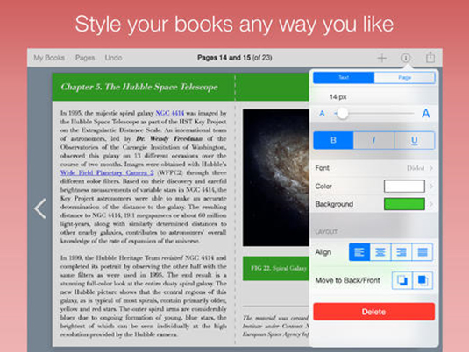
Extending Literacy:
Book Creator (free or $7.99 for full version)
This app was voted best educational app at the 2015 BETT awards and is appropriate for middle and upper primary also, as students can create more detailed texts.

Slide 12
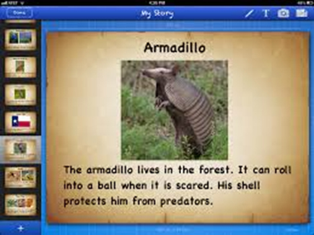
Story Buddy 2 (free or $1.49 for full version)
Made for ages 9-11, this app enables students to create their own e-books using customisable, text, imported images and photos, hand drawn pictures and voice recordings.

Slide 13
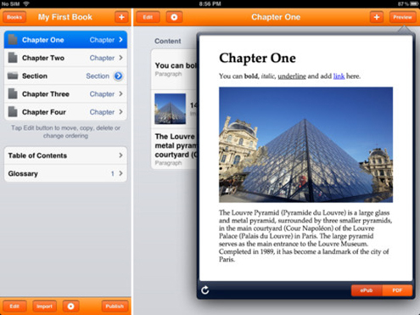
Creative Book Builder ($5.99)
Students can create detailed e-books using the usual elements, but this app also offers provision for including organisational elements of texts such as chapters, table of contents, glossary and footnotes.

Slide 14
Suggested Activities:
View the Write Time module How to Write a Story and use the worksheets to inspire the creation of e-books.
Create e-books using the activities outlined in the following Specialised English Lessons Writing modules:
  Imaginative Texts (Yrs 3 & 4) & Creating Imaginative Texts (Yrs 5 & 6) – Rewrite a popular story changing narrative elements.
  Who is Telling the Story? (Yrs 5 & 6) – Retell a story from a different point of view.

Slide 15
Suggested Activities:
Retell a popular myth or legend using one of the apps. Provide opportunities for students to read or view the Myths and Legends in the Reading Library to assist with this.
Use the following Reading Library Adventure Story worksheets to inspire
e-book creation:
  Live Dinosaur Tour Worksheet #4 – My Life as a Dinosaur
  Finders Keepers Worksheet #2 – Trapped in a Different Time
  Galaxy Chase Worksheet #4 – Space Narratives
(Older students could use the text creation ideas from Worksheet 2 for each of the Advanced Library Adventure stories).

Slide 16
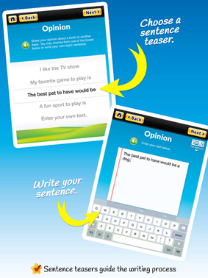
Apps for studying text structures and features
Using these apps offers students an opportunity to record their ideas in digital form, using structures and features relevant to the text type.
Developing Literacy:
Write to the Core (free or $1.49 for full version)
Offers pre-written sentence prompts to create simple opinion, informative/explanatory and narrative texts (aligned to U.S. Curriculum but still relevant to Australian & New Zealand Curriculum Writing outcomes).

Slide 17
Activities:
Explore texts such as storybooks, brochures, posters and print advertisements in the classroom e.g. Storytime imaginative texts, Make and Do informative texts and Happy Schools persuasive texts.
View the Specialised English Lesson Writing modules Words are Everywhere (Foundation) and What are Texts? (Yrs 1 & 2) to study the purposes of different text types.
Use the Write to the Core app to provide opportunities for students to compose their own simple opinion, information and narrative texts.

Slide 18
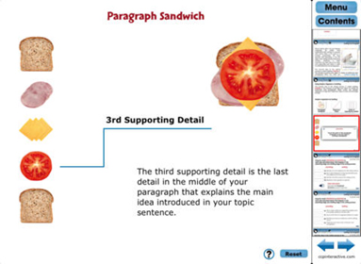
Extending Literacy:
How to Write a Paragraph (free or $1.49 for full version)
Guides students in building paragraphs for narrative, persuasive and informative texts.

Slide 19
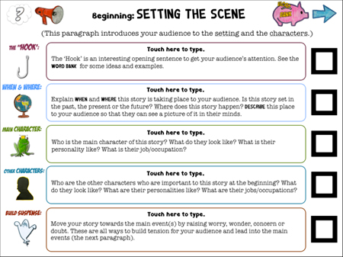
Writing a Narrative ($1.49)
Offers templates to guide students with structuring narrative texts, using common story elements.

Slide 20
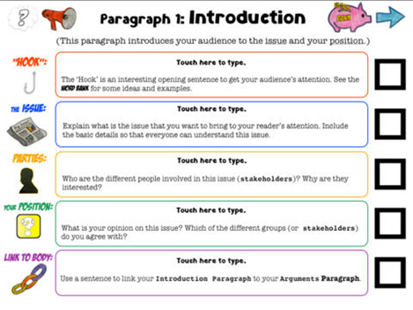
Writing an Opinion ($1.49)
Guides students in structuring a persuasive text. Includes onscreen writing prompts that demonstrate the language features of persuasive texts.

Slide 21
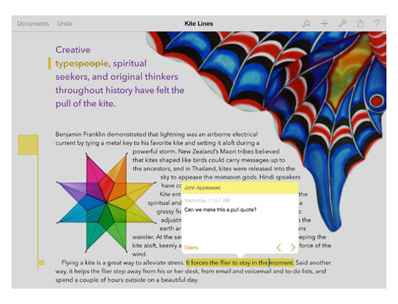
Pages ($14.99)
This app offers pre-designed templates to assist students in organising information into reports, posters or slide show presentations, using a wide variety of word processing features.

Slide 22
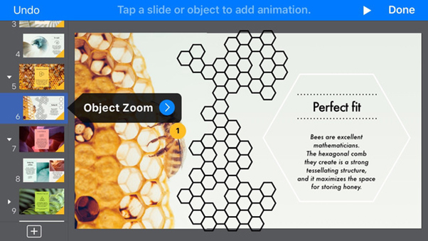
Keynote ($14.99)
Provides students with the tools to organise effective slide show presentations -using text, images, charts, tables and shapes, animations and transitions.

Slide 23
Activities:
Study paragraphing using the Specialised English Lessons Writing modules What is a Paragraph? (Yrs 3 & 4), Topic Sentences and Separating Information in Texts (Yrs 5 & 6) and use the How to Write a Paragraph app to practise this skill.
Explore different text types using the following Specialised English Lesson Writing modules:
  Yrs 3 & 4: Types of Texts and What’s in a Text? (Parts A & B)
  Yrs 5 & 6: Features of Texts and What are the Shapes of Texts?
Use the Write Time modules to assist students with developing their understanding of the structures and features of different text types. Use the Writing a Narrative and Writing an Opinion apps to create texts based on the ideas from the Writing a Story and Arguments worksheets and the Keynote or Pages apps to create information texts based on the Writing Information or Writing Instructions worksheets.
View the digital documentaries for the Children in History stories to inspire students to create their own information digital text using Pages or Keynote about a significant historical event/era.

Slide 24
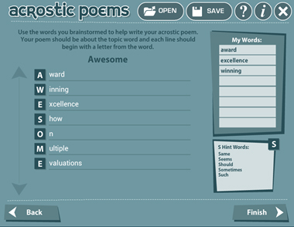
Apps for composing poetry
The International Reading Association offers a variety of apps for poetry composition. Each app focuses on a specific form of poetry and offers easy to follow guidelines.
Acrostic Poem (free)
Offers step by step instructions about creating acrostic poems by first brainstorming words to go with the letters and then using these words to create the poem.

Slide 25
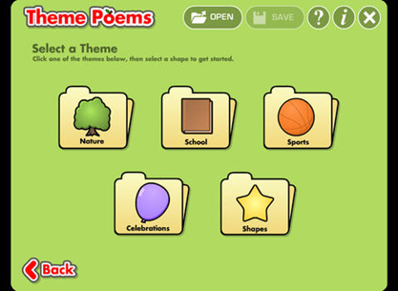
Theme Poem (free)
Enables students to create theme poems based on a variety of pre-set topics inside a shape related to the topic.

Slide 26
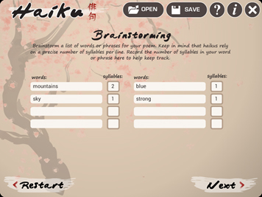
Haiku Poem (free)
Guides students through the composition process for writing haiku poetry, using initial brainstorming activities and pre-set templates.

Slide 27
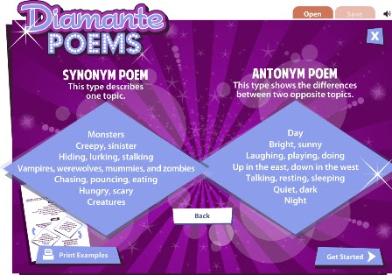
Diamante Poem (free)
Offers a guide for composing diamante poems using nouns, adjectives and gerunds to describe one topic or two opposing topics using a specific format.

Slide 28
Activities:
Developing Literacy:
Use the Theme Poem app to compose poems about classroom themes e.g. celebrations, sport, nature or ideas generated from shared texts, such as the Easy Reader stories I Wish… (fish shape) and Let’s Get Wet (raindrop shape).
Read the Rhyme Time poem The Rainbow and use the Diamante Poem app to create a poem about rainbows.
View the Specialised English Lessons Reading module Studying Poetry (Yrs 1 & 2) and encourage students to use some of these devices when composing poems using the apps.
Create acrostic poems that describe characters from shared texts e.g. the fairy, genie, dragon or pirate from the Wendy stories in Storytime using the Acrostic Poem app.

Slide 29
Activities:
Extending Literacy:
View the Write Time digital documentary How to Write Poetry to explore different types of poetry. Use the Haiku Poem app to compose poems about the beach at night.
Use the Acrostic Poem app to complete Runaway Worksheet #3 and the Diamante Poem app to complete The Secret Journey Worksheet #4 (Children in History).
Explore the poetry devices explained in the Specialised English Lessons Reading modules Nonsense Devices (Yrs 3 & 4) and Visual Imagery (Yrs 5 & 6) and encourage students to use these devices when composing poetry using the apps.

Slide 30
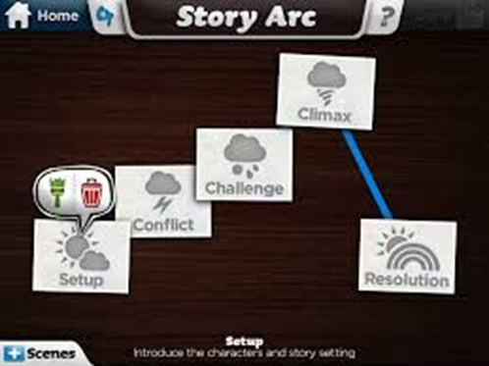
Apps for cartoon and comic creation
Students to create their own cartoon and comic strips using backgrounds, characters, sound effects and voice recordings.
Developing Literacy:
Toontastic (free)
Enables students to animate their own cartoons using their own drawings or pre-designed characters, backgrounds, special effects and voice recordings. Includes a ‘story arc’ to help students plan their narrative. Aimed at ages 6-8 years old.

Slide 31
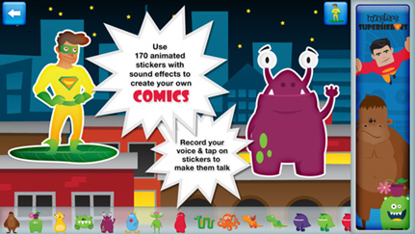
Superhero Comic Book Maker HD ($3.99)
Made for ages 3-9, this app enables students to create personalised animated comic books featuring monsters and superheroes. Includes pre-designed background scenes and animated stickers with sound effects and allows for voice recording.

Slide 32
Activities:
Use the Specialised English Lesson Reading module What’s in a Story? (Yrs 1 & 2) to explore elements of a narrative. Reinforce these concepts using the ‘Story Arc’ presented in the Toontastic app to assist students with creating their own cartoons.
View the Storytime story Wendy and the Pirate and the Puppet Play The Pirate’s Treasure to springboard a story about a cartoon about a pirate in Toontastic, using the ‘High Seas’ setting and ‘Pirates’ characters.
Explore human and non-human characters using the Specialised English Lesson Reading module Characters in Stories (Foundation). Use the Superhero Comic Book Maker app to create a story about a human character (superhero) or non-human character (monster).

Slide 33
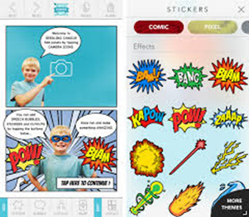
Extending Literacy:
Seedling Comic Studio (free with in app purchases for 2 themes - $1.49 each)
Made for ages 9-11, this app allows students to create their own comic book using photos, customised backgrounds, stickers, speech and thought bubbles and captions.

Slide 34
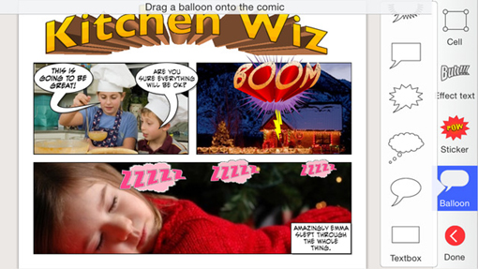
Strip Designer ($4.49)
This app enables students to use comic book templates to create their own personalised comic strips using photos, text balloons, stickers and drawing tools. It is rated 9+ for mild cartoon or fantasy violence.

Slide 35
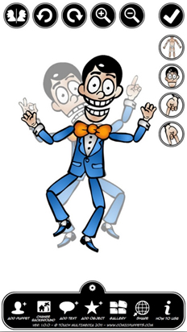
Comic Puppets
(free or $4.49 for full version)
Students can draw their own characters (or use pre-designed ones), then add accessories such as wigs, hats, expressions, objects and moveable limbs to create a comic strip.

Slide 36
Activities:
View the Skill Builder Comprehension module Visual Literacy to explore the key elements in a cartoon.
Use the following Specialised English Lesson Reading modules to assist students with creating effective cartoon and comic strips:
  The Grammar of Pictures (Yrs 3 & 4)
  What Do Pictures Say? Part A (Yrs 5 & 6)
  What Do Layouts Say to Us? (Yrs 5 & 6)
Read or view the Graphic Classics and discuss the features of the cartoon style presentations. Use one of the apps to create a cartoon based on a traditional fairy tale, myth or legend (eg Fairy Tales and Myths and Legends in the Reading Library).

Slide 37
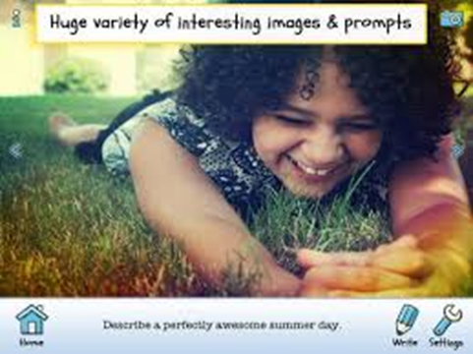
Apps for writing prompts
Writing prompts are a great way to get students planning and creating texts.
Developing Literacy:
Write About This (free or $5.99 for full version; has a New Zealand version for culturally accurate content)
Provides prompts for a variety of text types e.g. imaginative, reflective and descriptive writing. There is also provision for students to create their own prompts using pictures, text and audio.

Slide 38
Activities:
Familiarise students with how to use writing prompts to inspire text creation using Story Machine (Ziptales’ story generator). Explore the settings, characters and plots available and use them to complete a shared or individual writing piece.
Use the writing prompts to inspire shared or individual classroom writing sessions, then provide opportunities for students to share their written pieces.
Students use the Write About This… app to create their own prompts, using themes or topics being studied in the classroom.

Slide 39
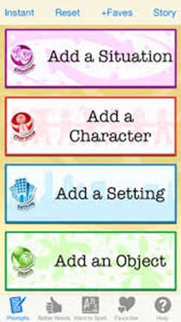
Extending Literacy:
Writing Prompts for Kids - $2.99
Students use writing prompts to create imaginative texts by selecting a situation, character, setting and an object to inspire the story.

Slide 40
Activities:
View the Write Time module How to Write a Story to assist students with planning and creating an effective narrative using the writing prompts.
Study the elements of narrative texts using the Specialised English Lessons Reading modules Describing a Setting and Narrative Texts (Yrs 3 & 4), and Interpreting Texts (Yrs 5 & 6) to assist students with creating texts based on the prompts generated from this app.
Provide opportunities for students to work together to create shared texts based on the prompts.

Slide 41
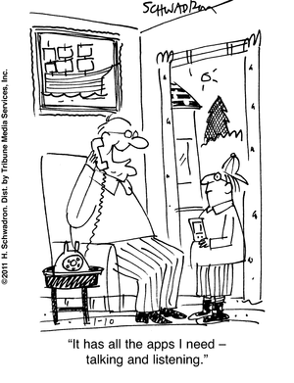
Apps for Communicating Verbally
Often, tablets are seen as primarily solo devices.
There are however many apps that you can use to develop verbal communication skills in your students.

Slide 42
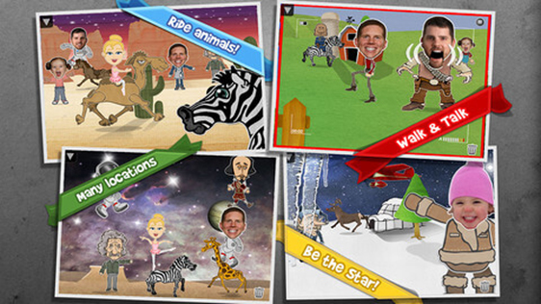
Developing Literacy:
Puppet Pals 2 –
School Edition ($9.99)
Students can create animated cartoons using a huge variety of pre-set characters and backgrounds (or they can customise their own) and provide voiceovers to tell a story.

Slide 43
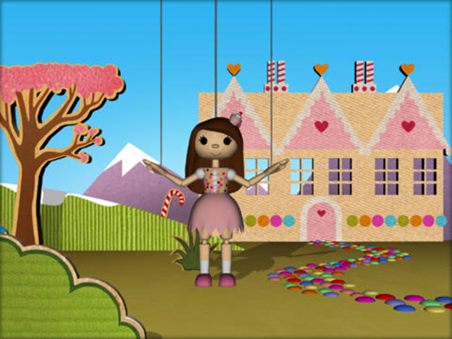
Puppets (free)
Allows students to animate pre-designed string puppets to tell a story, using backgrounds and voiceovers.

Slide 44
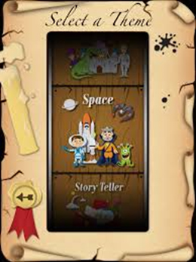
Story Wheel Storyteller ($1.49)
Students can work together to orally tell a story based on images that appear by spinning a wheel.

Slide 45
Activities:
Use the script ideas for Puppet Plays to provide an opportunity for students to practise telling a story orally, then refine these skills using the Puppet Pals or Puppets app.
Students view the Storytime story The Three Little Pigs. Explore common story themes using Worksheet 4, then use the Puppet Pals or Puppets app to create a story that has a moral.
View the Puppet Play The Octopus. Use Activity 1 from the worksheets to explore the concept of ‘One good turn deserve another’. Use the characters and scenes in Puppet Pals or Puppets to work with a partner to create a puppet play that demonstrates this main idea.
Explore the behaviours of successful group work by viewing the Specialised English Lesson Oral Language modules How to Work in a Group (Foundation) and Working Together (Yrs 1& 2), then use the Story Wheel Storyteller app to practise these skills.

Slide 46
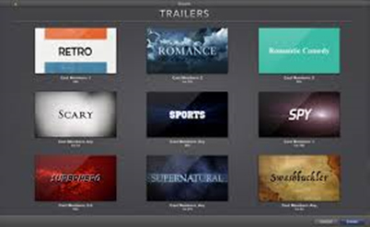
Extending Literacy:
iMovie ($7.99)
Provides the medium for students to create their own movies and movie trailers, using suggested guidelines, themes, music, voiceovers, photos and videos.

Slide 47
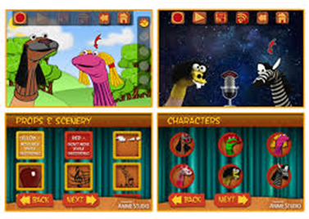
Sock Puppets (free, with in-app purchases)
Students can create their own puppet plays using sock puppets.

Slide 48

Free Chinese Shadow Puppets (free or $1.49 for full version)
Teaches students how to create shadow animal puppets using their hands.

Slide 49
Activities:
View the Children in History photo stories. Create an iMovie trailer that focuses on a historical event relevant to classroom themes or topics of study.
Students work together to create a short iMovie that advertises an amazing new product.
Explore positive group work behaviours by viewing the Specialised English Lesson Oral Language modules Group Work (Yrs 3 & 4) and Effective Group Work (Yrs 5 & 6), then encourage students to practise these skills whilst creating a movie or movie trailer in iMovie.
Imagine one of the True Tales in the Reading Library was being made into a movie. Students work together to create its iMovie trailer.

Slide 50
Activities:
Create an iMovie trailer about a topic being studied in the classroom e.g. cultural diversity – Bollywood trailer; Antarctica – expedition trailer.
Working in pairs or small groups, student use the Free Chinese Shadow Puppets app to create a hand puppet play to perform to an audience e.g. a younger class or an assembly.
Use the Sock Puppets app to practise the use of formal and informal language. View Specialised English Lessons Oral Language modules Ways of Speaking (Yrs 3 & 4) and Who are we Talking to? (Yrs 5 & 6) to assist with this concept.

Slide 51
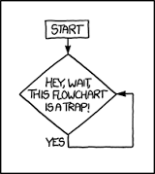
Apps for Organising Information
Organising information using a graphic organiser provides an effective means for synthesising information in a visual way.

Slide 52
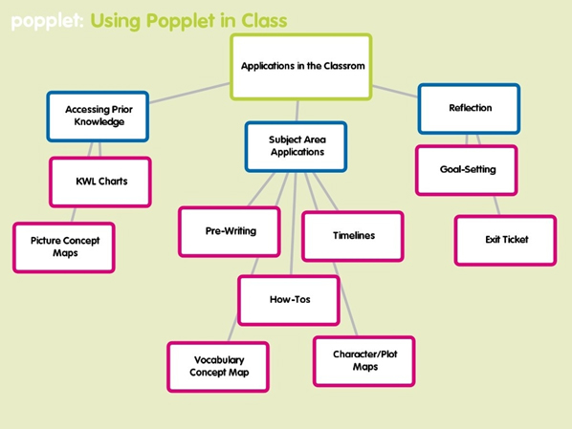
Developing Literacy:
Popplet (free or $7.99 for full version)
Enables students to organise ideas and information visually, using linked text boxes.

Slide 53
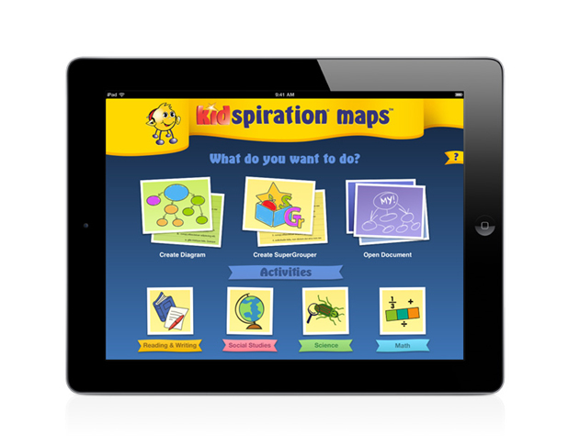
Kidspiration Maps (free or $14.99 for full version)
Provides students with the tools to organise and classify information by creating their own graphic organisers, such as story maps, Venn diagrams and concept maps.

Slide 54
Activities:
View the Learn the ABC modules and ask students to create a concept map about a letter of the alphabet by placing the letter in the middle and using links to write or draw things that begin with that letter or use the Easy Readers to create a concept map about words with short vowels or beginning blends using one of the apps.
Students use one of the apps to organise information using the tasks from the Specialised English Lesson Oral Language module What do you Think? (Yrs 1 & 2). Create a mind map about their likes and dislikes, or favourite after school activities, or favourite book.
Use the following worksheets to inspire graphic organisers using one of the apps:
  Worksheet Activity #2 from The Sea Monster (Puppet Plays) – a mind map about the sea monster’s home.
  Worksheet Activity #2 for The Pirate’s Treasure (Puppet Plays) – a mind map about what they can see, hear and feel at the picnic location.
  Worksheet #1 for The Wind (Rhyme Time) - a concept map of all the ways the wind is helpful.

Slide 55
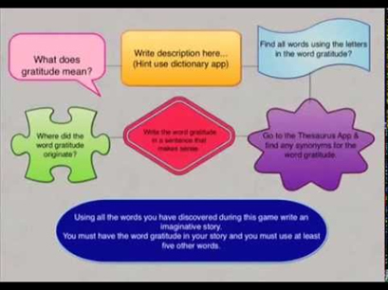
Extending Literacy:
Grafio (free or $12.99 for full version)
Students can create graphic organisers by drawing, sketching and connecting shapes for diagrams and schematics. Offers audio recording and pre-set stencils.

Slide 56
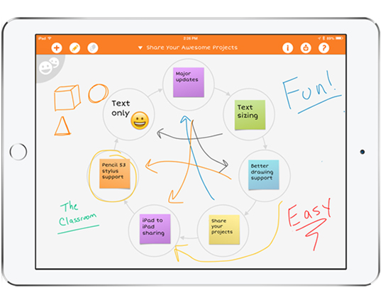
iBrainstorm (free)
Enables students to add notes and drag and drop them anywhere on the screen to organise ideas in a desired fashion. Offers drawing tools and colour coding.

Slide 57
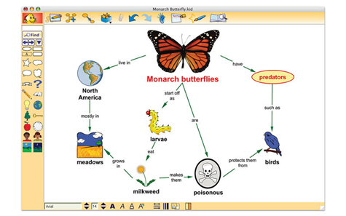
Kidspiration Maps (free or $14.99 for full version)
As mentioned in the Developing Literacy section, this app is also applicable to older students, as it enables them to create more detailed graphic organisers using a variety of tools.

Slide 58
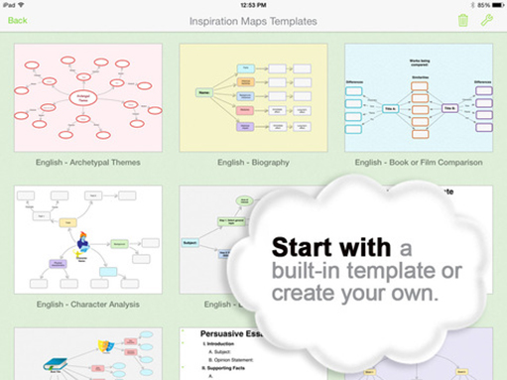
Inspiration Maps (free or $14.99 for full version)
Provide the tools for students to create their own diagrams and graphic organisers, using a variety of pre-set templates such as cause and effect diagrams, family trees and concept maps.

Slide 59
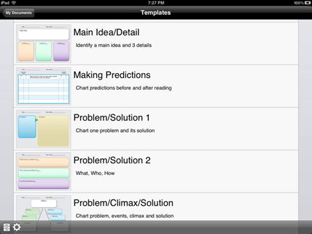
Tools 4 Students ($1.49)
Offers templates of graphic organisers to support high level reading comprehension skills.

Slide 60
Activities:
View the Specialised English Lesson Reading modules Graphic Organisers (Yrs 3 & 4) and Mapping Information (Yrs 5 &6) then explore how graphic organisers work using one of the apps.
Inspire the design of a graphic organiser using one of the apps with the following worksheets:
  Worksheet #8 for The History of Puppets (Puppet Plays - Developing Literacy) – describing a particular type of puppet.
  Worksheet #2 for The Bell and the Bushrangers (Children in History) – describing one of the characters.
Use the following Specialised English Lessons to explore high level reading comprehension skills then use the Tools 4 Students app to organise information about selected Reading Library stories:
  Understanding Texts - Part A (Yrs 3 & 4)
  Comprehension Strategies and Finding the Main Idea (Yrs 5 & 6)

Slide 61
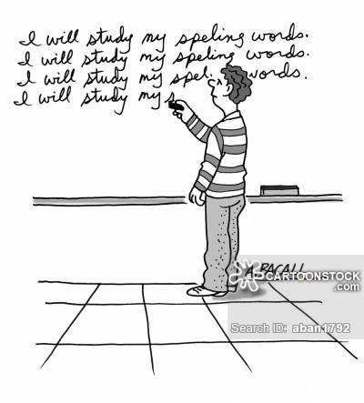
Apps for Building Spelling Knowledge
Building students’ spelling knowledge is an important component of all English programs.

Slide 62
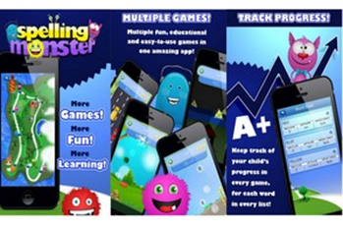
Developing Literacy:
Spelling Monster (free or $2.99 for full version)
Enables students to practise their own customised spelling list words, using interactive games.

Slide 63
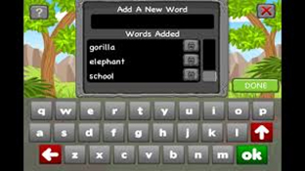
Spellosaur (free or $5.99 for School Edition - full version)
Using a customised list of words, students play spelling games to help them learn the words.

Slide 64
Activities:
Use the apps to assist students to learn set class spelling lists, personal words generated from writing tasks OR use the following word banks:
  Focus words from the Easy Readers phonics based stories (e.g. Short ‘a’ words from ‘Bad Cat’ – bad, cat, dad, mad, rag, had).
  Goldilocks Worksheets #1 & #2 and Little Red Riding Hood Worksheet #1 (Storytime).
  Worksheet #1 for each of the Timeless Tales.
  Word families generated from the activities in the Specialised English Lesson Writing module Word Families (Foundation).

Slide 65
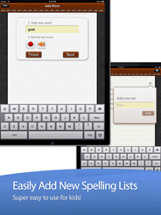
Extending Literacy:
A+ Spelling Test (free or $1.49 for full version)
Allows for teachers (or students) to enter a customised spelling list for students to practise, then be tested on.

Slide 66
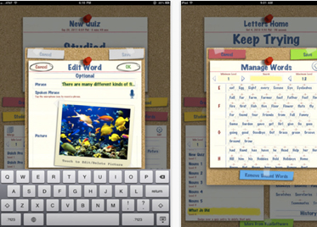
Spellboard ($7.99)
Offers a variety of games and activities to help students learn words from a customised spelling list. Has built in speech technology but also allows for a voice recording option.

Slide 67
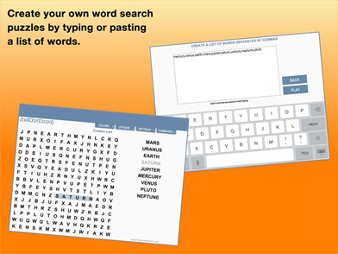
Just Word Search (free)
Enables students to create their own word searches using a list of words. They can be resized to increase level of difficulty.

Slide 68
Activities:
Use the apps to help students learn set classroom spelling lists or use the word banks provided in the following activities to create spelling lists for students to study:
  Aladdin Worksheet #1 from Graphic Classics
  Fill the Gaps Spelling worksheets in Skill Builders
  Specialised English Lessons Writing modules Why is English Spelt so Strangely? (Years 5 & 6)

Slide 69

Happy ‘App’ing!
We hope by providing you with this information we have equipped you with a wide variety of ideas about how to use apps effectively to support your literacy program.
Thank you.

Slide 70

Questions and Answers…

Slide 71
If you are not a subscriber yet, register for a 30 day free trial of Ziptales at www.ziptales.com

